Slide 1

Organizing the Digital Environment to Support Neurocognitive Differences

Slide 2
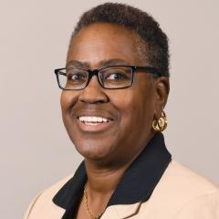
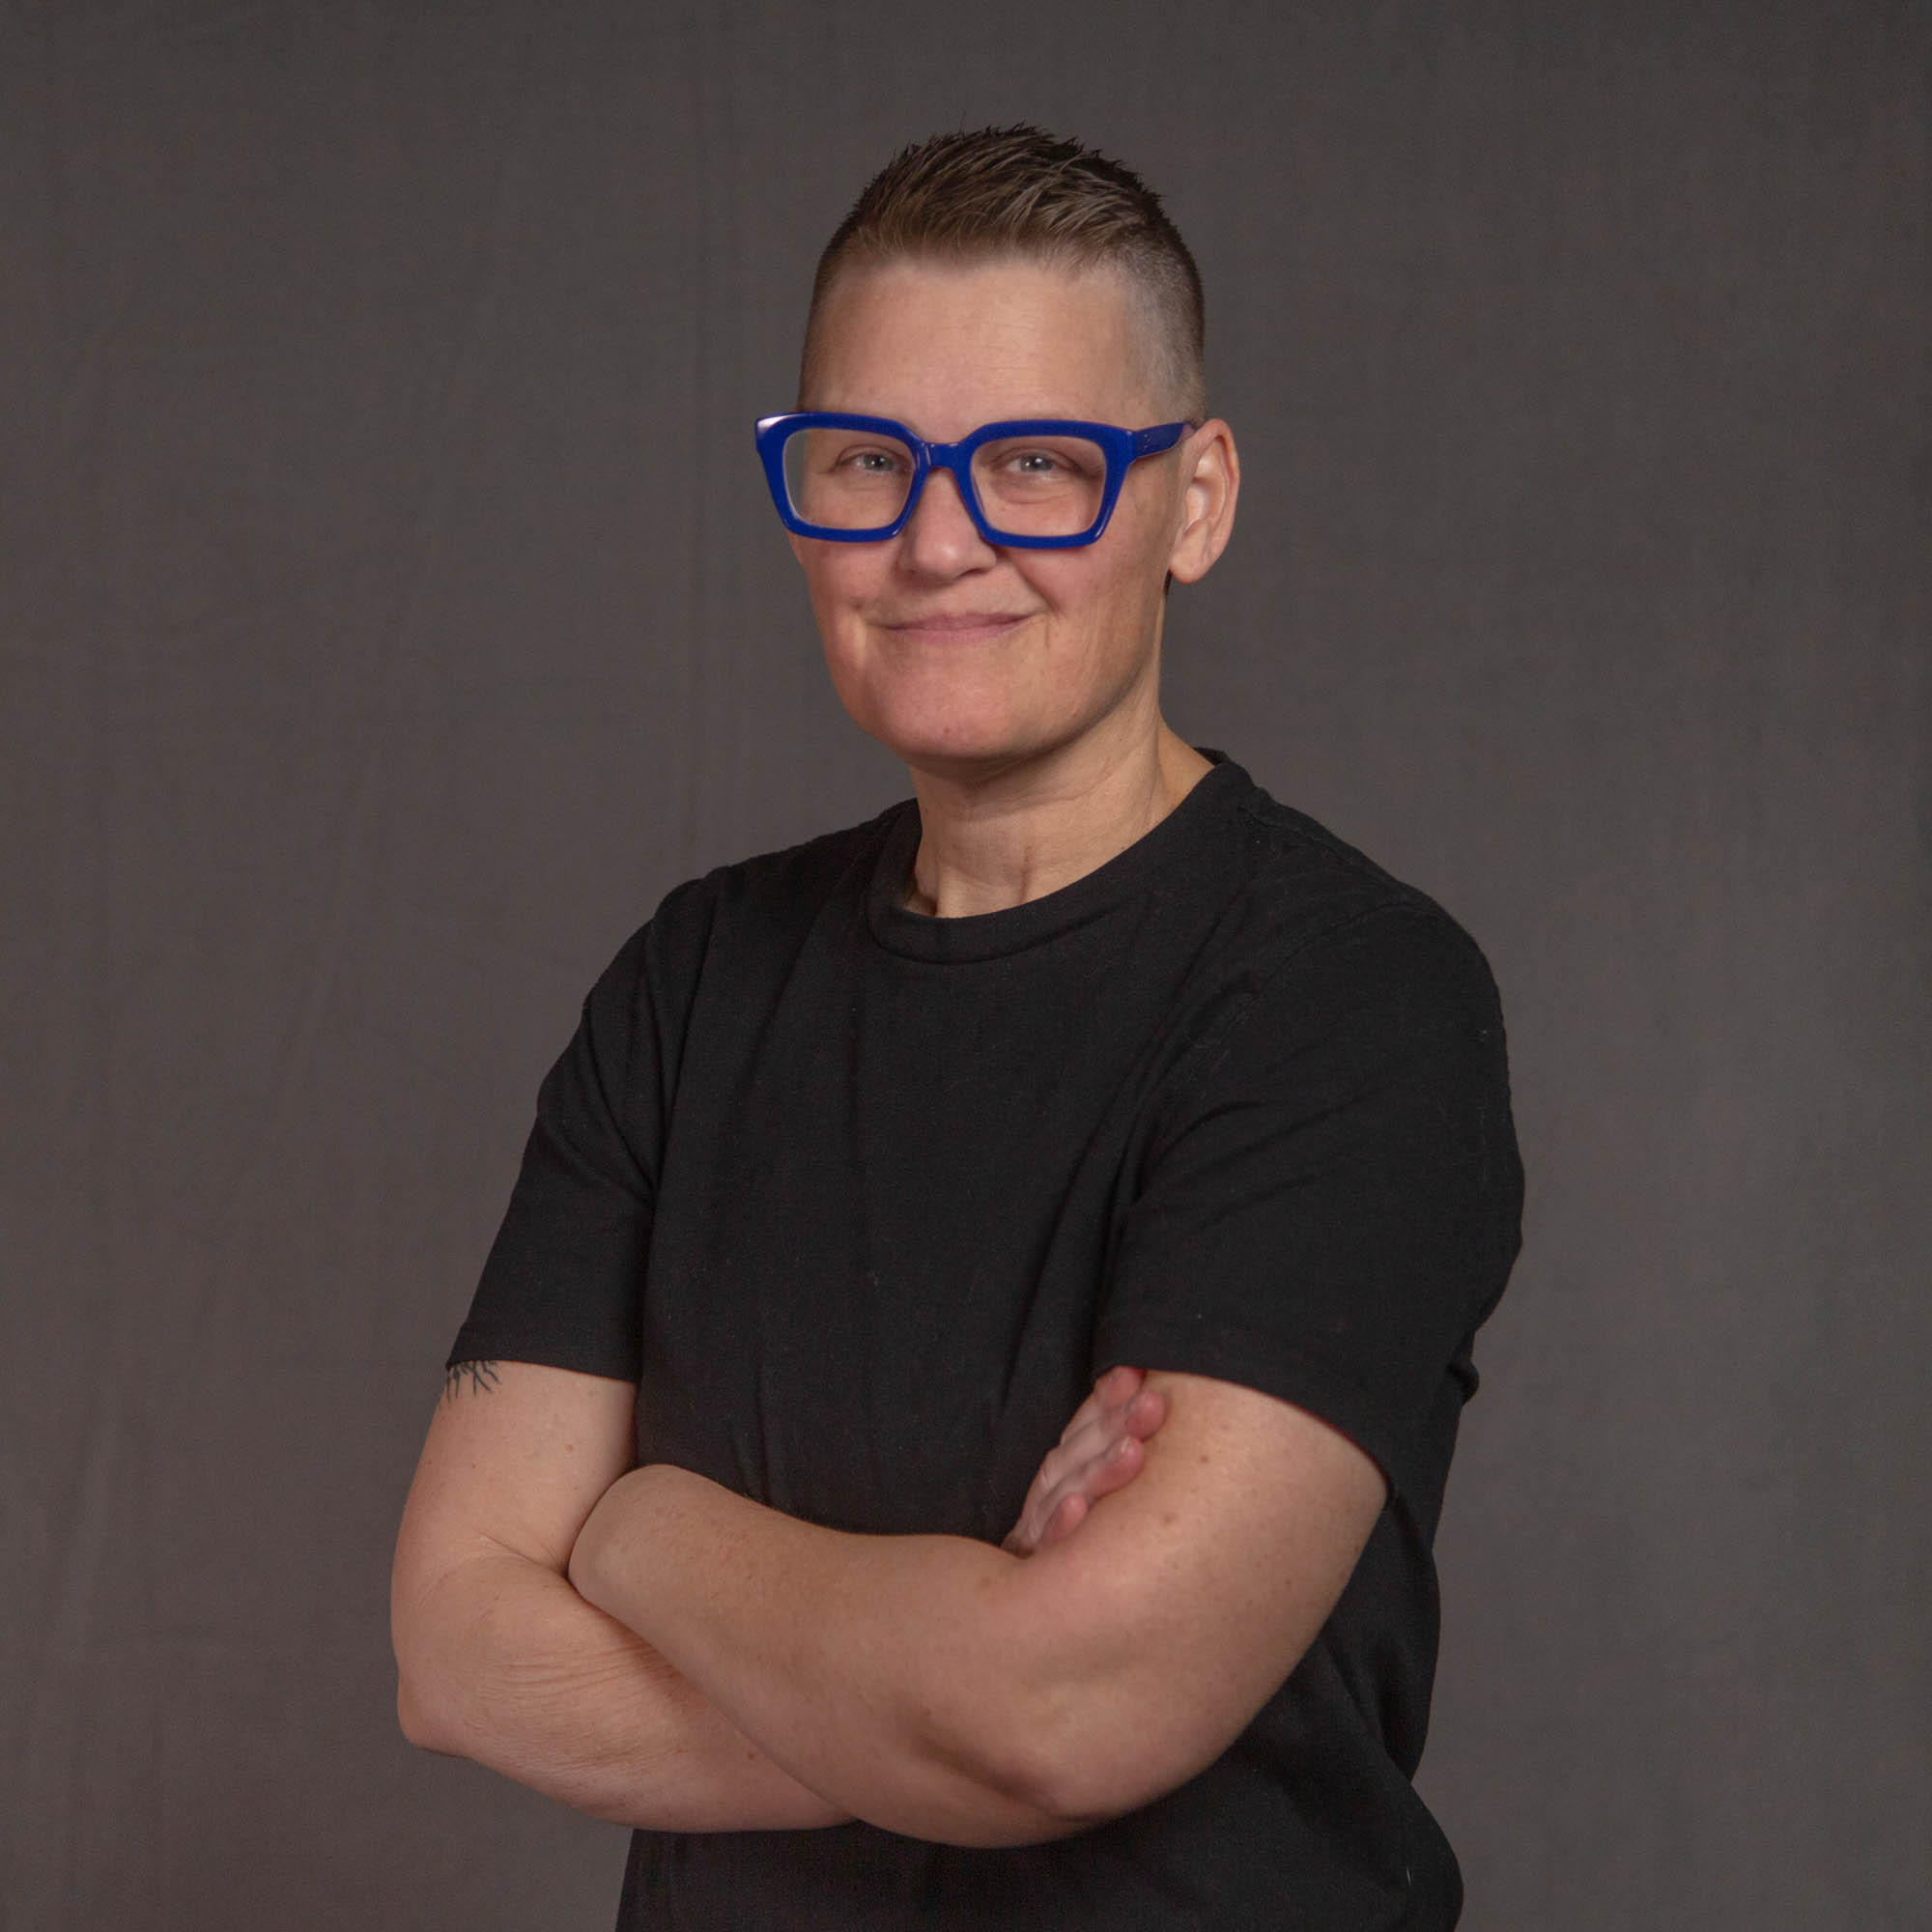
Session Presenters
Adero Allison, PhD
Assistant Director, Disability Resources
London Skiles, MEd
Instructional Designer, EdPlus@ASU

Slide 3
ASU Charter
ASU is a comprehensive public research university, measured not by whom it
excludes, but by whom it includes and how they succeed; advancing research and discovery of public value; and assuming fundamental responsibility for the
economic, social, cultural and overall
health of the communities it serves.

Slide 4
Agenda
Defining neurocognitive differences
The impact of design decisions
Design decisions to improve the student experience

Slide 5
Defining Neurocognitive Differences
Mobilization (gross motor skills)
Manipulation (fine motor skills)
Cognition
Sensation
Integration (internal vs external stimuli)

Slide 6




The Impact of Design Decisions
Input
Taking in new information or stimuli
Learning
Processing information
Memory
Storing
Information
Output
Recalling information

Slide 7
Jake – Organization

Slide 8
Design Decisions for Organization
Consistent Layout
Course Navigation
Module Progression
Page Content
Clear Instructions
Headings and lists
Step-by-step instructions
Sample submissions
Clear grading criteria
Minimize Change
Consistent days
Regular communication

Slide 9
Michelle – Time Management

Slide 10
Design Decisions for Time Management
Executive Function
Checklists
Adding “to-do” pages
Announcements
Regular Feedback
Smaller formative assessments
Weekly Check-ins
Flexibility
Due Dates
Positive Intent

Slide 11
Luna – Focus

Slide 12
Design Decisions for Focus
Chunk Content
Small blocks of text
Shorter Videos
Active Learning
Context
Guided Questions
Interactive Tools
Accessible Videos
Captions
Timestamps
Knowledge checks
Avoid unnecessary background music

Slide 13

Questions

