Slide 1
Accessibility for Social Media
Let’s Go!

Slide 2
ASU Charter
ASU is a comprehensive public research university, measured not by whom it
excludes, but by whom it includes and how they succeed; advancing research and discovery of public value; and assuming fundamental responsibility for the
economic, social, cultural and overall
health of the communities it serves.

Slide 3
Up to 27% of Americans have a disability!

Slide 4



Accessibility is more than you might think
There are ~ 331.9 million Americans
12.8 percent of U.S. ~ 42.5 million people have a cognitive disability with serious difficulty concentrating, remembering, or making decisions.
6.1 percent of U.S. ~ 20.2 million people are deaf or have serious difficulty hearing.
4.8 percent of U.S. ~ 15.9 million people have a vision disability with blindness or serious difficulty seeing even when wearing glasses.
Reference
Notes:
You also should take note that sometimes these disabilities are temporary. You had a bad eye injury so you’re vision isn’t great. Maybe you just went to see Taylor Swift or Beyonce in concert and your ears aren’t performing up to par.

Slide 5
Alt Text - Why should we take the time?

Slide 6

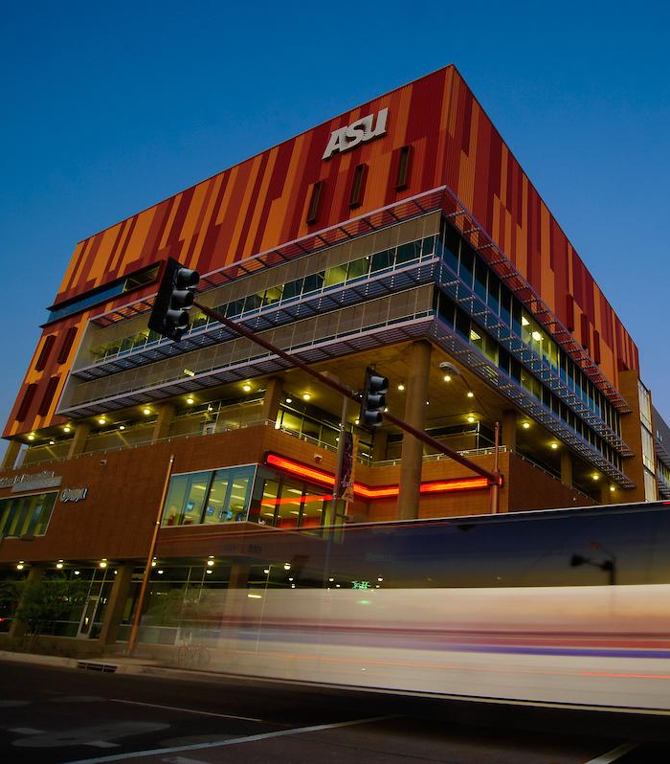
Alt Text
Alt text is critical for those who use screen readers, particularly those who are visually impaired or blind, to process images on a page. It provides semantic meaning to, and a description of, and image. It is also used by search engines to return search results.
Reference material

Slide 7
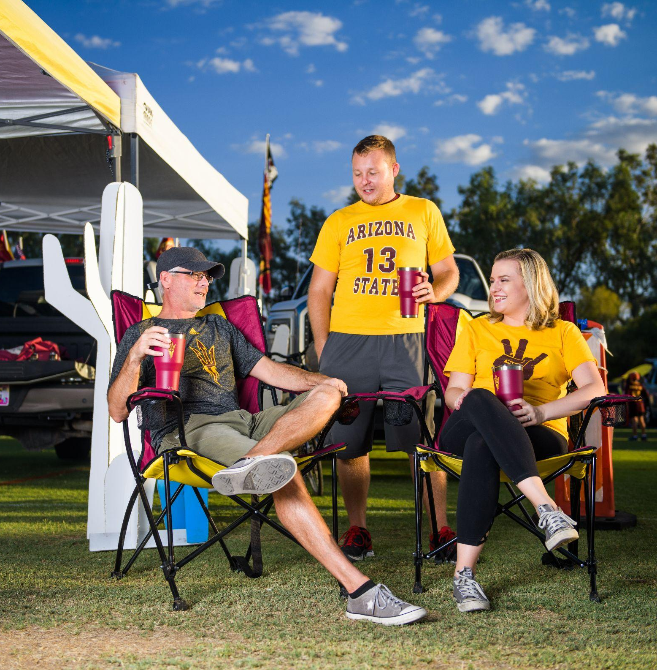
Here are some tips for alt text…
Identify the purpose.
Does the image create a mood or portray something specific?
If an image is decorative, meaning it doesn’t provide any additional value, you can write the alt text as null.
Tip - One way of finding the purpose is to disregard the image and only read the content and then re-look at the document along with the image. What additional information or mood does the image convey?

Slide 8
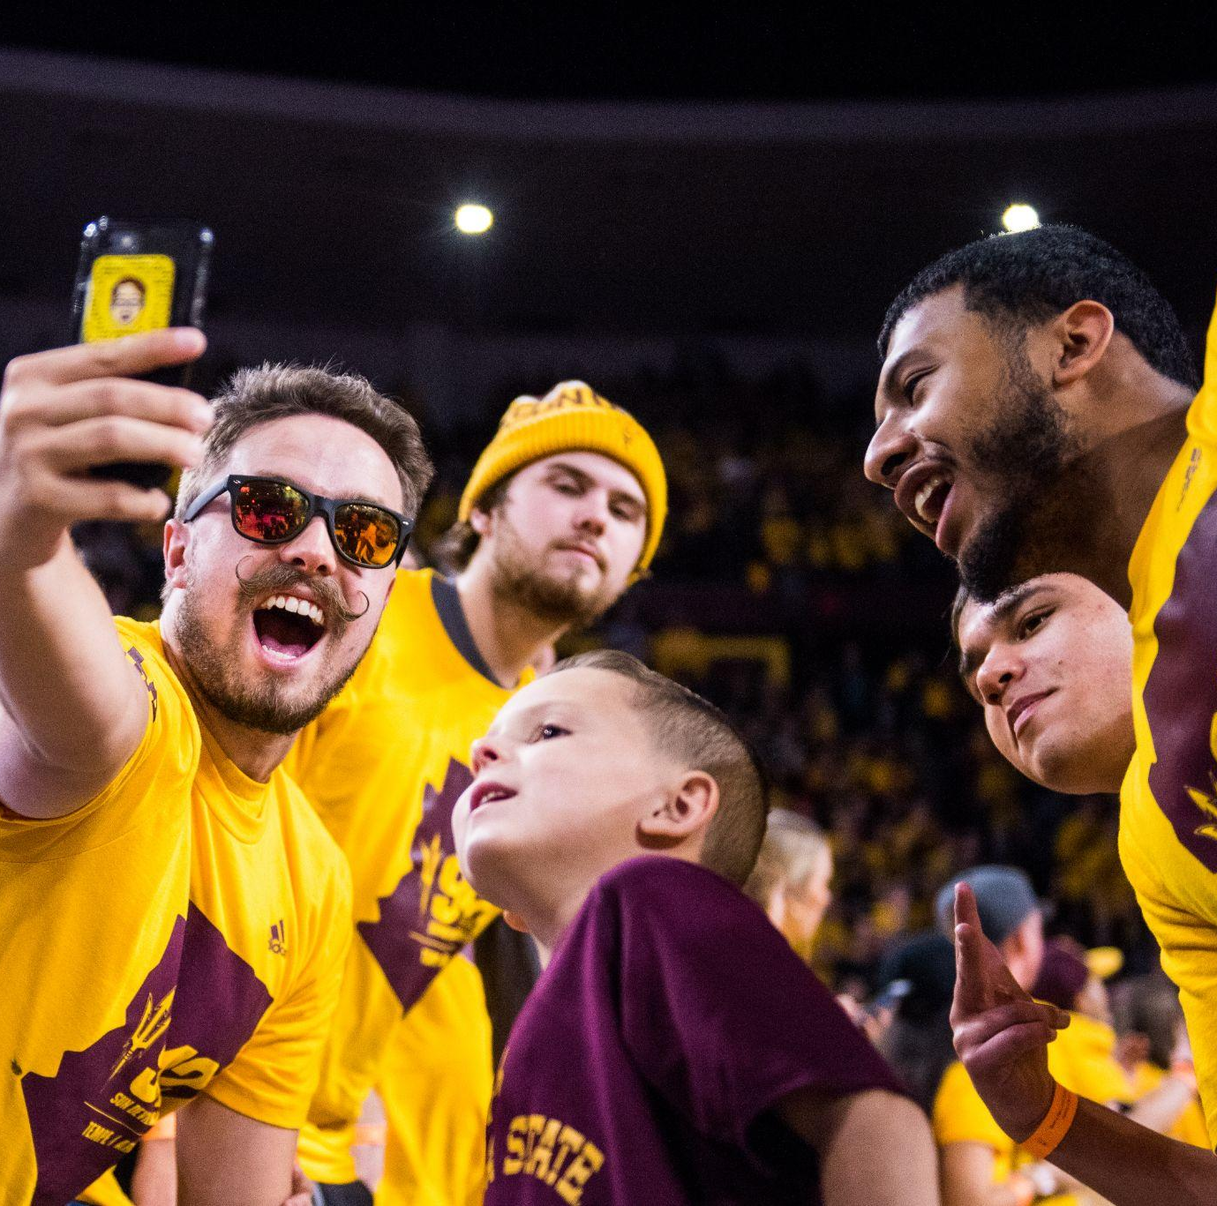
Be concise and accurate
A good alternative text provides a precise description of the image and conveys what is most important. If it requires for you to “set the mood” then do so.
  Ex: Student jumps for joy during a graduation ceremony.
  A family sits together, holding hands, devastated by the loss of their furry friend.
Be accurate and ensure that all of the information that you are adding to the alt text is correct.
Tip - Close your eyes for a few seconds. What are the highlights of the image that you are remember?

Slide 9
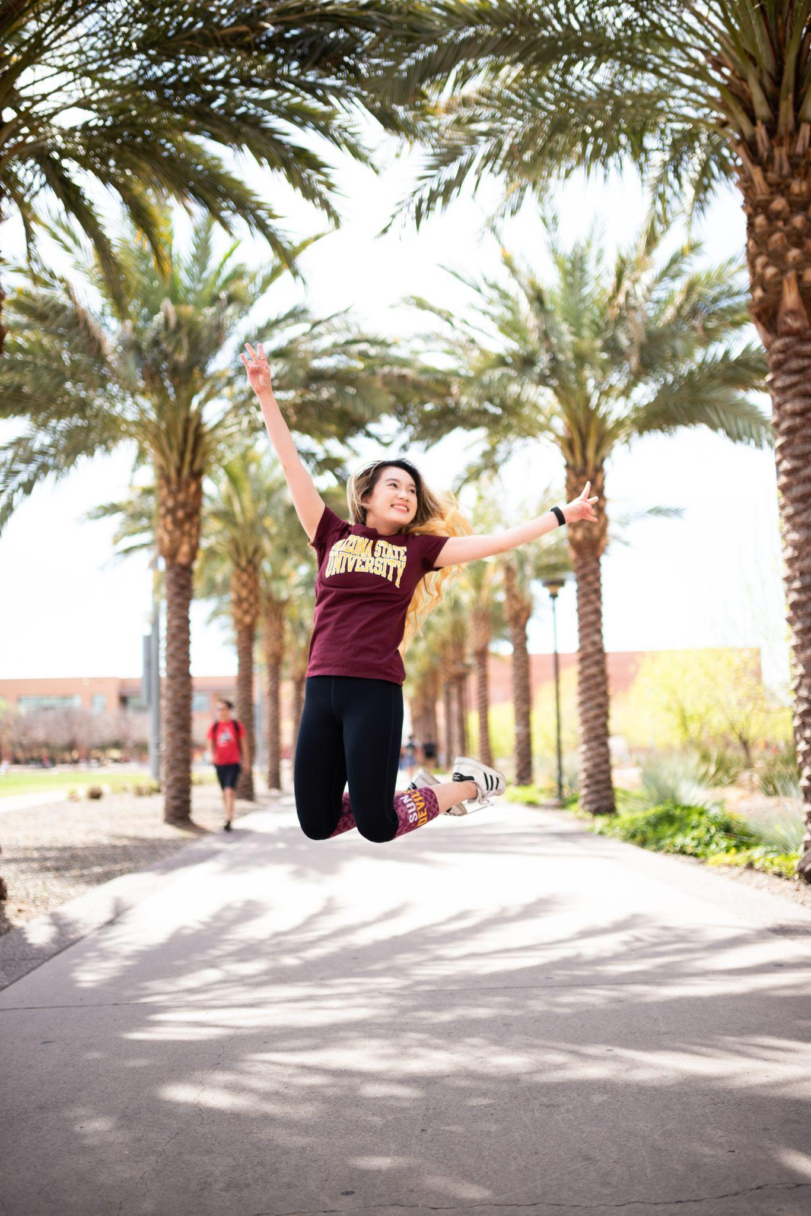
Be equivalent.
The purpose of writing alternative text is to provide a textual description of the image without losing or adding information so that it is equivalent to what a sighted user would normally gauge from viewing the image.
Omit extra information. Ex. If the student is not identified in the copy, there is no need to be that specific in the alt text.
If the person is known and you acknowledge them in the copy of the post, feel free to use their names in the alt text. (ex. You have a picture of Dr. Crow with Sparky for Mascot day. Your alt text should read. “President Michael M. Crow smiles with Sparky”...)

Slide 10
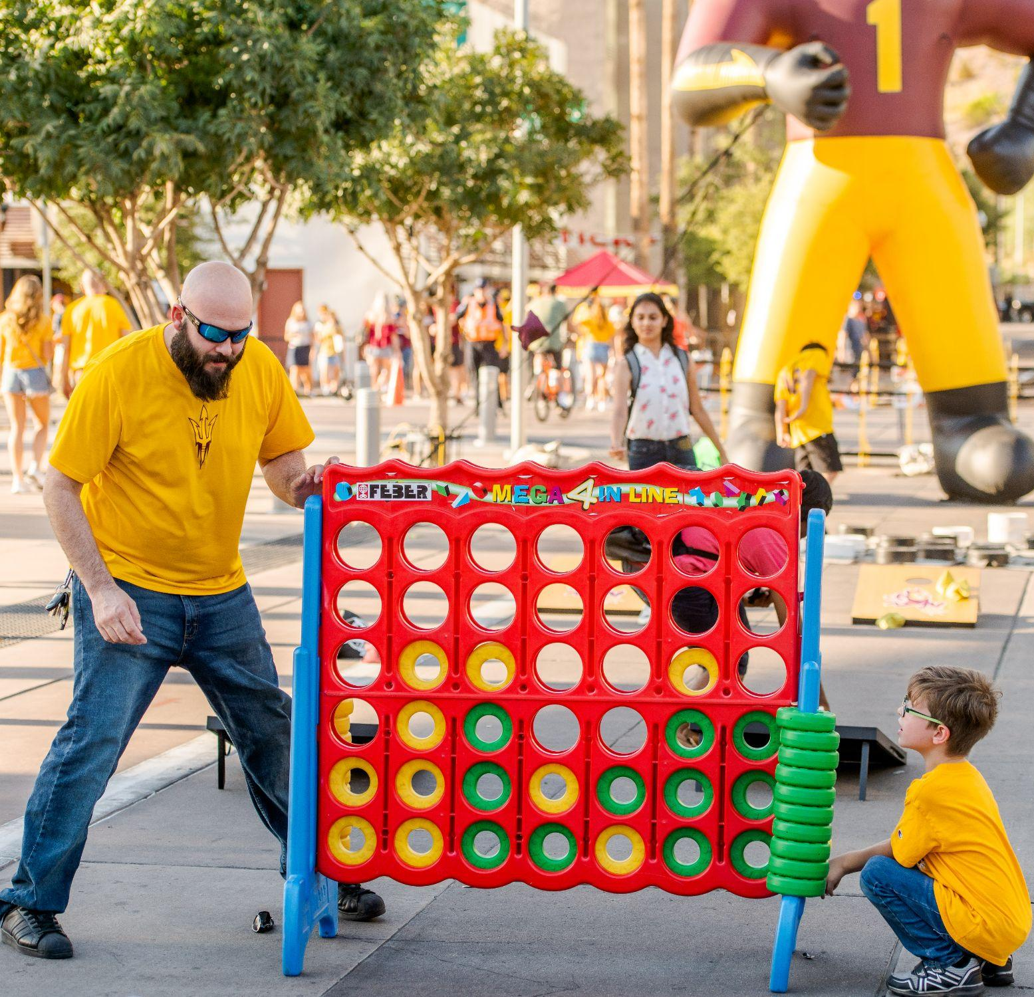
Use language appropriate for the audience and matching the post.
For example, if you have to provide alternative text for the image of a human body in a health insurance form. First, you would see whether the image is used for marking out diseased areas on the body or it is used to explain a certain disease explained in the surrounding content. Secondly, since the targeted audience is a customer (general public), even if a detailed description is required, you would need to keep the medical terminologies to a minimum and use them only if required.

Slide 11
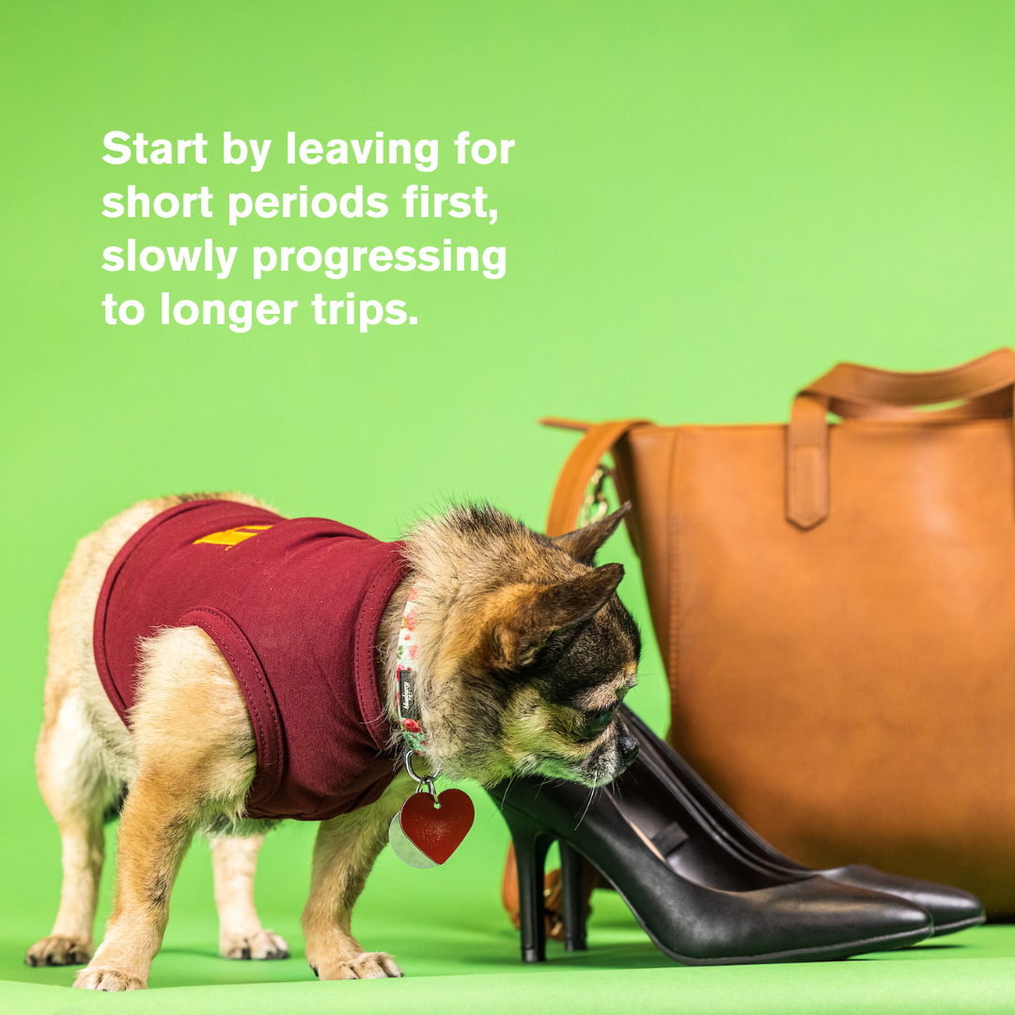
Use proper punctuation and sentence structure.
Even though the alternative text is going to be read out by the screen reader, proper punctuation does matter. Whenever the screen reader comes across a comma or a period, it takes a pause (a small one for a comma and a long one for a period). This gives the user a more pleasant and natural experience when listening to the alternative text.
If there is text on the image, make sure that you include that as well, since screen readers can not pick up text that is embedded into an image.

Slide 12
Video - Why captions and audio are important

Slide 13
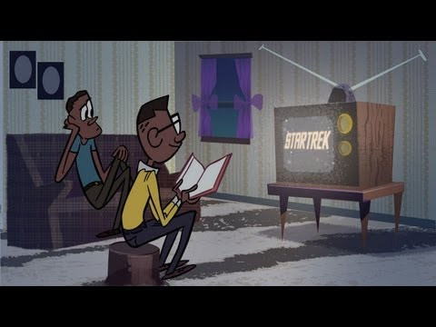
For the next 10 seconds, close your eyes.
1. What was the video about?
2. What important information did you get/miss?
Start at 15 seconds.

Slide 14
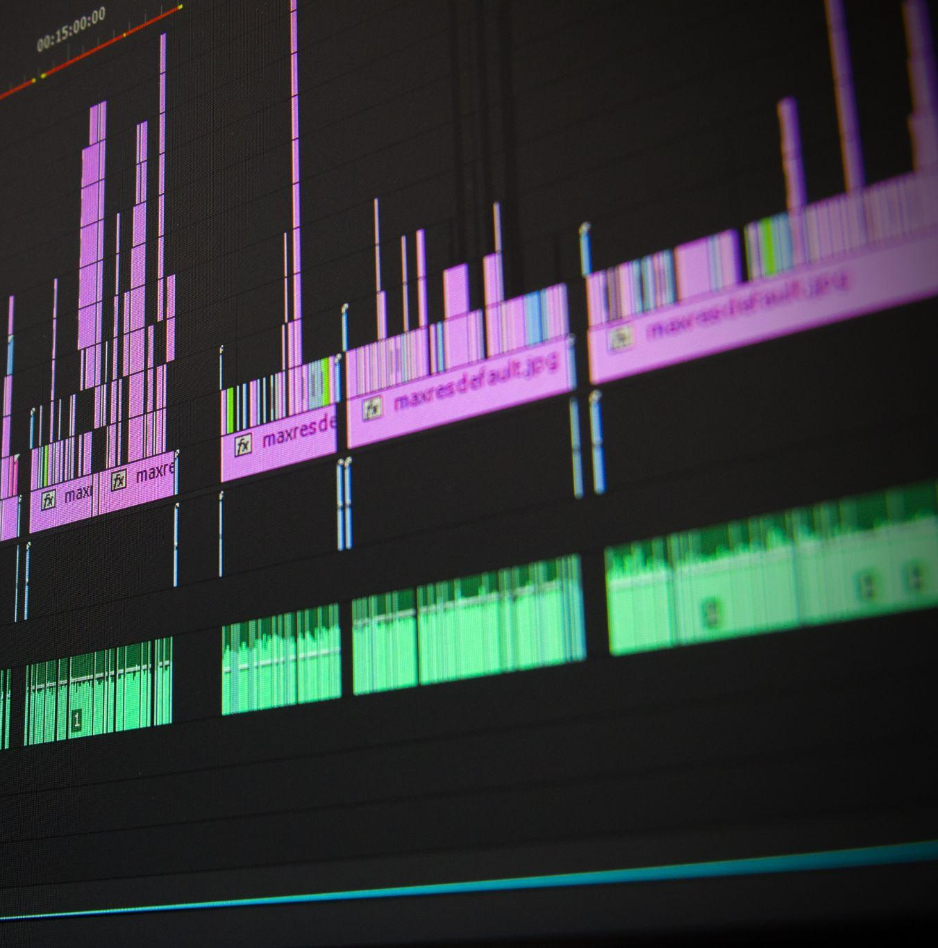
Audio is important for those who are visually impaired or also have a learning disability such as dyslexia. In the same way alt text provides information about a photo, audio helps provide the user with the context.

Slide 15
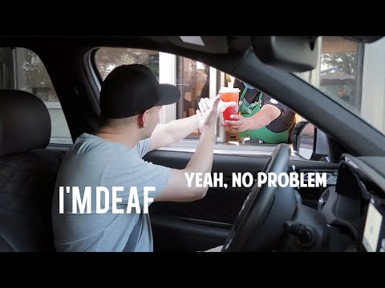
For the next 10 seconds, watch the video. Make sure the cc (closed captioning) is off.
What were these two talking about?
What if every video you saw online, you couldn’t get context for?
Start at 51 Seconds

Slide 16
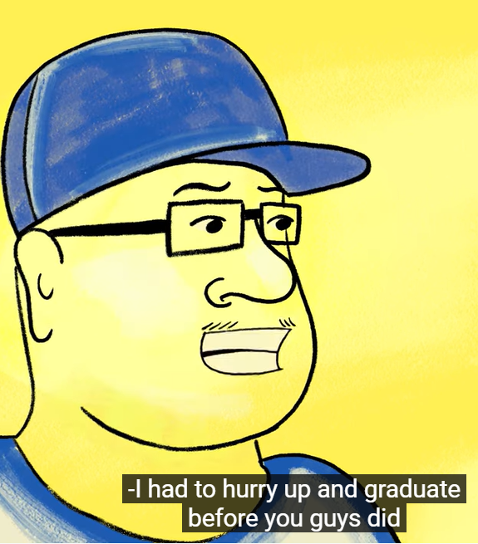
Captioning allows those who are hearing impaired to still engage with the content. Using clear and precise language is important and should be reviewed before publishing. The easiest way to utilize captions for social is to use open captions, or burn the captions in. This insures that nothing is being covered, like the lower thirds.

Slide 17

You got support!
Check out the ASU Accessibility page for info on adding captions and alt text to video and photos.
If you’re looking for social media specific information, you can find an extended version of this presentation and more on the Accessible social media page.

