Slide 1
Accessible Listening
Inclusive Uses of Sound in the Classroom
Charles Eppley (they/he)
Assistant Teaching Professor of Interdisciplinary Arts & Performance
School of Humanities, Arts & Cultural Studies (SHArCS)
Arizona State University
Notes:
Abstract: This program will examine when and how to accessibly use sonic media in the classroom. Hearing is a biological process; the act of listening is a social process. Both can provide barriers to learning. The way that we hear and listen is deeply informed not only by physiological abilities, but also by conscious and unconscious cultural perspectives. No one student will hear or listen to (and interpret) sound-based educational materials in the same way. Further, many students are d/Deaf, Hard of Hearing, or have audio processing disabilities. This session will discuss the social and pedagogical opportunities and barriers to using sound recordings, such as music, documentary audio, or audiovisual material, in class (especially in online settings) and will define and illustrate concrete accessibility values and practices that can reduce barriers to aural knowledge, including sound description and captioning.

Slide 2
A little bit about me…
I am a teacher-scholar and interdisciplinary art historian. I specialize in face-to-face and online teaching.
I work in the fields of disability studies, sound art, and media studies. I am interested in how sound, disability, and technology intersect in media environments.
In addition to my role at ASU, I am a researcher in the Proclaiming Disability Arts initiative at the NYU Center for Disability Studies. I also work as a sound describer/captioner.

Slide 3
Sound in the classroom
How often do students encounter sound in the classroom?
What forms do sonic media take?

Slide 4
Sound in the classroom
How often do students encounter sound in the classroom? Often!
What forms do sonic media take? Many!

Slide 5
How can we make sonic information accessible to all students?

Slide 6
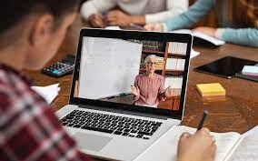
Many of us regularly teach with audiovisual media
Live in-person lectures
Live Zoom lectures
Recorded lecture videos
Embedded Youtube videos
Film screenings
Streaming audio, music &
podcasts
Miscellaneous
Lecture materials often use sound. In most cases, a majority of class information from lecture will be conveyed aurally.

Slide 7
Sound in the classroom
But how often do we think about the sonic components of these files and educational materials?
Is the information that we convey in audio available in other visual or textual formats - or is it limited to sound alone? Is it accessible to our d/Deaf, Hard of Hearing (HoH), and neurodivergent students?

Slide 8
Sound in the classroom
But how often do we think about the sonic components of these files and educational materials? Is the information that we convey in audio available in visual or textual formats - or sound alone?
Please take a moment to reflect on how you have used sound in your teaching materials, consciously and unconsciously.

Slide 9
Sound in the classroom
As educators, we are often instructed to create visual and textual materials to supplement our speech. This mode of visual learning (through graphs, images, and bullet point summaries) helps students who are neurodivergent or have audio-processing issues.
But some information may be lost if we don’t think carefully about which components we transcribe.

Slide 10
Sound in the classroom
As educators, we are often instructed to create visual and textual materials to supplement our speech. This mode of visual learning (through graphs, images, and bullet point summaries) helps students who are neurodivergent or have audio-processing issues.
But some information may be lost if we don’t think carefully about which components we transcribe. What information, and which students, might get left out?

Slide 11
Listening is an access issue
Ultimately, the use of sound in our teaching creates an access issue:
Hearing is biological (i.e., it is physiological). Listening is cultural (i.e., it is learned). In both cases, no two students will hear or understand the sounds that you give to them in the same way. It is important to provide all students with equal access to acoustic information.

Slide 12
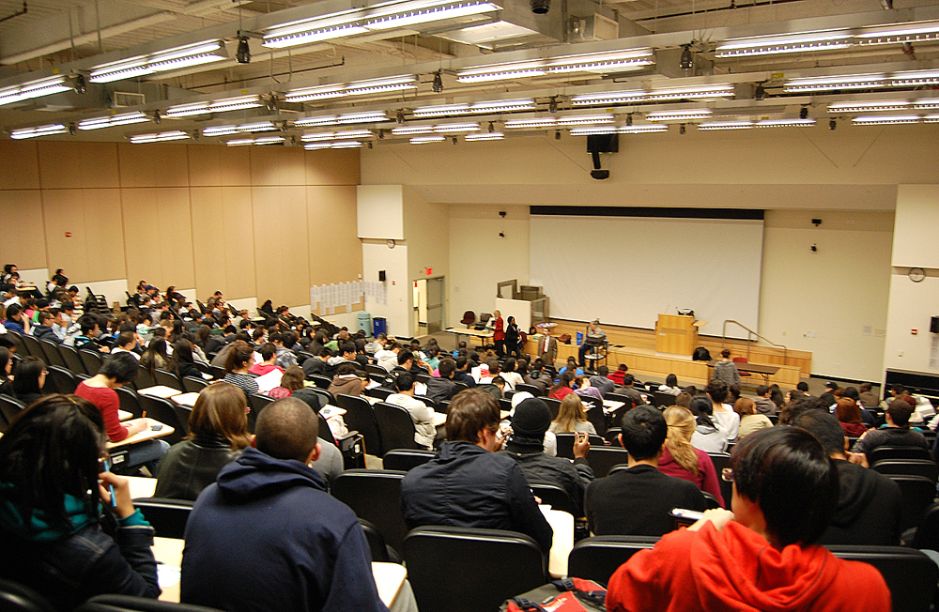
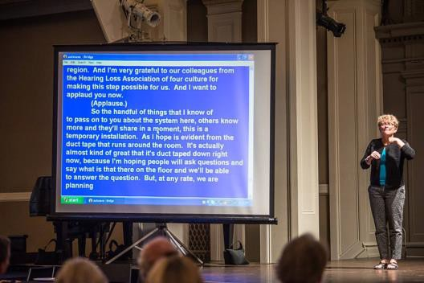
Live in-person lectures
Left: Live captioning (CART) demonstrated. Source: Hearing Loss Association of America. Right: A lecture hall at Baruch College, New York City, US. May 2009. Source: Wikimedia.

Slide 13
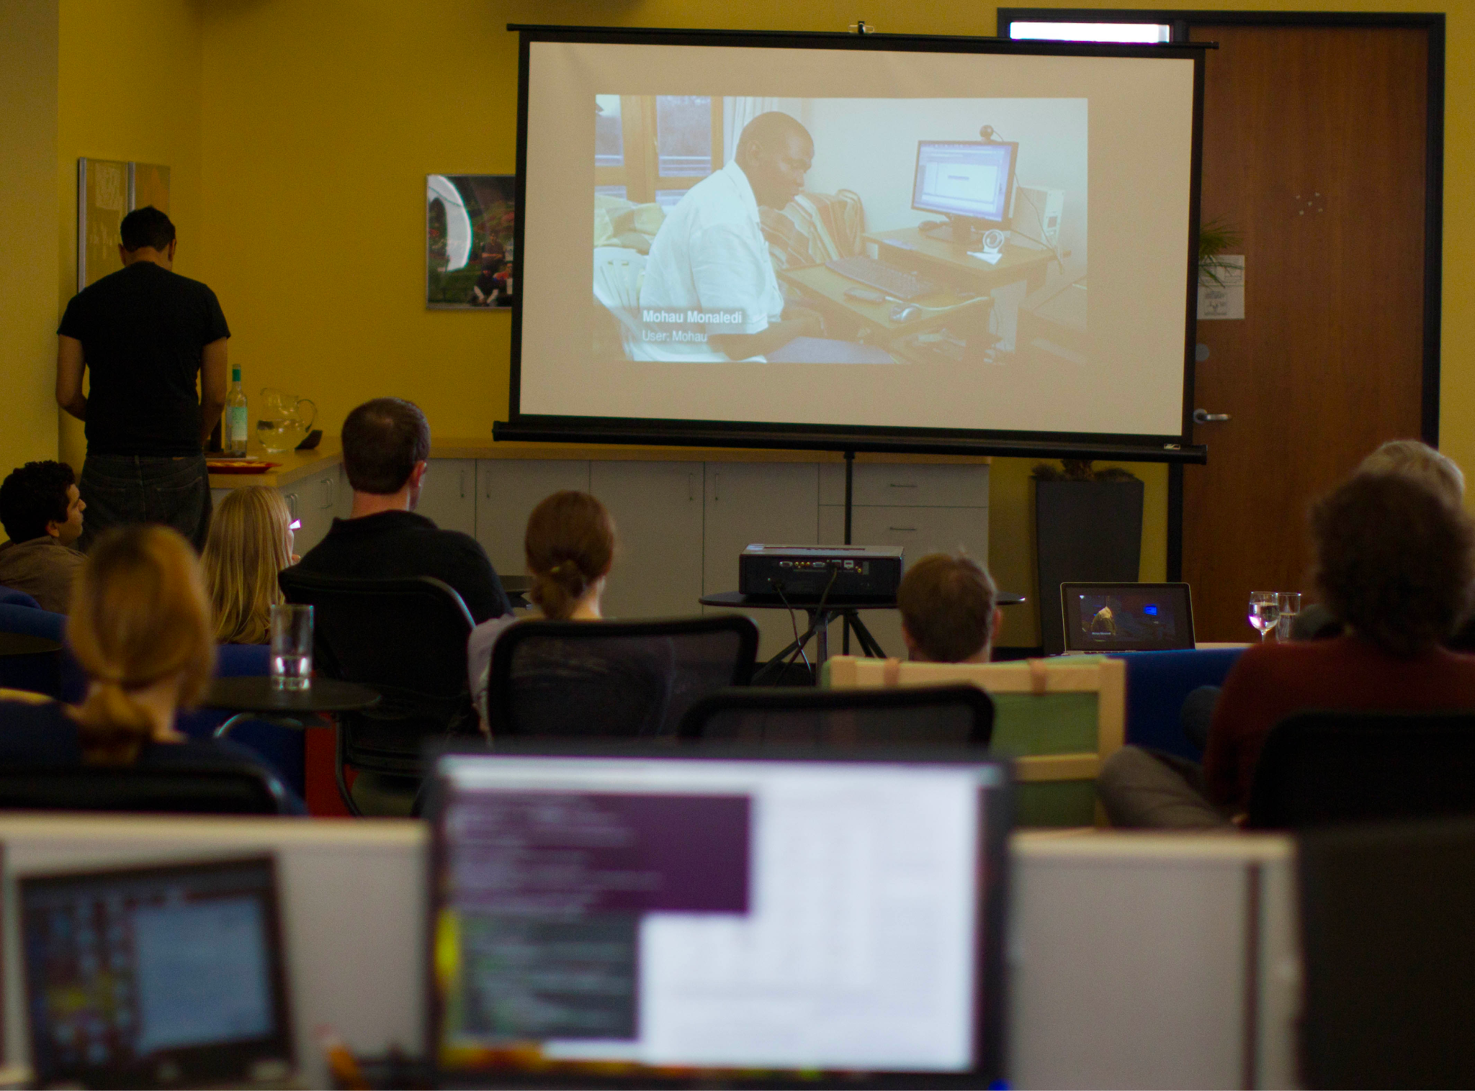
Live in-person lectures (or screenings)
Left: Collab Space at the Wikimedia Foundation (August 2011). Source: Wikimedia.
Right: A lecture hall at Baruch College, New York City, US. May 2009. Source: Wikimedia.

Slide 14
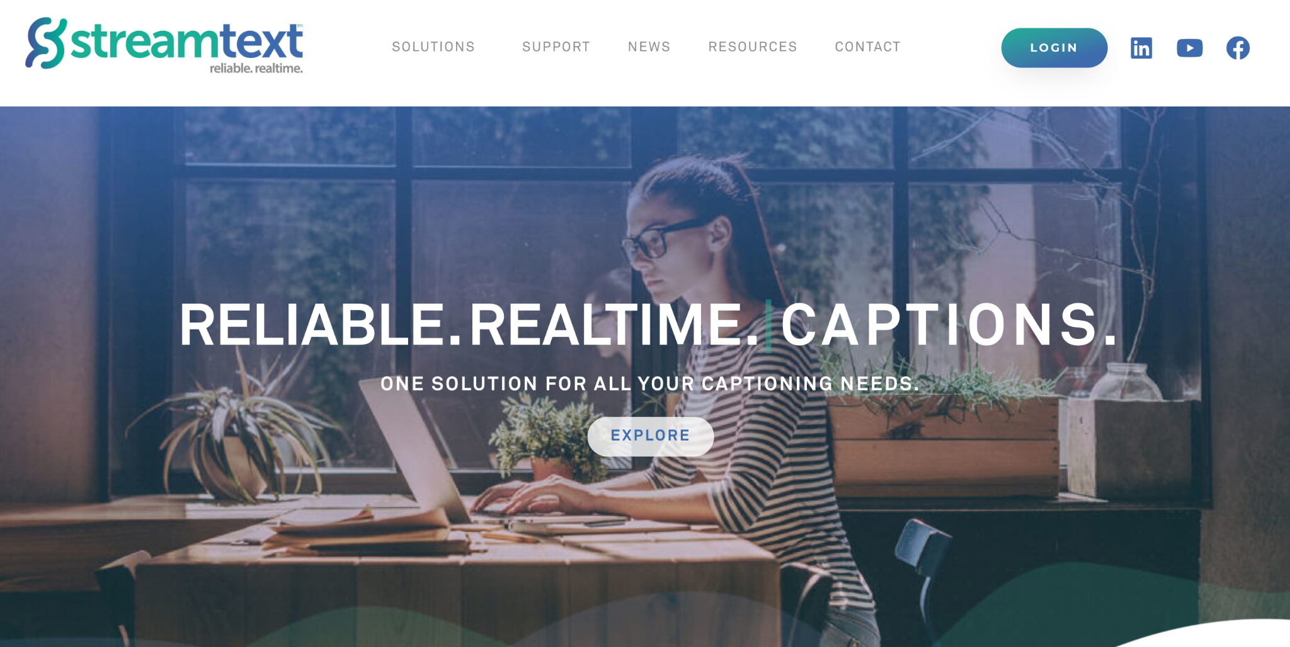
AI-based and/or live captioning (CART) companies provide realtime text transcription of lectures. Captions are displayed on a streamtext event website or projected on a secondary screen.

Slide 15
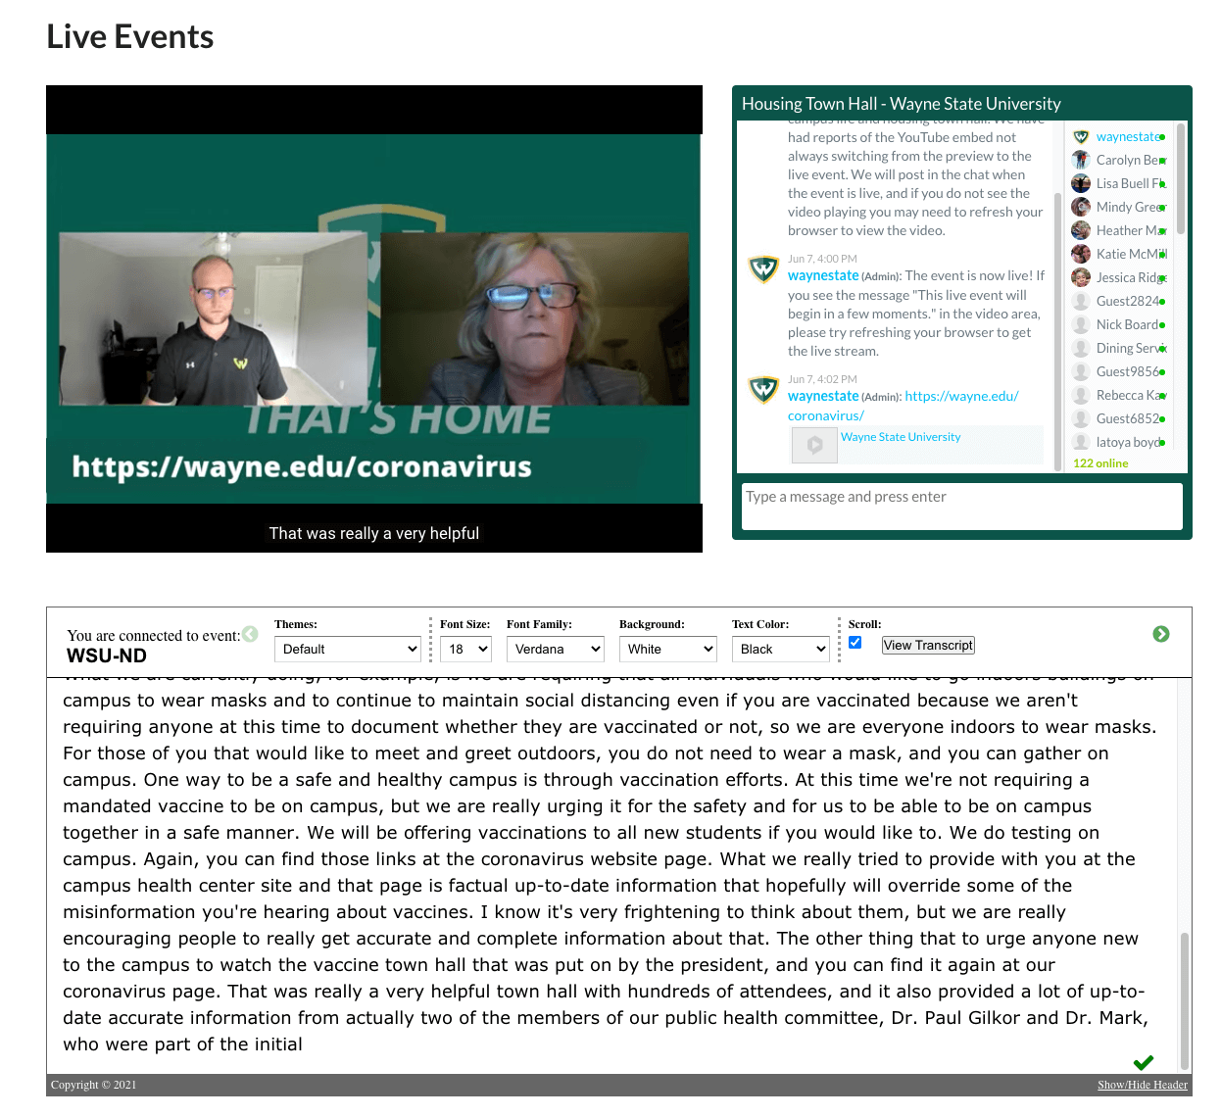
Here, admins at Wayne State University use Streamtext to supplement a live Zoom meeting about Covid-19.
A benefit is that users can adjust the font, size, and color of plaintext to make it more readable. Captions are not adjustable.
Source: https://web-team-blog.wayne.edu/2021/06/15/running-accessible-livestream-events/

Slide 16
AI captioning is not yet ideal or reliable.
When possible, hire a human captioner.
They will be less likely to make errors, and will also be able to recognize and correct their mistakes in real time.
Notes:
Many ASL interpretation companies will also provide CART captioning. Just ask!

Slide 17
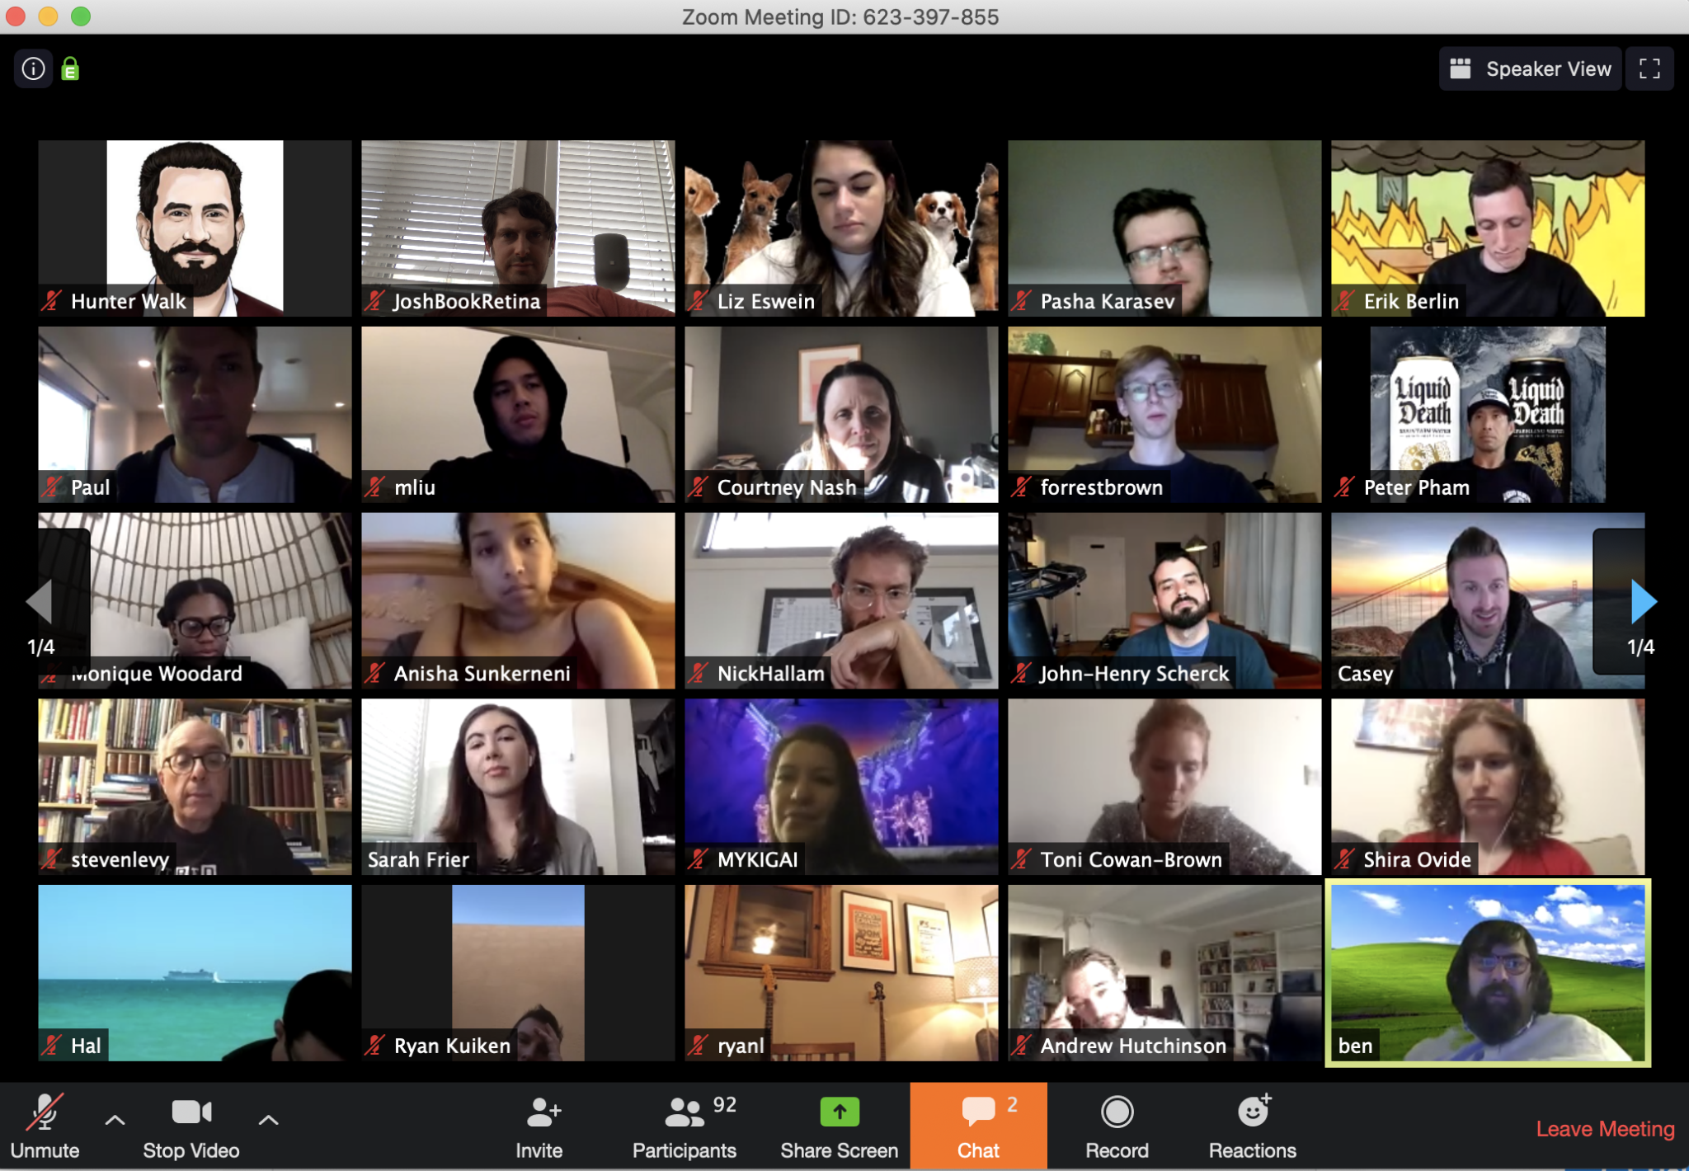
Live Zoom lectures
Activate captioning on Zoom
Zoom software with “closed captioning” transcription option. This is an effective and easy way to ensure that your students can follow along. But it isn’t perfect.

Slide 18
Live Zoom lectures
Activate captioning on Zoom
VRS struggles to recognize non-normative vocal types and expressions on which it was not trained (i.e., people who stutter, have a vocal impairment, or speak with an accent).

Slide 19
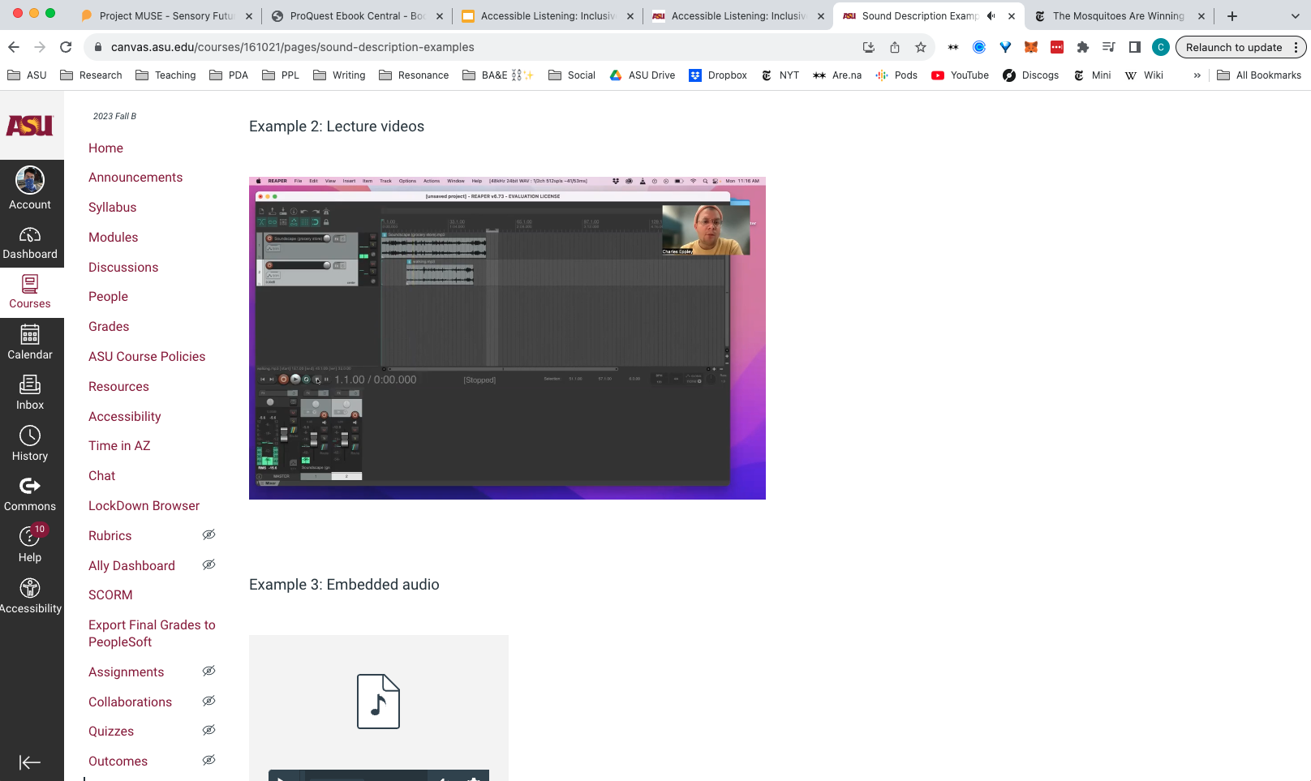
Sound on Canvas
This is an example of a typical Canvas course page for an ASU student. Canvas offers numerous access features. But we need to know how and when to use them. We also need to understand their limitations and how our pedagogical creativity can complement standard access features.

Slide 20
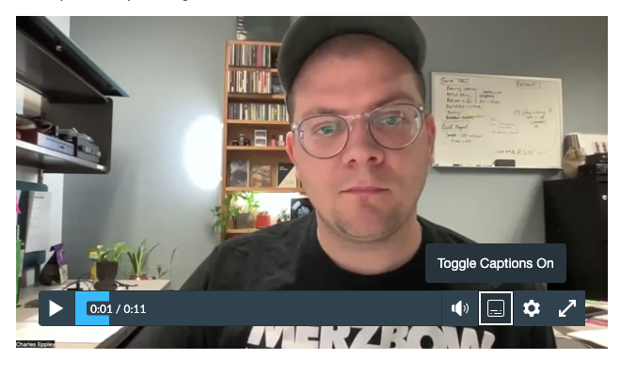
Sound on Canvas
Unless you specifically add captions to your video, your students won’t have an option to read along as you speak. This means that d/Deaf, Hard of Hearing, and neurodivergent students won’t have the same opportunity to learn as their hearing
and neurotypical classmates.

Slide 21
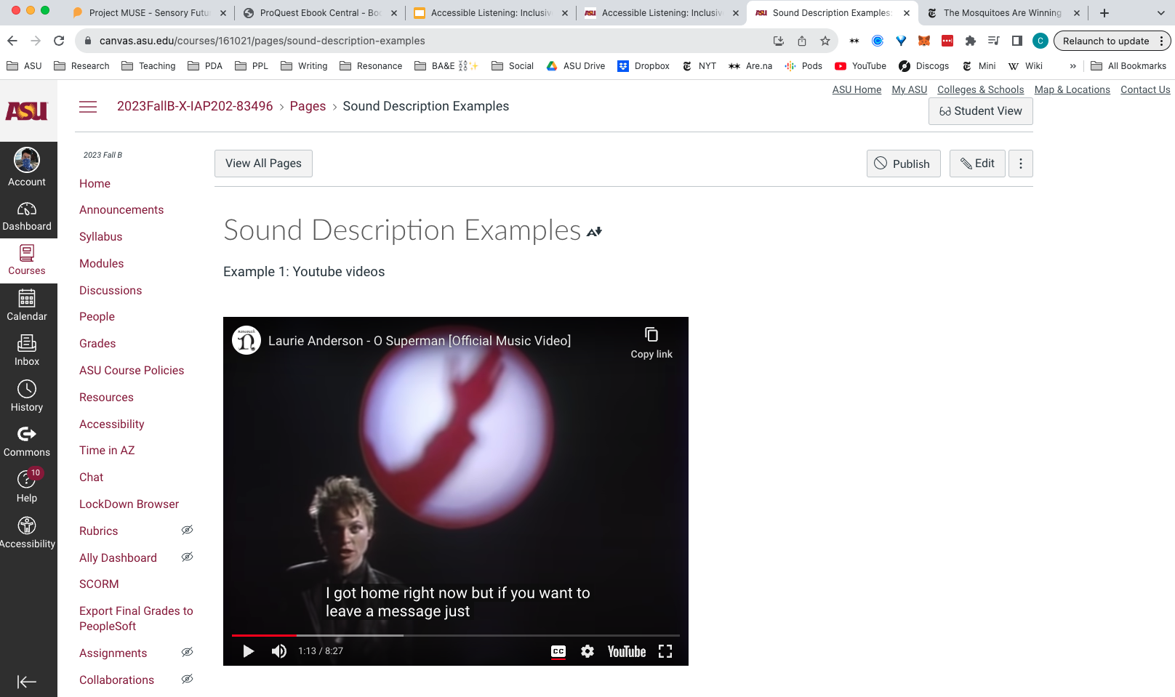

Slide 22
You can’t trust Youtube 🙅‍♀️
Youtube captions are often incorrect. Here, the artist sings: “Hi! I’m not home right now…”
The automated captions on Youtube transcribe that phrase to: “I got home right now…”

Slide 23
You can’t trust Youtube 🙅‍♀️
You should encourage students to use captions on Youtube where they are available, but you should warn them that they may be incorrect. It is better to provide your own captions directly. You can add caption text to your Canvas page.

Slide 25
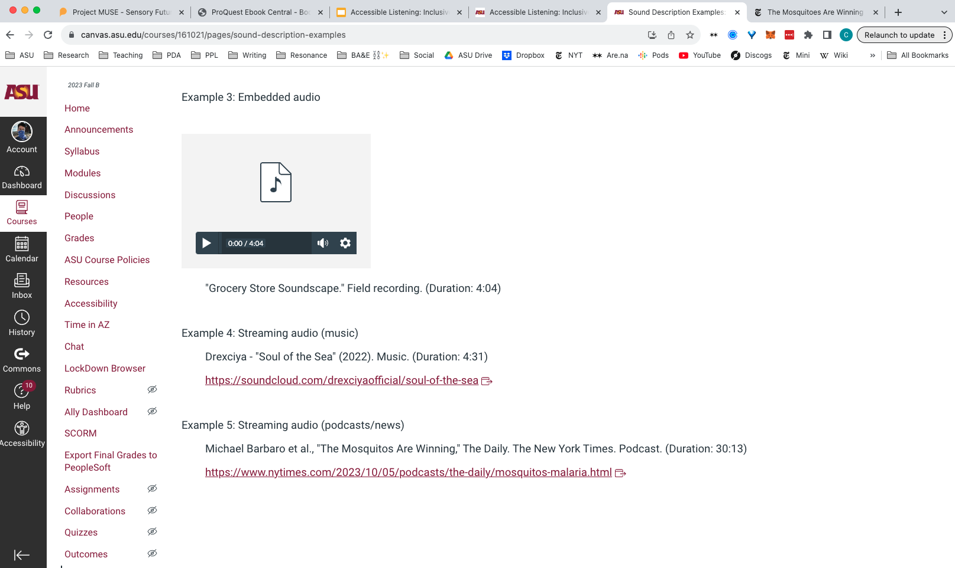

Slide 26
There are two helpful methods of making your audio media more accessible:
Sound description
and
Captioning

Slide 27
Sound description
Don’t get confused! Sound description and audio description very different. They are both useful, however, in different ways.
Sound description uses text to describe acoustical information: voices, noises, soundscapes, and music. It’s primarily used by people who are d/Deaf, Hard of Hearing, or have auditory processing disorders.
Audio description uses speech to describe visual information. It’s primarily used by people who are b/Blind or have low vision. Typically AD uses pre-recorded audio files or live describers.

Slide 28
An example of sound description
A melodic whirring begins slowly, while sounds akin to playful electronic bells dot the soundscape. Another beat, which feels like a very quick rushing back and forth, is added to the mix. As the music warms up, a voice quickly joins in with a, “Yo.” Fingers snap twice and add more texture to the layered composition. A flute is added and it is as if a lovely breeze has brushed against your skin on a warm day.
Bojana Coklyat’s example of sound description for the Alt Text as Poetry workbook. Describing a sound composition by artist JJJJJerome Ellis.
Notes:
https://alt-text-as-poetry.net/

Slide 29
An example of sound description
A melodic whirring begins slowly, while sounds akin to playful electronic bells dot the soundscape. Another beat, which feels like a very quick rushing back and forth, is added to the mix. As the music warms up, a voice quickly joins in with a, “Yo.” Fingers snap twice and add more texture to the layered composition. A flute is added and it is as if a lovely breeze has brushed against your skin on a warm day.
Yellow = analytical (objective)
Pink = intuitive (subjective)
Notes:
https://alt-text-as-poetry.net/

Slide 30
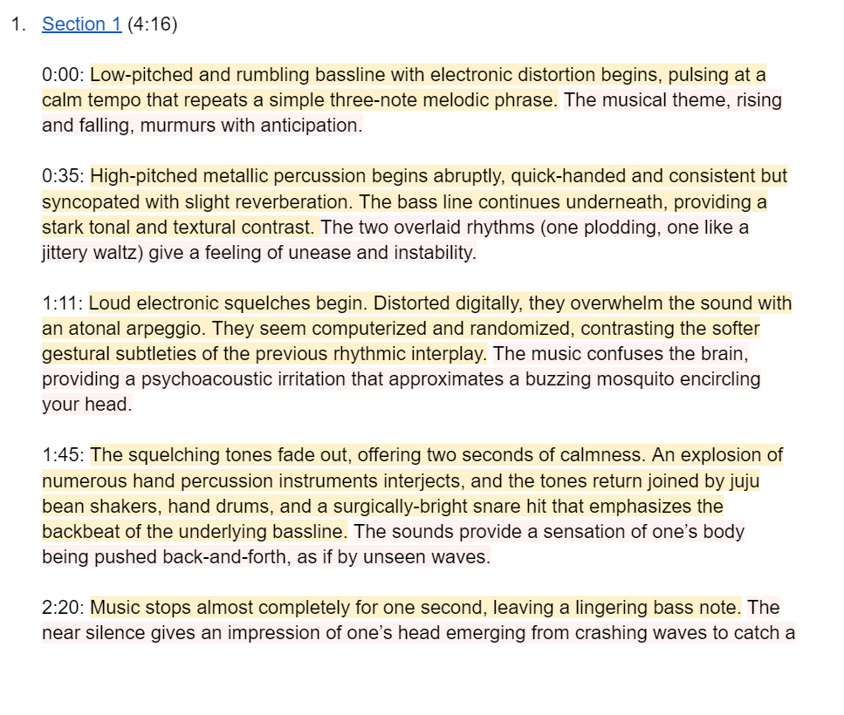
Yellow = analytical
Pink = intuitive
Sound descriptions for a Remote Access program at Tangled Art & Disability (Toronto) (2022)

Slide 32
Access artistry
Accessibility can feel overwhelming and legalistic. It can be prescriptive. However, it does not need to be. In the field of disability arts, many people are exploring the concept of “access artistry,” which refers to creative approaches to accessibility.
In an “access artistry” context, your work toward creating accessible materials can be an avenue of creative expression - or, in the context of teaching, a pedagogical gesture. This perspective may help you feel more comfortable creating accessible media.

Slide 33
Be sure to balance your “access artistry” with conventional access methods.
People depend on access features. Your creative spirit should not overpower the ultimate goal of description and captioning: to create more accessible and equitable learning and social environments.

Slide 35
When to use audio description
Audio description is an important access tool as well. It is used to describe visual images to people who are b/Blind or have low vision. Audio description is related to image description, but again they are different from each other:
Audio description is typically used for time-based visual media and live performance. AD tends to be spoken.
Image description is typically used for fixed or static images. ID tends to be written and then transposed to braille or synthesized to audio through screen reader software.

Slide 36
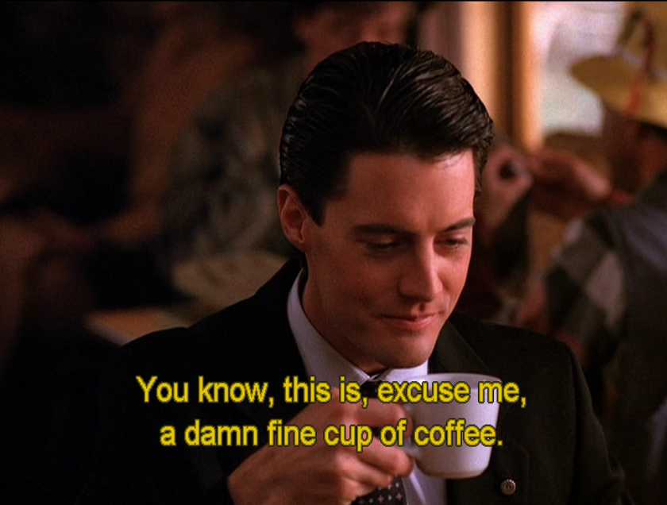
Captioning
Captioning can seem difficult. But it doesn’t have to be! There are many tools to help you create accessible video captions, including a useful feature in Zoom.
Captions are important for viewers to perceive the speech of characters or speakers, and to understand soundtrack audio information.
Agent Dale Cooper enjoying a damn fine cup of coffee. Source: Twin Peaks (1990). Dir. David Lynch. Season 1, Episode 1 (“Traces to Nowhere”).

Slide 37
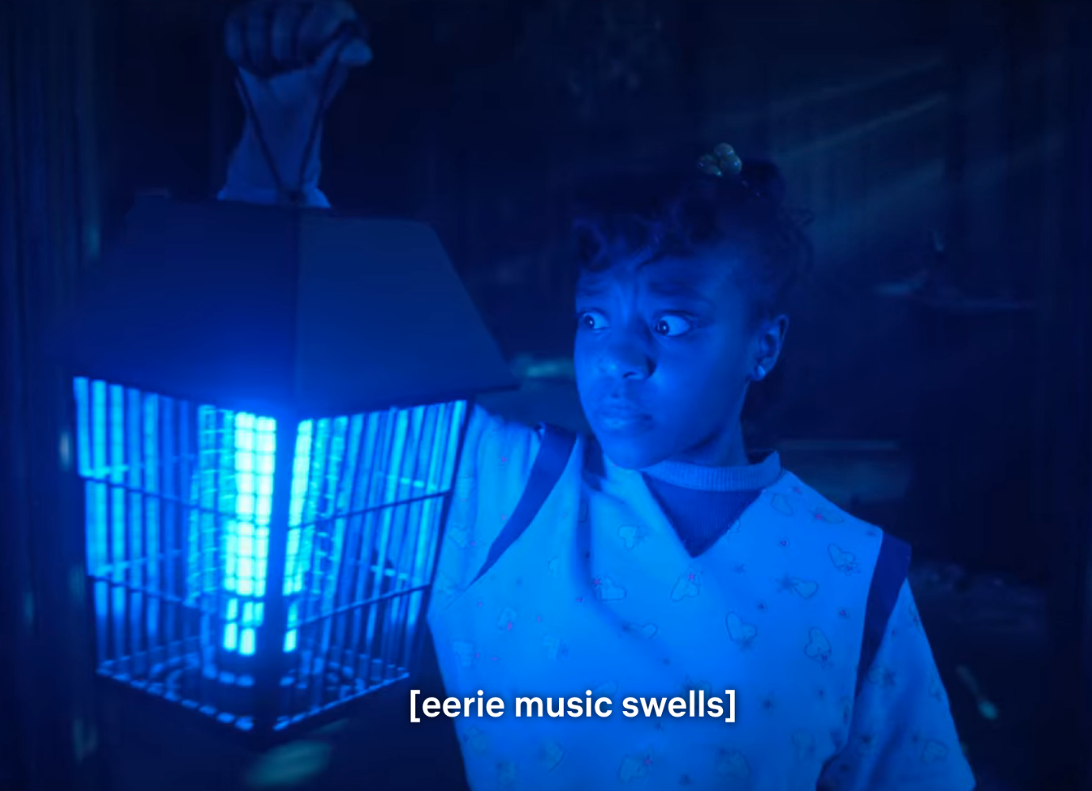
Captioning
However, captioning is often of poor quality in terms of the information conveyed. Often it is limited to speech alone. Or when sound, noise, or music is conveyed, it is generalized and not specific — e.g., when they read “(scary music),” or “(loud noise).”
“Eering music swells” in Stranger Things.

Slide 38
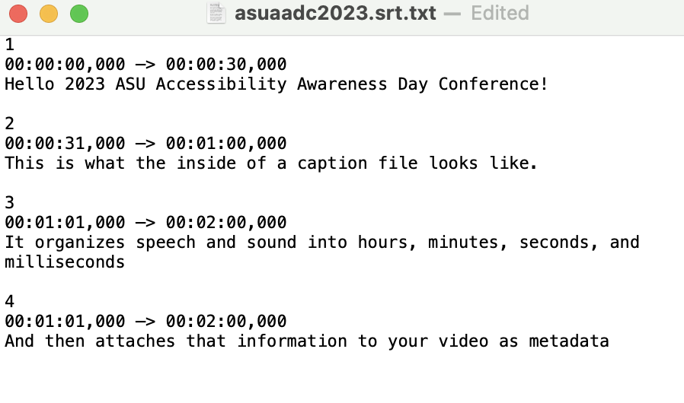
Captions align plaintext with sound, typically in video files. Closed captions are unseen until activated. Open captions are always shown on the screen.
Captions can include speech, noise, music, and soundscape information. They are encoded into the video file.
Typical SRT file text. There are many ways to create a caption files that you can attach to your videos
on Canvas or Youtube.
Hour; Minute; Second; Millisecond
( 00:00:00,000 )

Slide 39
Captioning
There are a few types of caption files to be aware of as a media creator (which all instructors now are): SRT and VTT are the most common. In addition to text, these files can hold metadata to stylize how the caption text looks on the screen.
For example, you could make your captions look like this..
As opposed to this standard style.

Slide 40
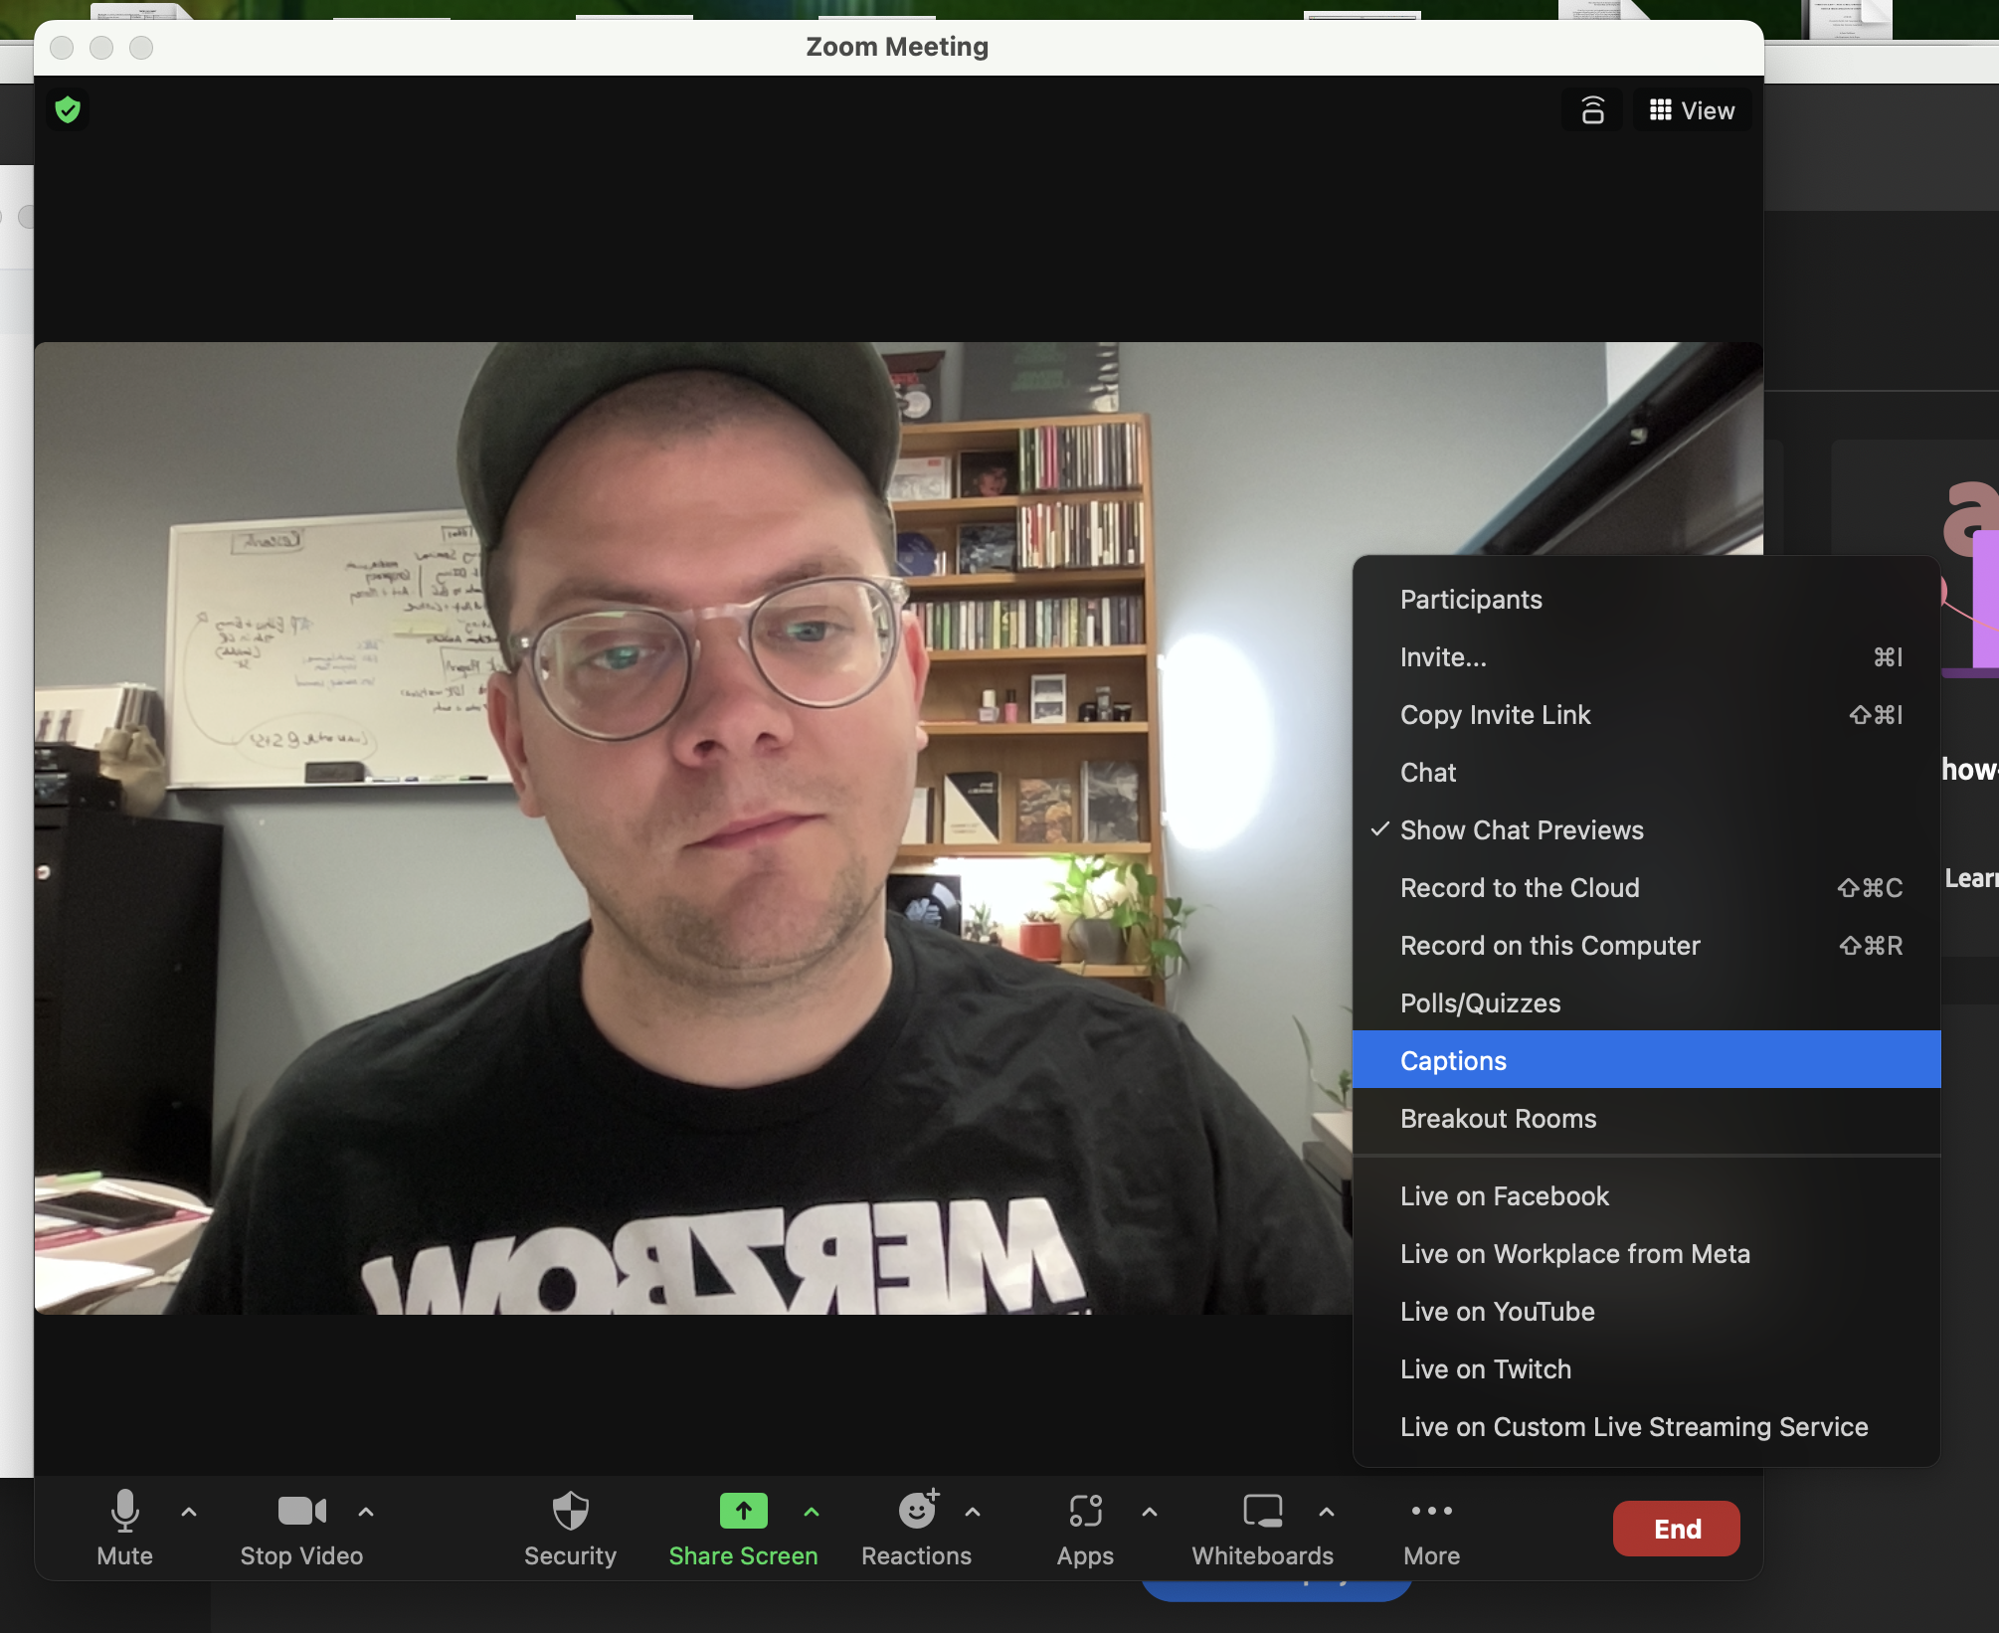
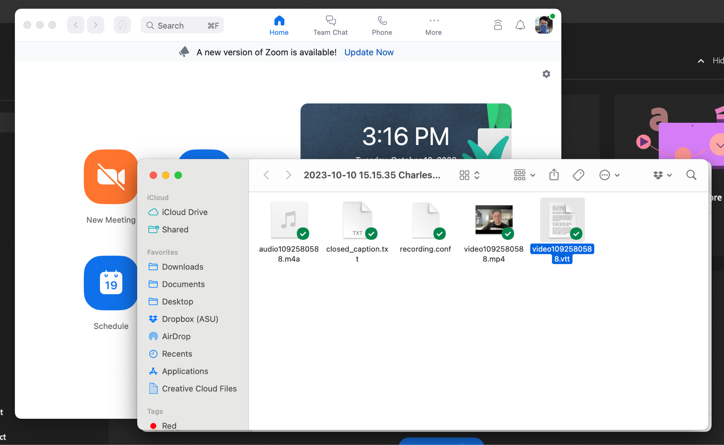
When you record on Zoom, you can use an auto-caption feature. This shows your speech on the screen during the meeting.
But it also creates caption files (Zoom uses VTT) that you can upload later. This makes your video accessible to those who watch it when you upload to Canvas or Youtube.

Slide 41
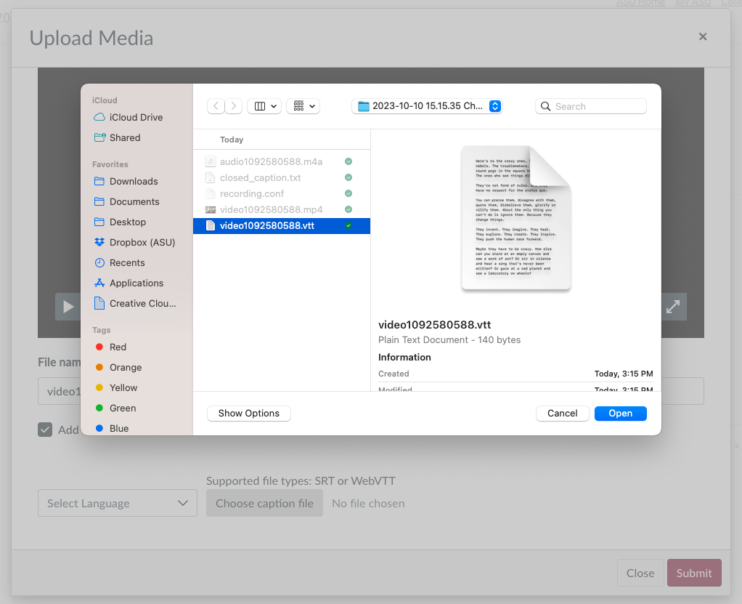
If you turn captioning on before you record, Zoom will automatically transcribe your text.
Be sure to check your caption text, as Zoom may not transcribe it perfectly.

Slide 42
.TXT
=/=
.SRT or .VTT
Zoom does not create caption files automatically. You have to activate this feature during your meeting.
Caption files (VTT and SRT) are not the same as the transcript files (TXT). TXT files cannot be used to caption your videos, as they have to be converted to a caption format.

Slide 43
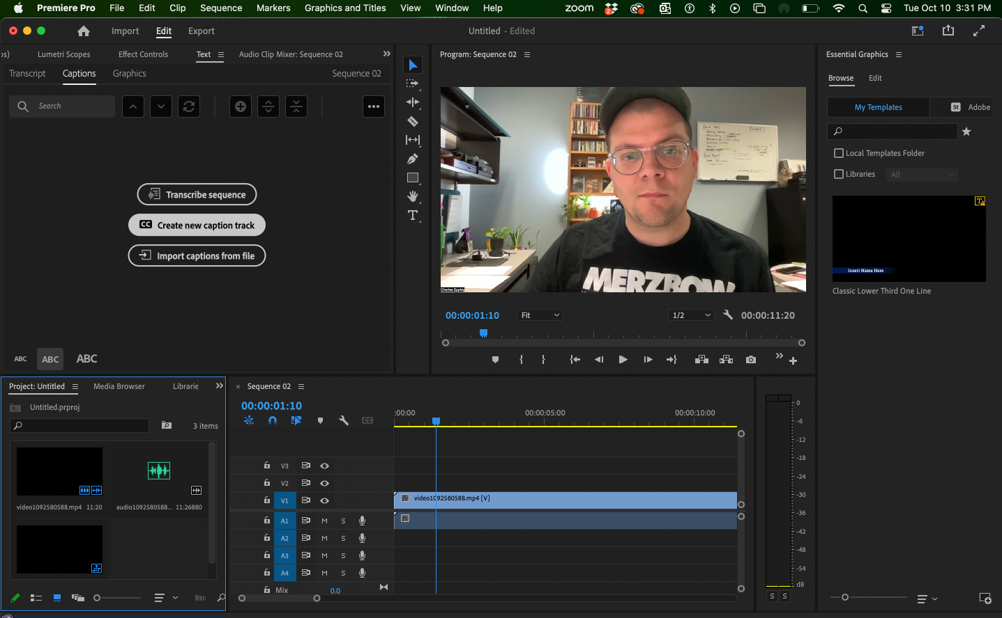
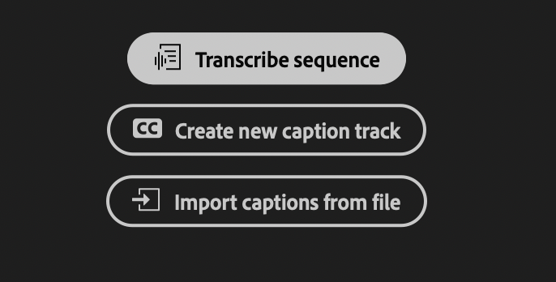
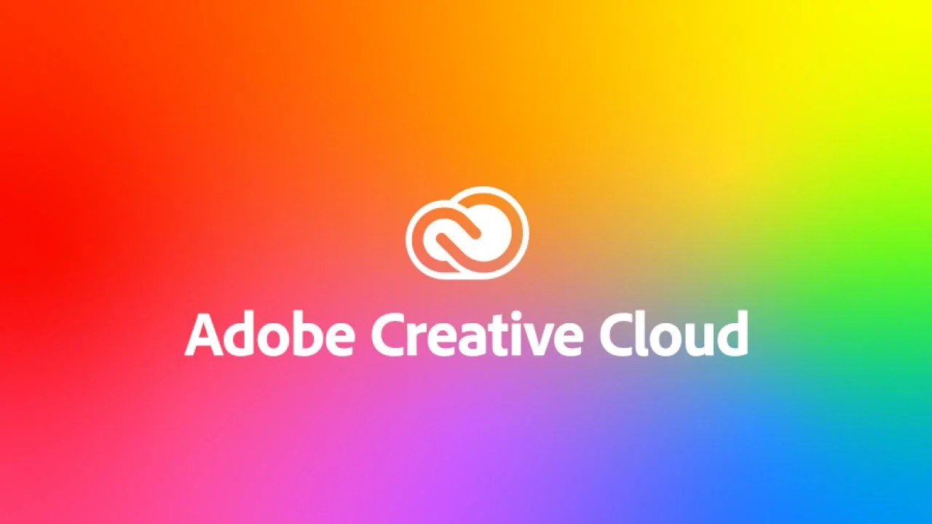
Oops! I forgot to turn on captions…
In the event that you forget to turn captions on while you record your lecture, you can still create your caption file. An easy way to do this is to open your video in Adobe Premiere Pro, and use its auto-caption feature. You can also import existing caption files.

Slide 44
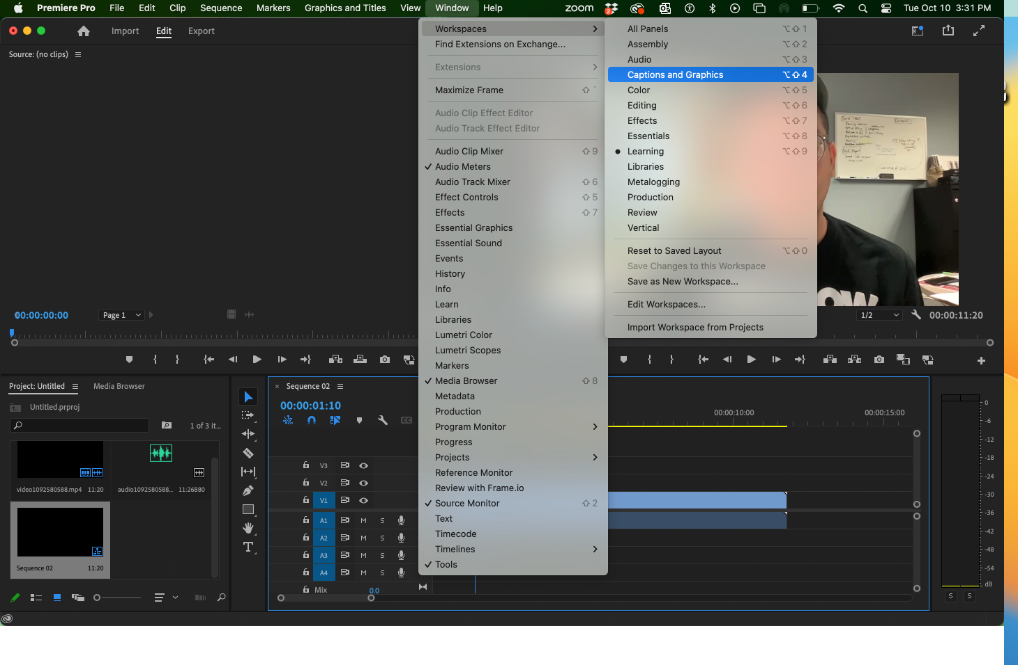
Go to Window > Captions and Graphics
Click “Transcribe sequence” and then “Create new caption track.”

Slide 45
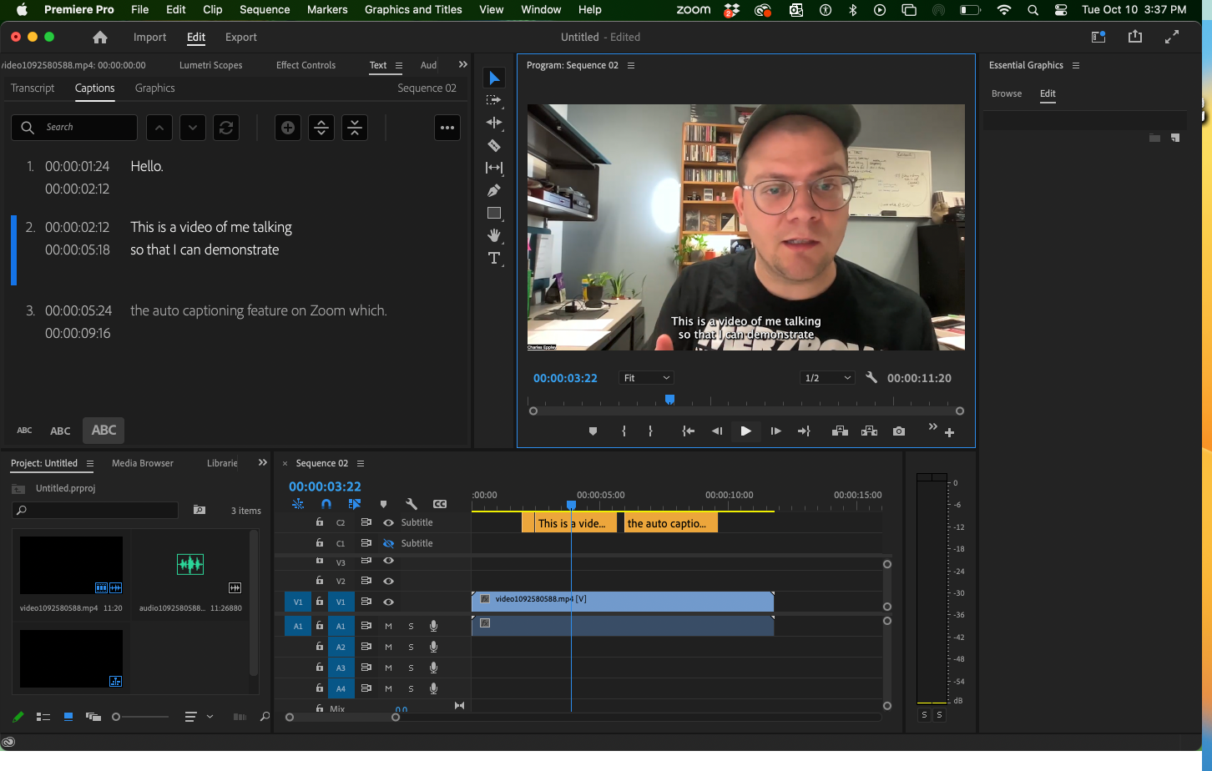

Slide 46
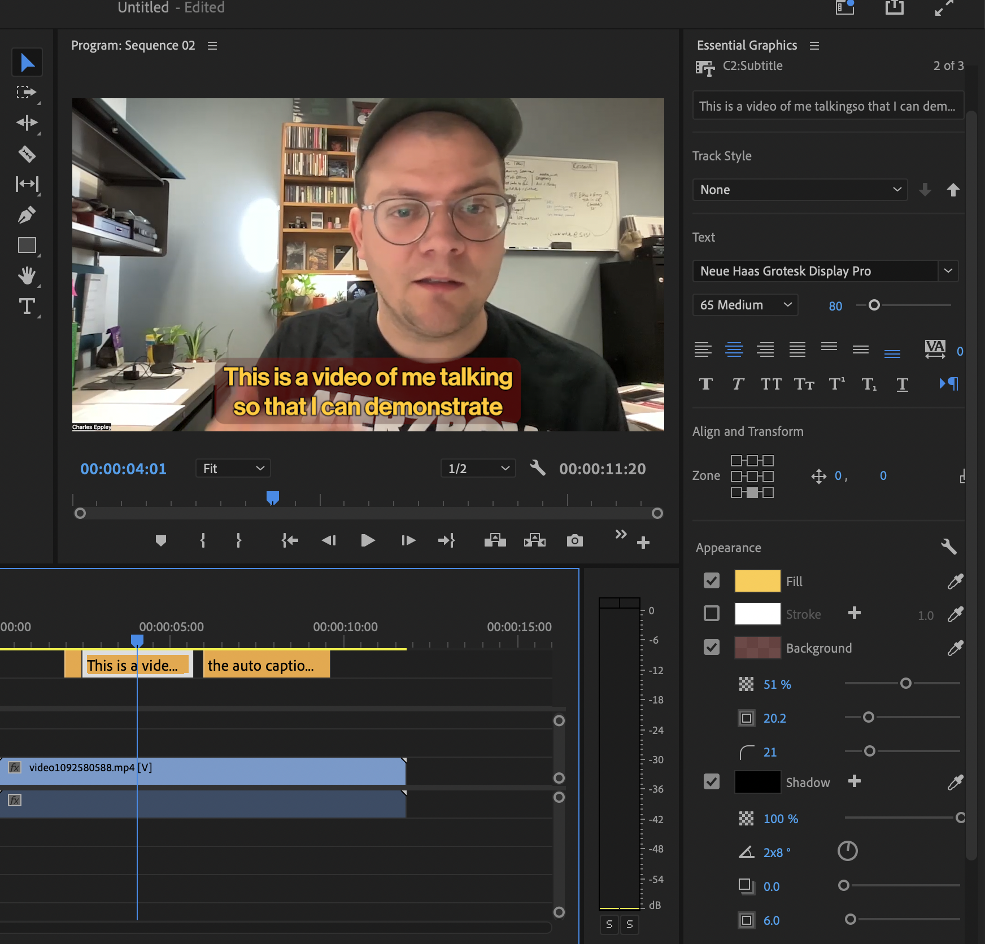
In Premiere, you are able to customize your caption style. For example, you could add drop shadow, a background color, change the font and font size, and modify colors.
Just make sure that what you design is visually accessible (i.e., has high contrast and is readable).

Slide 47
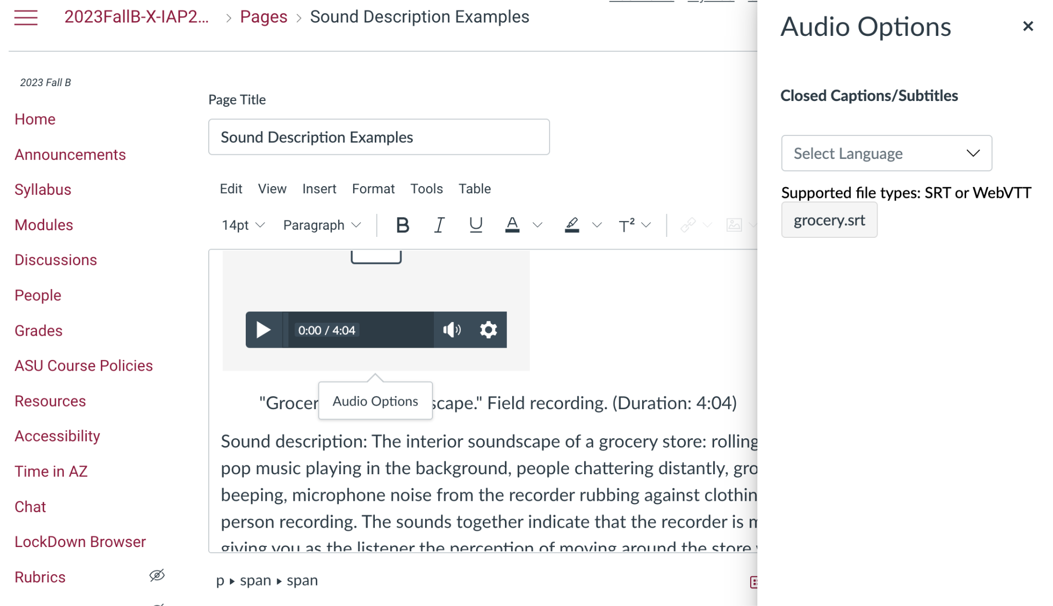
Canvas lets you upload custom caption files to embedded video and audio.
Creating SRT files is easier than it seems. You can do it in the Text Editor (Mac) or Notepad (Windows) apps. There are many tutorials online.

Slide 48
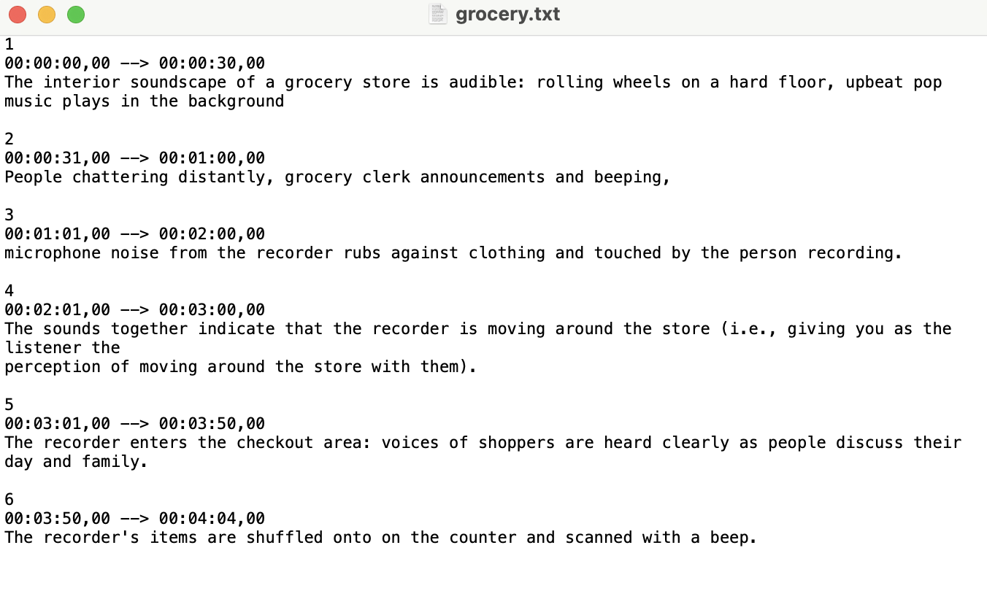
Creating SRT files is easier than it seems. You can do it in the Text Editor (Mac) or Notepad (Windows) apps. There are many tutorials online.

Slide 50
Warning: Sometimes Canvas does not like to accommodate or cooperate. If it refuses to show your captions, you can just copy and paste them directly onto the page as a sound description.
You can use sound descriptions and captions together.

Slide 51
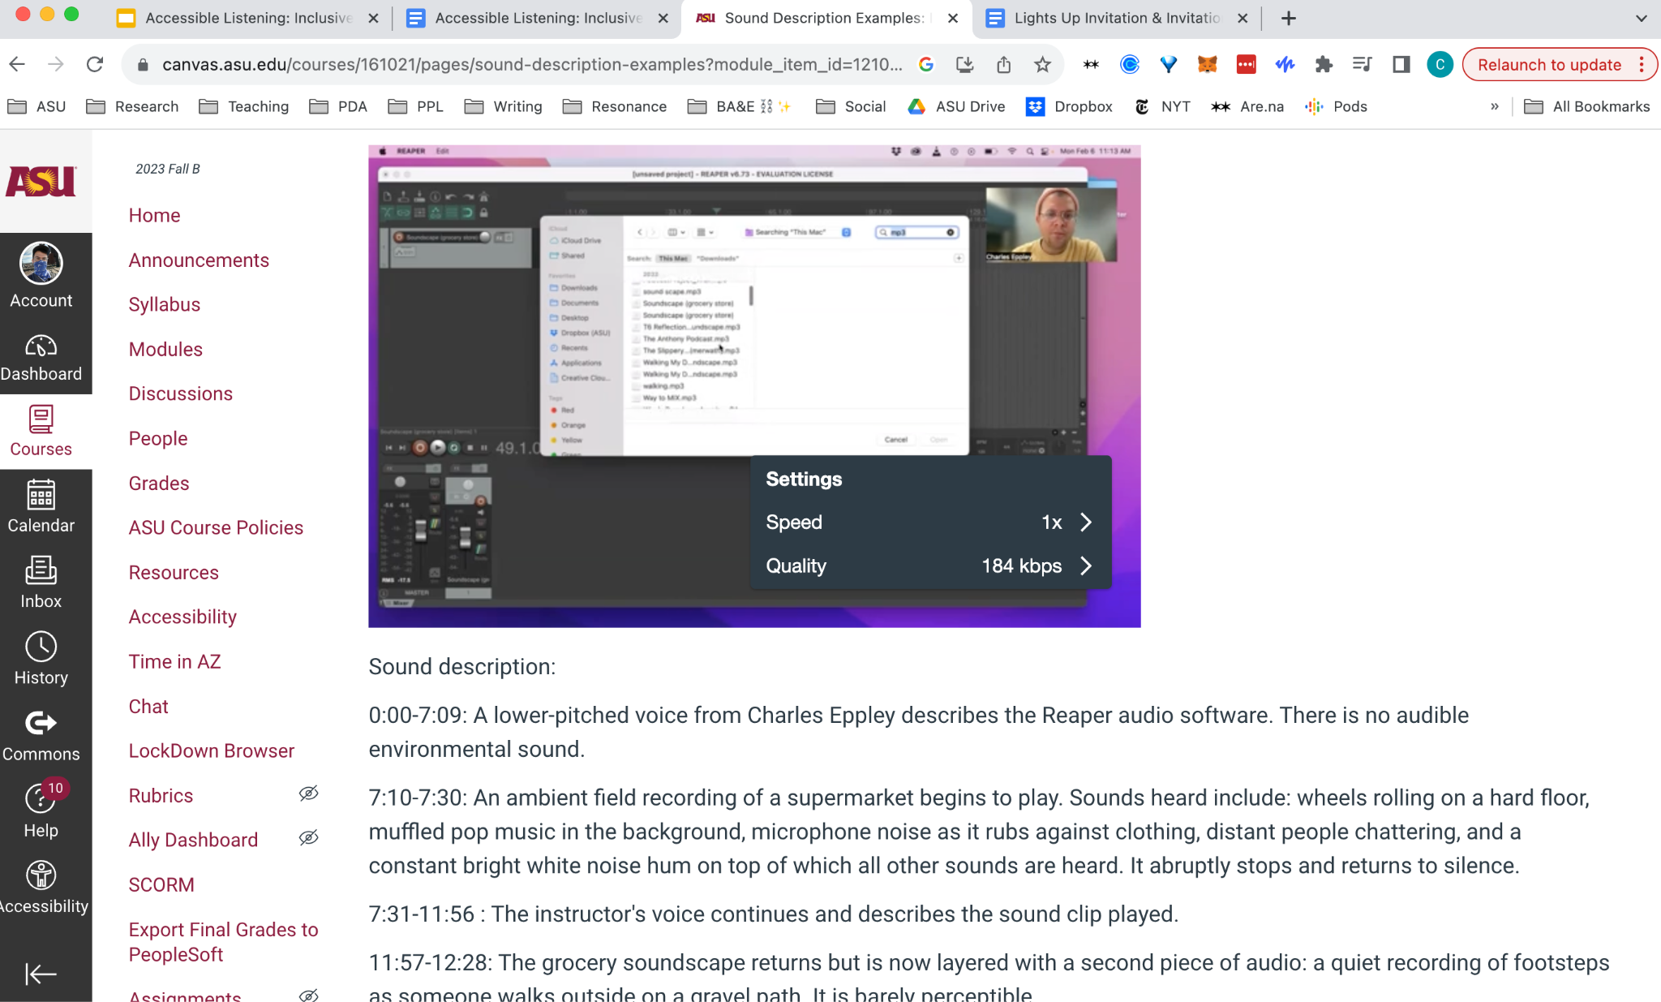
For longer videos, use timestamps to help readers situate themselves.

Slide 52
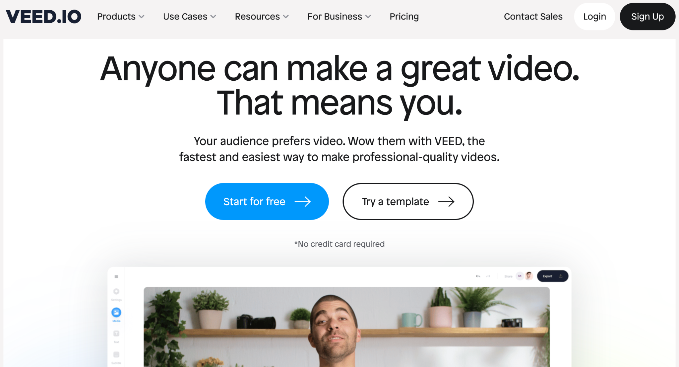
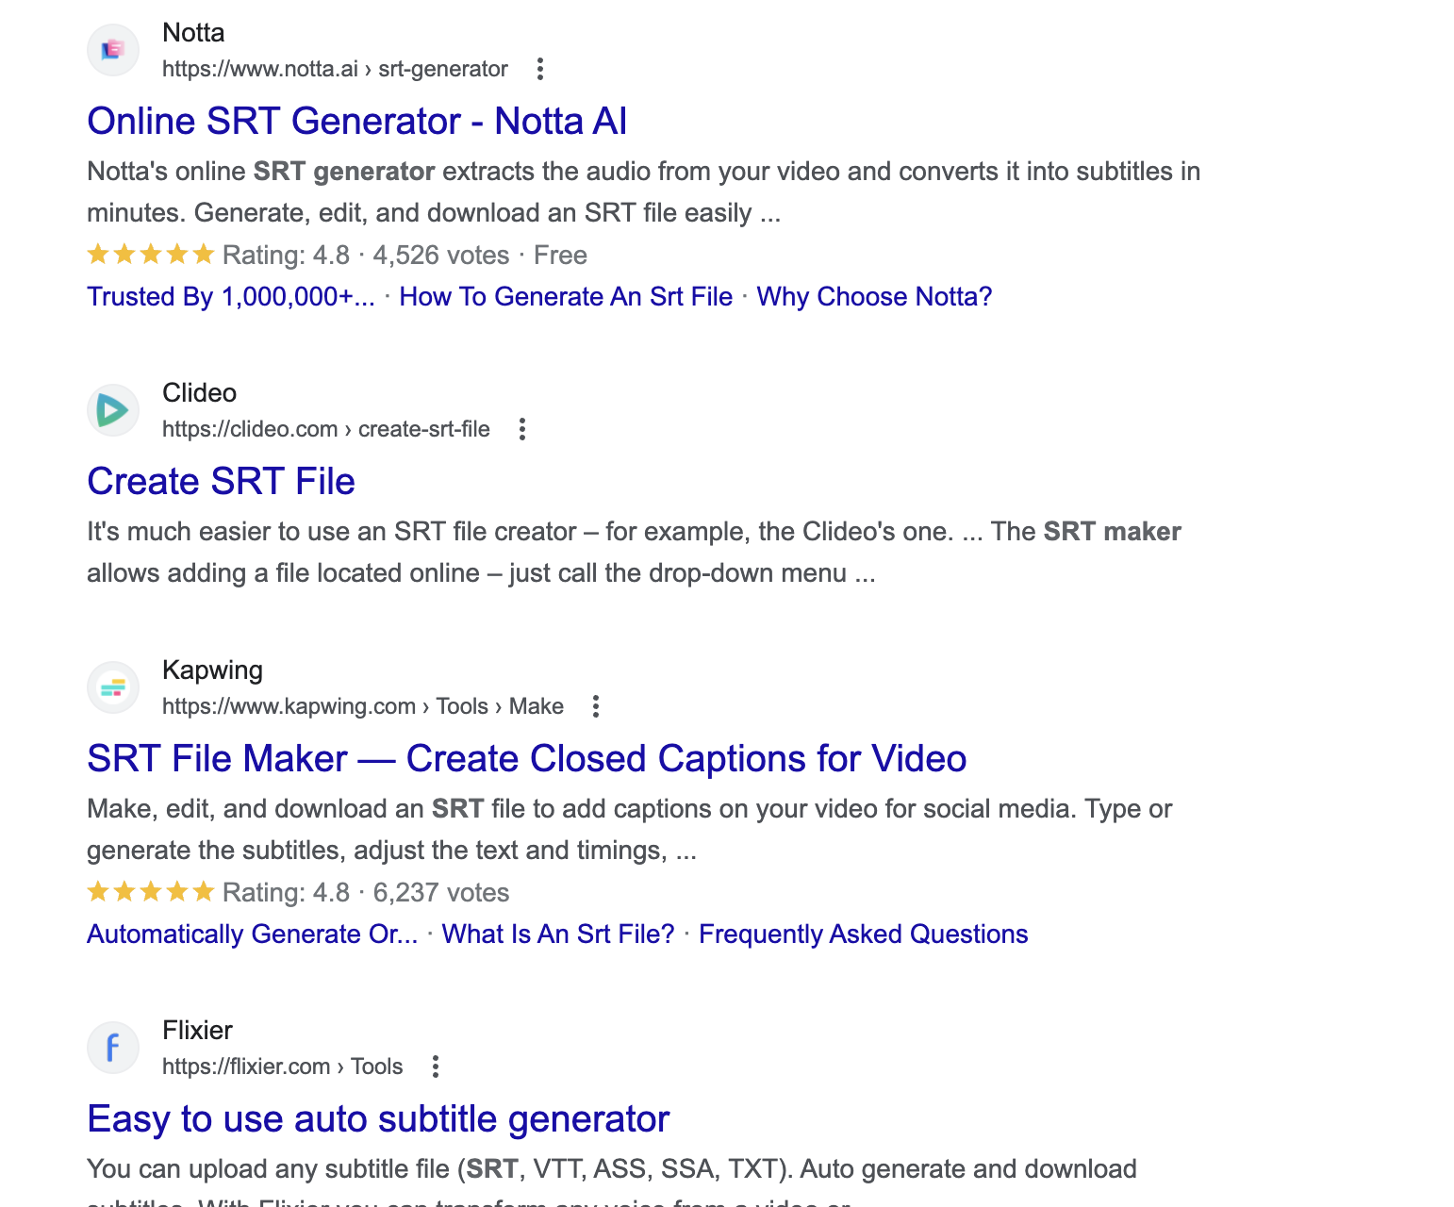
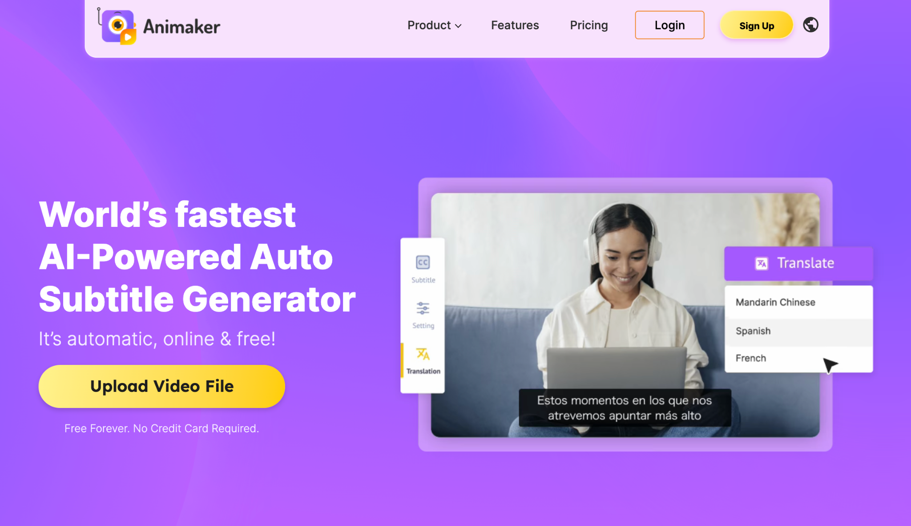
There are dozens of caption generator tools. Search “SRT” or “VTT” generator for free and paid options. Premiere Pro also can create them.

Slide 53
How can I use this information?
I’ve thrown a lot of information at you today. It is OK to sit with it and think about how it might factor into your teaching. Here are a few places that you can begin:
Consider using AI or human-composed live captions for in-person lectures
Create captions for your recorded lectures via Zoom or Adobe Premiere Pro
Write sound descriptions for recorded audio, especially when that audio is central to your curriculum

Slide 54
I am available to chat!
Feel free to email me at: charles.eppley@asu.edu to discuss anything that I’ve talked about today.
Thanks for watching, listening, and reading!

