Slide 1
AI-Enhanced Assistive Technologies for Neurodivergent Learners
By: Angel Morgan
Assistant Instructional Professional
MLFTC, Learning Design and Technology

Slide 2
What is Neurodiversity?
Neurodiversity is a concept that recognizes and respects neurological differences as natural variations of human diversity, rather than viewing them as deficits or disorders (Shah et al., 2022).
Neurodiverse individuals are commonly diagnosed with Autism Spectrum Disorder (ASD), Attention-Deficit Hyperactivity Disorder (ADHD), Dyslexia, or another neurodevelopmental difference.

Slide 3
Neurodiversity Statistics in Higher Education
0.3%–1.9% of postsecondary students in the United States are autistic, and 5% report attention-deficit (Dwyer et al., 2023).
Neurodiverse students account for anywhere between 11%-30% of the entire undergraduate population (Dwyer et al., 2023).

Slide 4
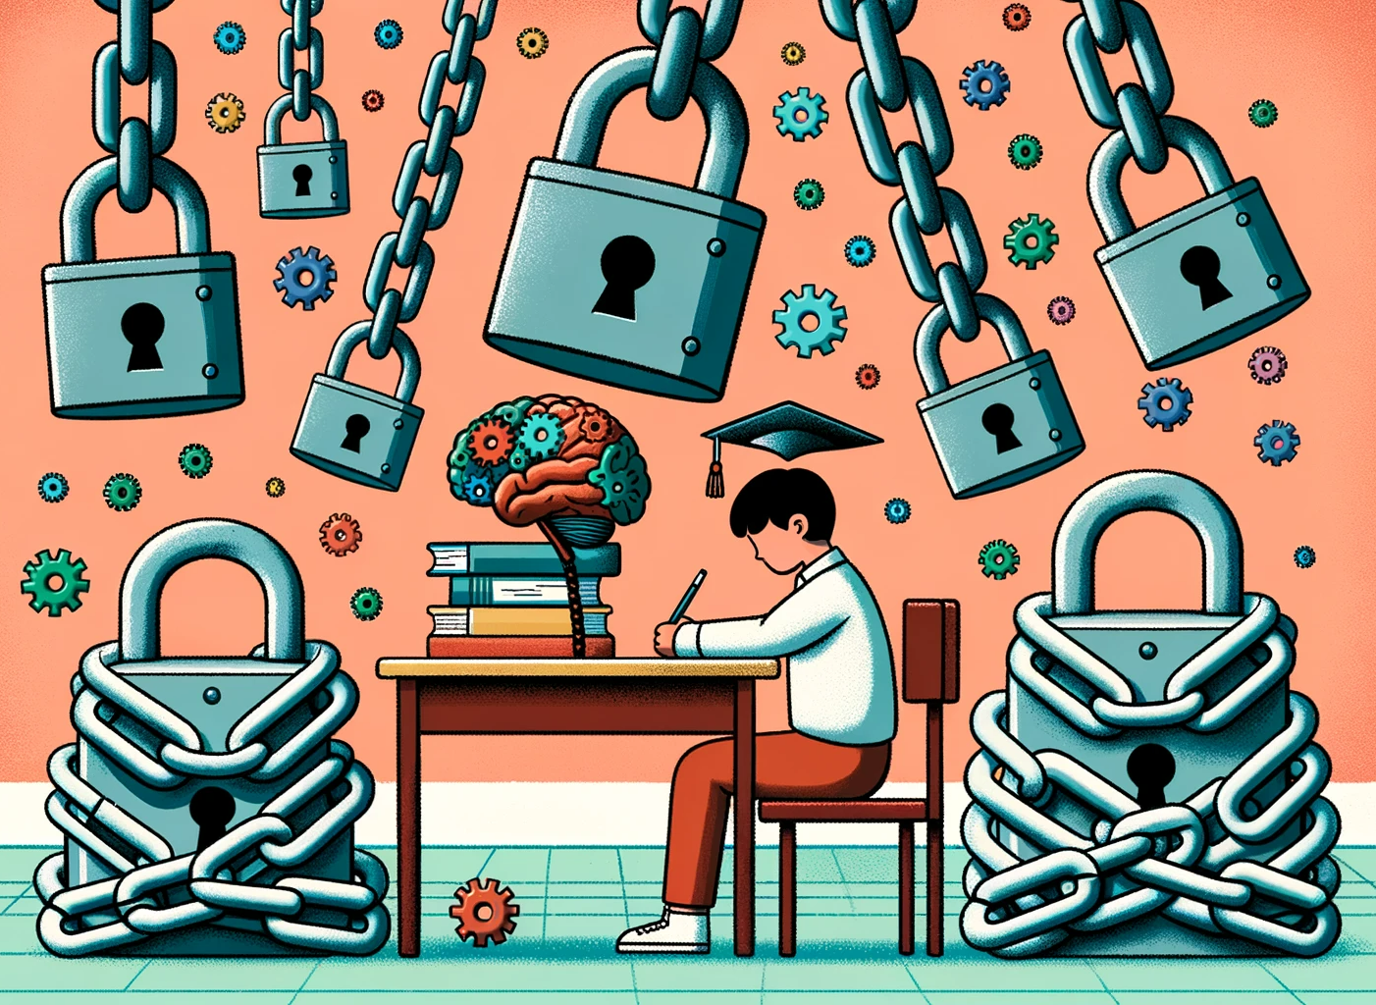
Barriers for Neurodiverse Learners
Reading comprehension and fluency challenges (Cheyney-Collante et al., 2021)
Spelling and writing skills (Jacobs et al., 2020 & Tariq & Latif, 2016)
Low working memory (Nagarhalli, 2021)
Social communication challenges (Izuno-Garcia, 2023)
Planning and organization (Mittag, 2020)
Attentional control (Thorell et al., 2022)

Slide 5
AI Tools to Reduce or Mitigate Barriers to Learning

Slide 6
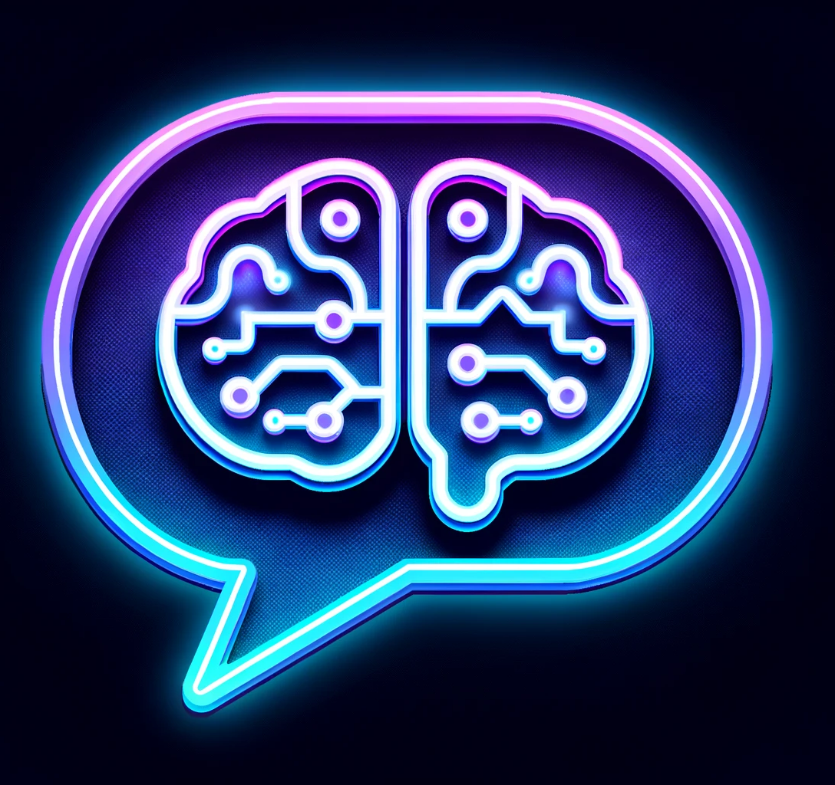
Generative AI Tools: ChatGPT & Bard
Research and summarize complex topics
Break down complex tasks into more manageable steps
Draft emails or talking points
Providing pros and cons or outlining potential outcomes for decision making
Practice social skills in a low stakes environment
Provide timely prompts to refocus attention
Assist in setting SMART goals

Slide 7
Literacy Tools: QuillBot & Grammarly
AI-Powered Document Check (Pfeifer & Allen, 2023 & Grammarly 2023))
Spelling & Grammar Suggestions
With Rule Explanations
Citation Generator
Paraphrase Tool
Text Summarizer
Tone and Style Suggestions
Academic Templates (Quillbot’s Co-Writer)
AI co-creators

Slide 8
Memory and Communication Tool: Otter.ai
Real-time captions and notes (Otter.ai Staff, 2023 )
Helps students focus on discussion vs. taking notes
Interactive notes and takeaways panel
Automatically generates a transcript with a summary
Tagging features for questions and answers
Platform integration: Google and Microsoft calendars, Zoom, Google Meet, and Teams
“Otter.ai's transcriptions are well known for accuracy and automatically inserts punctuation as well as breaks between phrases and different speakers” (Verge & Crowell, 2021).

Slide 9
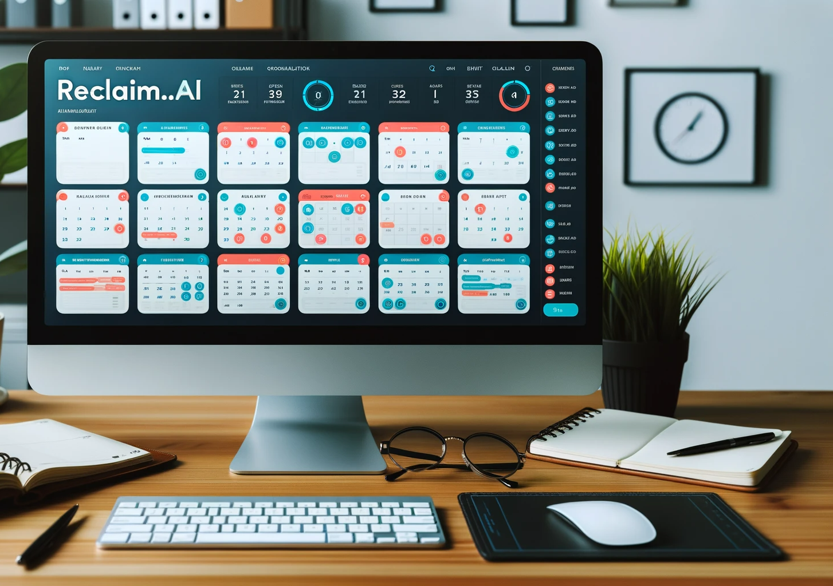
Planning and Organization Tool: Reclaim.ai
Finds optimal times for study, meetings, and breaks
Aids in setting and monitoring academic and personal objectives
Sorts tasks by importance or deadline to combat procrastination
Integrates with Google Calendar for better time management
Integrates with Slack to simplify communication

Slide 10
References
Cheyney-Collante, K., Gonsalves, V., & Giuliani, S. (2022). Online dyslexia professional development for diverse practitioners: A multiple-case study. Teacher Education and Special Education, 45(3), 246-264. https://doi.org/10.1177/08884064211050344
Dwyer, P., Mineo, E., Mifsud, K., Lindholm, C., Gurba, A., & Waisman, T. C. (2023). Building neurodiversity-inclusive postsecondary campuses: Recommendations for leaders in higher education. Autism in Adulthood: Challenges and Management, 5(1), 1–14. https://doi.org/10.1089/aut.2021.0042
Grammarly Staff. (2023). AI Writing Assistance. Grammarly. https://www.grammarly.com/ai
Izuno-Garcia, A. K., McNeel, M. M., & Fein, R. H. (2023). Neurodiversity in promoting the well-being of children on the autism spectrum. Child Care in Practice. 29(1), 54-67, https://doi.org/10.1080/13575279.2022.2126436
Lisa Jacobs, Adrian Parke, Fenja Ziegler, Chris Headleand & Antonella De Angeli (2022) Learning at school through to university: the educational experiences of students with dyslexia at one UK higher education institution, Disability & Society, 37(4), 662-683, https://doi.org/10.1080/09687599.2020.1829553
Mittag, J. (2020). The effects of background music on the executive function of children with ADHD in the classroom setting: A study proposal. Occam's Razor, 10(4). https://cedar.wwu.edu/orwwu/vol10/iss1/4
Nagarhalli, A. D. (2021). Executive function deficits among ADHD students in classroom learning: Issues and strategies. In R. Gopalan (Ed.), New Developments in Diagnosing, Assessing, and Treating ADHD (pp. 211-219). IGI Global. https://doi.org/10.4018/978-1-7998-5495-1.ch013
Otter.ai Staff. (2023). Lecture notes - real-time for Students &amp; Teachers. Otter.ai. https://otter.ai/education
Pfeifer, P. & Allen, M. (2023, September 5). AI in the Classroom: Revolutionizing Education with Intelligent Technologies. Quillbot. https://quillbot.com/blog/ai-in-the-classroom/
Redillas, M.. (2023). Maximizing Efficiency: ADHD-friendly Planning with Reclaim AI. mariaisquixotic. https://mariaisquixotic.com/maximizing-efficiency-adhd-friendly-planning-with-reclaim-ai/
Shah, P. J., Boilson, M., Rutherford, M., Prior, S., Johnston, L., Maciver, D., & Forsyth, K. (2022). Neurodevelopmental disorders and neurodiversity: definition of terms from Scotland's National Autism Implementation Team. The British Journal of Psychiatry : The Journal of Mental Science, 221(3), 577–579. https://doi.org/10.1192/bjp.2022.43
Tariq, R., & Latif, S. (2016). A mobile application to improve learning performance of dyslexic children with writing difficulties. Journal of Educational Technology and Society, 19(4), 151-166. https://www.researchgate.net/publication/310773732_A_Mobile_Application_to_Improve_Learning_Performance_of_Dyslexic_Children_with_Writing_Difficulties
Thorell, L., Fuermaier, A., Christiansen, H., et al. (2022). Distance learning during the COVID-19 pandemic for children with ADHD and/or ASD: a European multi-center study examining the role of executive function deficits and age. Child Adolesc Psychiatry Ment Health 16, 101, https://doi.org/10.1186/s13034-022-00540-4
Verge, J. & Crowell, N. (2021). Using Speech-to-Text Automatic Speech Recognition Software to Improve Accessibility in Audiology Practice. Canadian Audiologist, 8(2). https://canadianaudiologist.ca/issue/volume-8-issue-2-2021/column/acessibility-issues/

