Slide 1
Designing Courses with Intention: Universal Design Benefits Everyone
Krista Puruhito, Ph.D.
Associate Teaching Professor
School of Social and Family Dynamics
Sarah Bolmarcich
Associate Teaching Professor of Classics
School of International Letters and Cultures (Classics and Middle Eastern Studies)

Slide 2
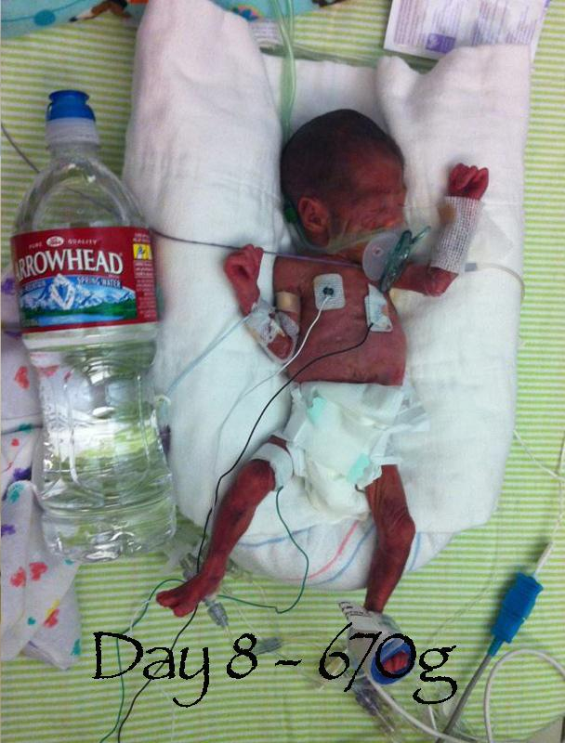
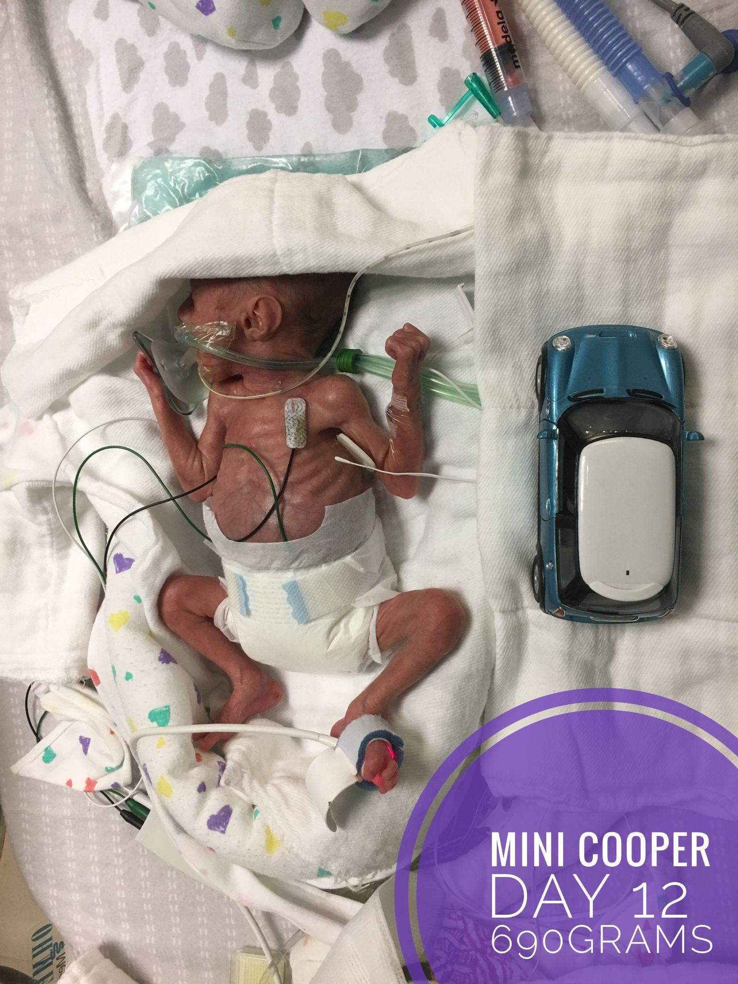
My whys

Slide 3



Slide 4
ASU Charter
ASU is a comprehensive public research university, measured not by whom it excludes, but by whom it includes and how they succeed; advancing research and discovery of public value; and assuming fundamental responsibility for the economic, social, cultural and overall health of the communities it serves.

Slide 5
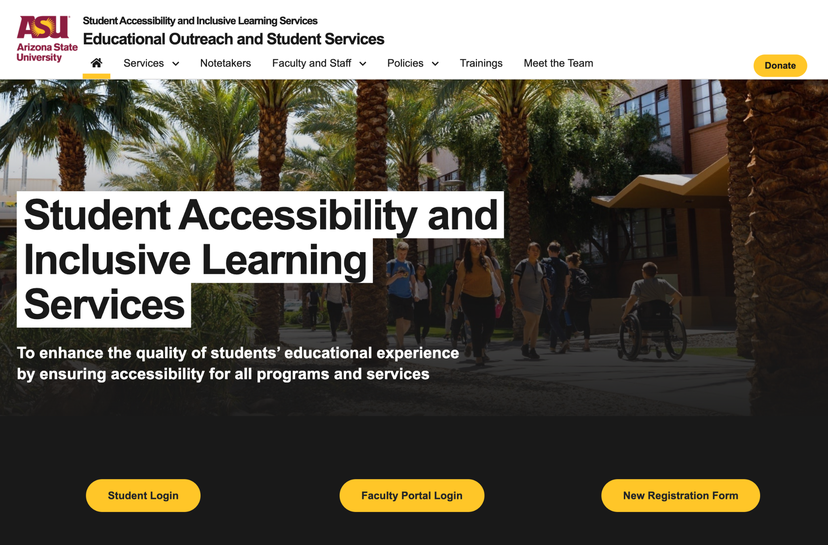
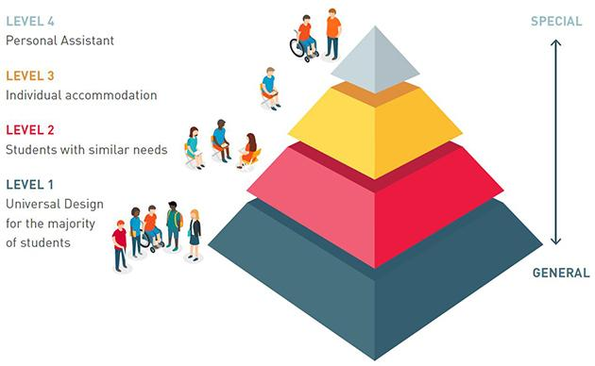
Continuum of Supports
ASU Student Accessibility and Inclusive Learning Services
(AHEAD, 2017)

Slide 6
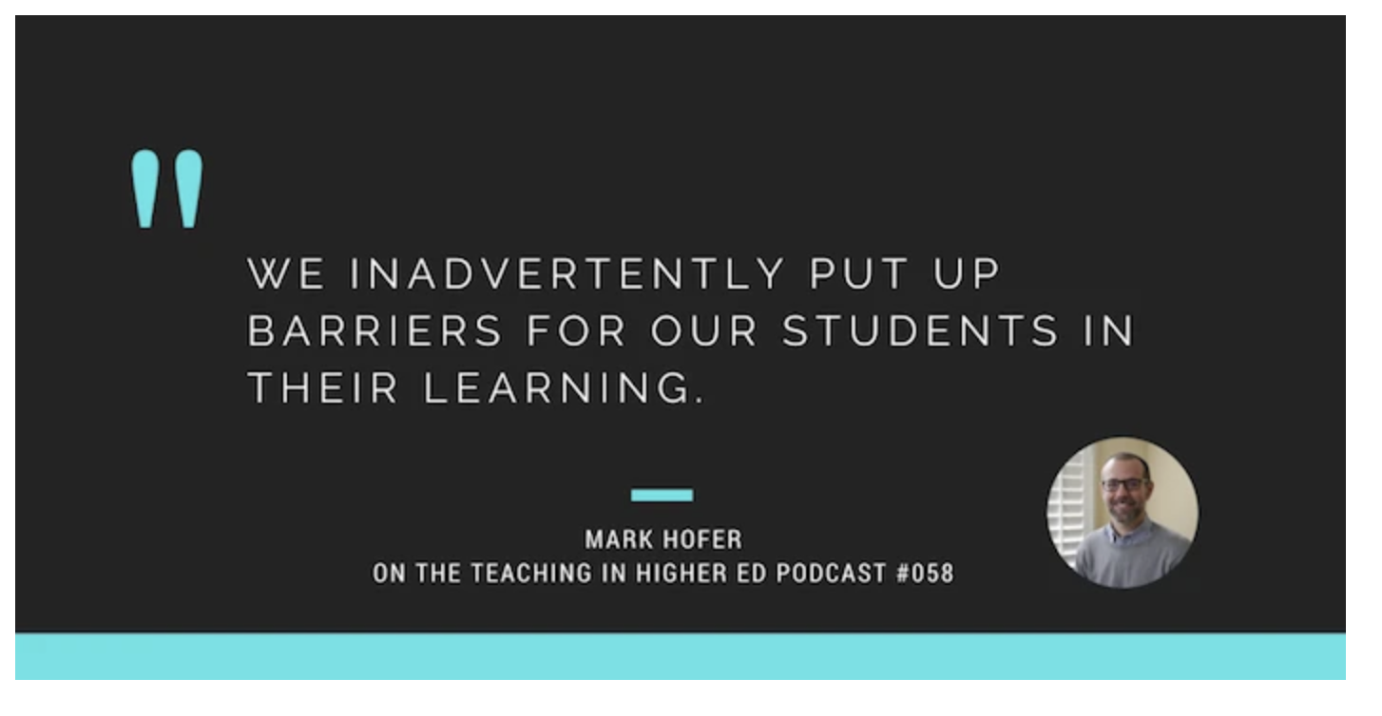
(Stachiowiak, 2015)

Slide 7
What is Universal Design for Learning (UDL)?

Slide 8
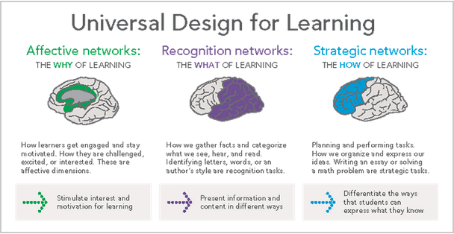
Engaging the whole brain in learning
(CAST, 2018)

Slide 9
01
Motivation and Interest
(Puruhito, 2017; Hobson & Puruhito, 2018)

Slide 10
02
Present information in multiple (organized and accessible) formats
(CAST, 2018)
Notes:
Presenting information in multiple modalities is the second component of UDL. Presenting information in multiple formats activates recognition networks. Providing lectures, podcasts, and written information allows students to access information in multiple ways, but it ALSO creates repetition, which is important for learning!
I’ll be honest with you here, when I first started teaching I hated standing and delivering lectures. Even in my online classes I struggled to see the importance of providing video lectures of the content that was covered in the textbook. But, I now realize it’s value when done properly. Lectures, can be high level summaries of what students are going to read. This provides them a framework to add detail to as they read. It can also be a time to address specific concepts that students struggle with.
It’s also important to note there that organizing the material so that it is accessible is super important. When creating assignments, be sure to put important information at the front or top of an assignment so it can be easily accessed, and use the headings feature in your word processor to make information easier to navigate for students with visual impairments
.

Slide 11
Universal Design =
Learning Styles
(Wise, 2022)
Notes:
I want to quickly note and address the difference between universal design for learning versus learning styles. You may have heard of the research on learning styles (kinesthetic, auditory, visual). Learning styles have been largely debunked by many many studies over the past decade. At best, most non-disabled people have learning preferences, but these preferences have little impact on learning outcomes. Providing information in multiple modalities is optimal for learning for most. This is different for people with disabilities though, which is where accessibility accommodations come into play.

Slide 12
03
Differentiate how students demonstrate competencies

Slide 13
Communication

Slide 14
Talking to students about supports and accommodations

Slide 15
UDL Resources
https://thesanfordschool.asu.edu/hopeanalytics
https://udlguidelines.cast.org/
http://udloncampus.cast.org/home
https://digitalpromise.org/2017/03/30/udl-adult-learners-guidelines-strategies/

Slide 16
References
AHEAD (2017). UDL and the continuum of supports. Retrieved from https://www.ahead.ie/udl-pyramid
CAST (2018). Universal Design for Learning Guidelines version 2.2. Retrieved from http://udlguidelines.cast.org
Wise, A. (2022). Should We Dismiss Learning Styles in Instruction? COABE Journal: The Resource for Adult Education, 11(1), 64–70.
Stachiowiak, B. (Host). (2015, July 23). Universal design for learning [Audio podcast]. Teaching in Higher Ed https://teachinginhighered.com/podcast/universal-design/

Slide 17


