Slide 1
Build Accessible and User-Friendly Courses in Articulate Storyline & Rise
Lindsay O’Neill Assistant LMS Administrator, Leadership and Workforce Development, OHR Principal, Lindsay O’neill Consulting LLC
Notes:
Slides copyrighted by Lindsay O’Neill, Lindsay O’Neill Consulting LLC. Licensed under Creative Commons: CC BY-NC 4.0. To view a copy of this license, visit https://creativecommons.org/licenses/by-nc/4.0/
Articulate Storyline and Rise are wonderful for creating engaging learner experiences. They also have incredible accessibility features that you may not know about! Learn how to create courses that are fully accessible and user-friendly for all learners.
In this session we’ll cover what it takes to create courses in Articulate Storyline and Rise that are accessible and compliant with Section 508. We’ll cover best practices for developing accessible courses in Articulate 360, including the interactions and elements to avoid. Incorporating alt-text, closed captions, and even transcripts is easy, and we’ll practice the ins and outs of formatting content for keyboard navigation. Attendees will leave with a checklist for creating accessible Storyline and Rise courses.
Attendees will be able to:
Describe best practices in developing accessible content in Storyline and Rise
Recall interactions and elements to avoid
Demonstrate including alt-text, captions
Format courses to facilitate keyboard navigation

Slide 2
What we’ll cover today…
Describe best practices in developing accessible content in Storyline and Rise
Recall interactions and elements to avoid
Demonstrate including alt-text and captions
Format courses to facilitate keyboard navigation

Slide 3
What we will NOT cover today…
General best practices in accessibility
Detailed accessibility instructions for Rise/Storyline*
Notes:
*Like WCAG Level AAA - though I am providing you with resources to find detailed instructions!
508 compliance is level AA
Overall best practices in accessibility
We’re not covering those, but use them!
There are levels of accessibility, this is just the basics. Truly accessible courses should be tested with screen readers to make sure there are no bugs.

Slide 4
Accessibility in Elearning

Slide 5
Elearning vs. Webpages
Elearning interfaces and navigation are unique
Lots of content
Frequent interactions
Heavy use of audio, video
May be more difficult to check accessibility using tools like WebAIM’s Wave
Notes:
Open each file, run WebAIM WAVE extension

Slide 6
Building in Accessibility
Best done from the start
Accessibility Goal: keyboard navigation, screen reader usability
Accessibility checks need human judgment
But what about templates?
Notes:
Even if templates start out accessible, developer changes make it inaccessible.
I’m talking alt-text, use of inaccessible blocks, no closed captions…

Slide 7
Handouts
QR Code
Link
tinyurl.com/ articulate508
Notes:
tinyurl.com/articulate508

Slide 8
Articulate and Accessibility
Tons of accessibility features! More being added regularly.
Rise vs. Storyline
Rise: limited creativity, responsive and more easily updated, easier to make accessible content
Storyline: ultimate creativity, not responsive and less easily updated, less easy to make accessible content
Notes:
Rise: Quicker to make accessible courses and to update
Most blocks accessible
No worrying about headings (e.g. H1, H2…), hierarchy of content
Easy keyboard navigation
Storyline: Slower to make accessible courses and to update
Attention to detail is a must
Must program headings (e.g. H1, H2…), hierarchy of content
Done correctly, still easy keyboard navigation

Slide 9
Rise

Slide 10
Accessibility Considerations in Rise
Alt-text
Closed captions
Avoiding non-accessible interactivity
Notes:
Only the major ones are listed here!

Slide 11
Rise Demo Course
Staying Healthy in the Heat – Live on the Web

Slide 12
Storyline
Notes:
Slower to make accessible courses and to update
Attention to detail is a must
Must program headings (e.g. H1, H2…), hierarchy of content
Done correctly, still easy keyboard navigation

Slide 13
Accessibility Considerations in Storyline
Alt-text for images and each state
Setting focus order for keyboard use
Learner control of multimedia
Closed captions
Avoiding non-accessible interactivity
Notes:
Only the major ones are listed here!

Slide 14
Alt-Text and Object Visibility
Right-click, select Accessibility
Edit alt-text, choose visibility
Notes:
Adding alt-text, choosing visibility to assistive tech

Slide 15
Focus Order
Order in which keyboard users navigate
Home tab – select Focus Order
Notes:
Focus order

Slide 16
Storyline Demo Course
Saguaro National Park – Live on the web

Slide 17
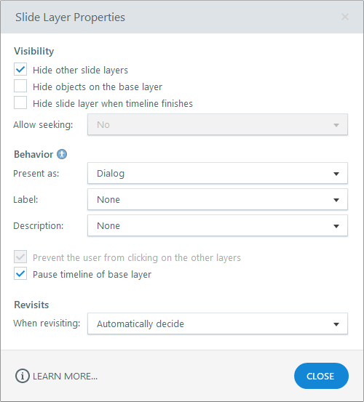
Accessible Layers
Choose “Dialog”
Hide other slide layers
Pause timeline of base layer
Be sure to set focus order!
Notes:
From Articulate: Turn a standard layer into a dialog layer to make interactions even more intuitive and inclusive. When learners encounter a dialog layer, the keyboard focus stays on the modal dialog and its contents by dimming everything else in the browser window so learners can't interact with anything else in the course while the layer is open.
Learners can navigate dialog layers with a screen reader or keyboard. Enhance the screen reader experience for dialog layers by defining accessibility attributes for an alternative title and description.

Slide 18
Wrap-Up
Create accessible templates
Try it yourself: Preview and test with a keyboard
Accessibility checks require your judgment!
Go further: Download a screen reader and test
Use a checklist and keep practicing!

Slide 19
Questions?
lindsay.oneill@asu.edu or lindsay@lindsayoconsulting.com

