Slide 1
Advancing Digital Accessibility: Insights and Strategies
GSA Government-wide IT Accessibility Program
November 7, 2024

Slide 2
Today’s Agenda
Why Accessibility Matters
Legislative and Regulatory Landscape for Digital Accessibility
About Us: The GSA Government-wide IT Accessibility Program
Recent Congressional and Executive Actions
Findings from GSA’s (Federal) Governmentwide Section 508 Assessment
Insights and Resources for Advancing Digital Accessibility

Slide 3
Why Accessibility Matters
61 Million adults (26%) in the United States live with a disability
Roughly 1-in-4 adults has some type of disability
14% (8M) blind or with limited vision
13% (8M) deaf or with limited hearing
35% (21M) with limited reach, strength or manipulation
54% (33M ) with limited mobility
*Source: 2010 US Census
Just because you haven’t heard a complaint doesn’t mean you don’t have a problem; individuals often fear further discrimination due to complaints

Slide 4
Legislative and Regulatory Landscape for Digital Accessibility

Slide 5
Section 508 of the Rehabilitation Act
Section 508 of the Rehabilitation Act (29 USC 794d), as amended in 1998, requires information and communication technology (ICT) that is procured, developed, maintained, or used by federal agencies to be accessible and usable by:
Individuals with disabilities
Members of the public accessing government ICT
Federal employees
Section 508 tasks GSA to provide technical assistance to help federal agencies comply with Section 508 requirements, and ensure that covered ICT is accessible to, and usable by, individuals with disabilities.
Notes:
To that end, section 508 of the rehabilitation act was amended in 1998 to require that any federal information in communication technology that is procured, developed, maintained or even used is accessible to people with disabilities, including both members of the public who access and and use government information and information technologies and federal employees who need digital tools and applications to be accessible to do their jobs on a daily basis.

Slide 6
The Section 508 Standards
Technical Requirements Built on Section 508 Statute: Organized by ICT functionality, these technical standards ensure that covered hardware, software, electronic content, and related documentation and services are accessible to persons with disabilities.
Formal Designation and Oversight: Officially named the ICT Standards and Guidelines (36 CFR 1193 and 1194), these requirements are maintained by the U.S. Access Board.
2017 Refresh: The standards were updated to harmonize with global accessibility guidelines, including those from the European Commission and the World Wide Web Consortium (W3C) Web Content Accessibility Guidelines (WCAG) version 2.0.

Slide 7
Americans with Disabilities Act, Title II
Title II of the ADA requires state and local governments to make sure that their services, programs, and activities are accessible to people with disabilities.
New rule, Accessibility of Web Information and Services of State and Local Government Entities (28 CFR Part 35) - applies to web and mobile content and applications
Requires conformance to WCAG 2.1 Levels A and AA

Slide 8
Arizona State Policy 1300
All State of Arizona electronic or information technology shall be accessible to people with disabilities.
Budget Units (BU) shall adopt a standard for electronic or information technology systems that complies with Section 508 of the Rehabilitation Act (29 U.S.C. § 794d).
For websites and online applications, BUs may use the latest version of the Web Content Accessibility Guidelines (WCAG) level A and AA issues, maintained and published by the World Wide Web Consortium (W3C) for this purpose.
WCAG version 2.2 released as final recommendation October 2023

Slide 9
The GSA Government-wide IT Accessibility Program

Slide 10
About Us: The GSA Government-wide IT Accessibility Program
Host Section508.gov and assist with technical support, guidance, and advice to agencies and individuals with questions and issues relating to the implementation of Section 508 requirements.
Focus on providing support to federal agencies in the following primary areas:
Accessible Acquisition
Policy and Program Management
Content Creation
Accessible Design and Development
Accessibility Testing
Accessibility Training and Events
Conduct the Congressionally-mandated, annual Governmentwide Section 508 Assessment

Slide 11
FY 23 Government-wide Section 508 Assessment

Slide 12
Assessment Mandate
Section 752 of the 2023 Congressional Authorizations Act (Pub. L. No. 117-328) directs the Office of Management and Budget (OMB), General Services Administration (GSA), and U.S. Access Board (USAB) to produce a comprehensive report on government-wide accessibility.
New assessment criteria defined
Agencies required to respond
Report to Congress:
A comprehensive assessment by agency and governmentwide generally of compliance to accessibility standards
A detailed description of actions and efforts GSA took to support compliance at agencies over the past year and planned efforts in the next year
A list of recommendations to Congress to help improve accessibility compliance

Slide 13
Key Finding #1
Section 508 Compliance Can Be Improved Across Government

Slide 14
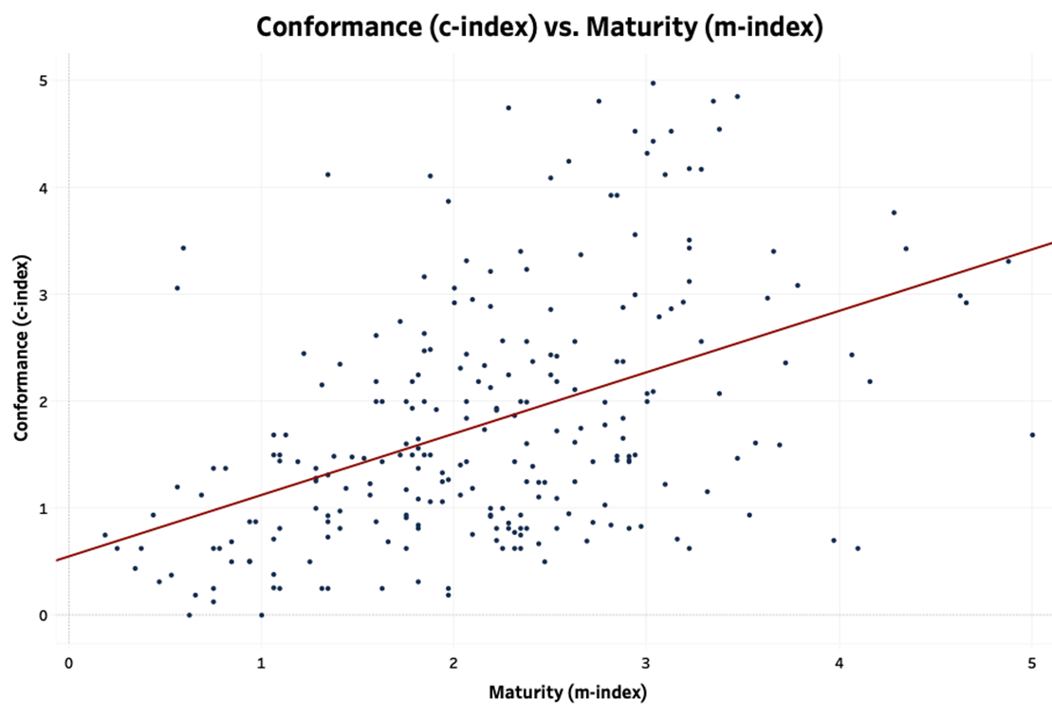
Overall Performance Across Government
Responses from 249 reporting entities revealed the government as a whole is not meeting the statutory requirement of Section 508 to provide equal access to all members of the public and federal employees with disabilities.
 | Very Low Maturity | Low Maturity | Moderate Maturity | High Maturity | Very High Maturity
Very High Conformance | 0 | 2 | 6 | 9 | 0
High Conformance | 2 | 3 | 8 | 5 | 3
Moderate Conformance | 0 | 12 | 23 | 8 | 4
Low Conformance | 4 | 39 | 37 | 5 | 1
Very Low Conformance | 21 | 25 | 27 | 4 | 1

Slide 15
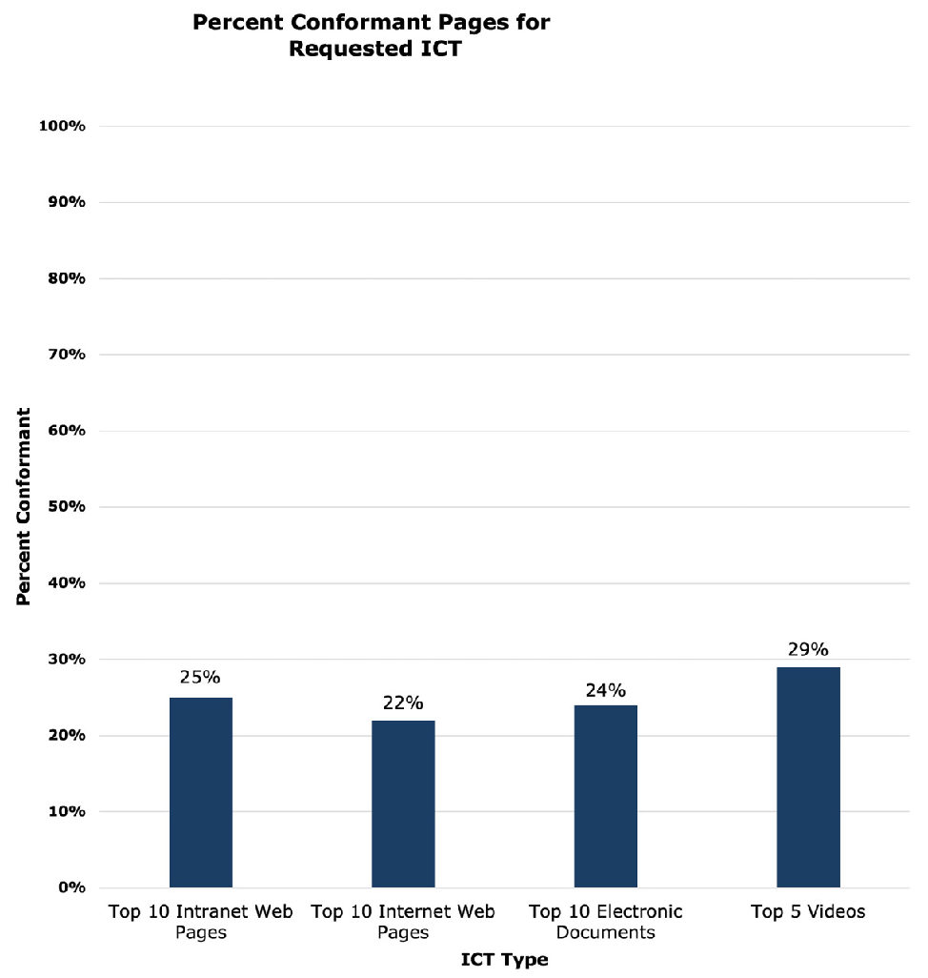
Of the self-reported top 10 viewed intranet and internet pages, top 10 viewed electronic documents, and top five viewed videos, less than 30% fully conform to Section 508 standards.
The Majority of Top-Viewed ICT Tested Do Not Fully Conform to Section 508 Standards

Slide 16
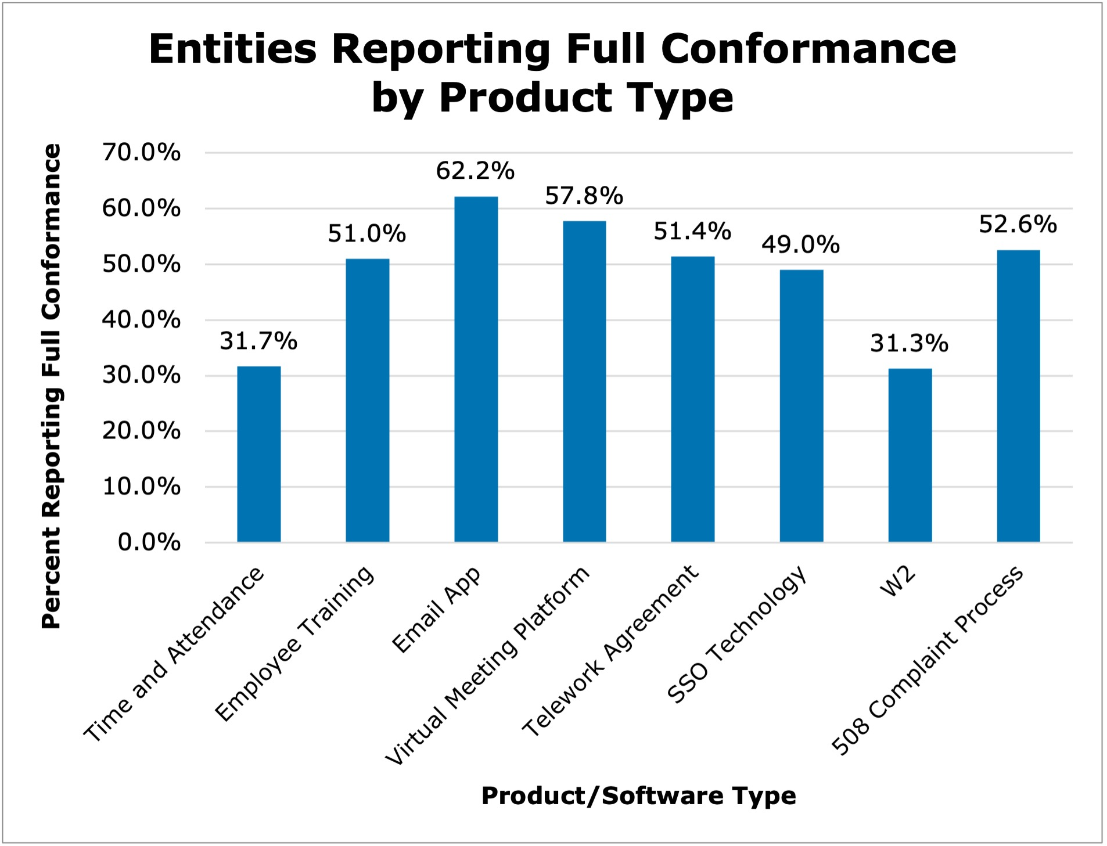
Top ICT Compliance Outcomes
The self-reported conformance information for common digital technologies used within agencies shows:
The highest conformance was 62.2% for agency email applications.
The lowest was 31.3% with organization W2s.
Every instance of noncompliance with Section 508 captured in this data indicates federal employees with disabilities and members of the public are impeded or excluded in their interactions with federal ICT.

Slide 17
Key Compliance Recommendations
Target Accessibility of High-Use Software: Congress should consider conducting oversight efforts into major providers of ICT to the federal government to determine the best course of action for improving accessibility of high-use products.
Share Best Practices: Agencies should more actively engage with the digital accessibility community, GSA, and the Access Board to develop and share best practices.

Slide 18
Key Finding #2
Resources Are Impactful

Slide 19
Section 508 Program Manager (PM) Utilization
Maturity Bracket | Average Section 508 PM Hours Spent per Week
Very High | 31 hours
High | 26 hours
Moderate | 19 hours
Low | 10 hours
Very Low | 3 hours
Entities with higher Section 508 PM participation tend to have more mature Section 508 organizations.
Section 508 PMs across government spent an average of 15.4 hours per week on Section 508.

Slide 20
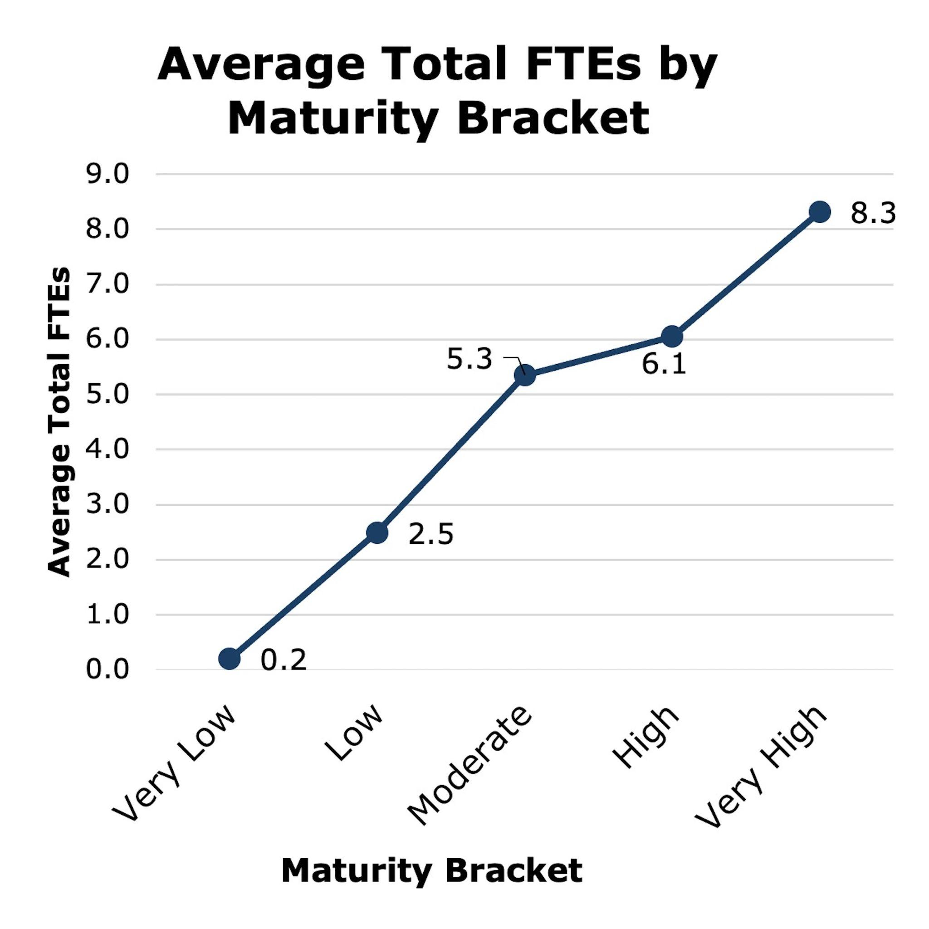
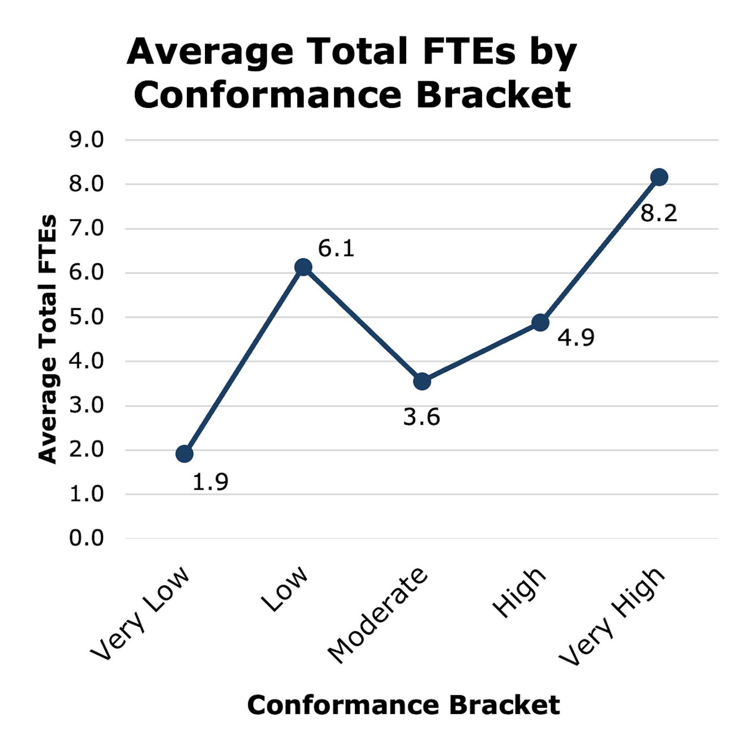
FTE by Maturity and Conformance Bracket
More mature entities tend to have more FTEs.
Entities with better conformance outcomes tend to have more FTEs.

Slide 21
Key Resourcing Recommendations
Ensure Sufficient Section 508 Program Manager (PM) Utilization: Agencies should have an assigned Section 508 PM with utilization and authority that is proportionate and sufficient to ensure an effective Section 508 program.
Ensure Sufficient Section 508 Program Resourcing: Agencies should consider including information about Section 508 program capacity in annual budget requests to highlight necessary resources to improve ICT accessibility.

Slide 22
Read the FY23 Assessment Report
The web version of the report is available at: https://www.section508.gov/manage/section-508-assessment/2023/message-from-gsa-administrator/
A downloadable PDF version of the report is available at: https://assets.section508.gov/files/reports/cr-2023/FY%2023%20Governmentwide%20Section%20508%20Assessment%20Report.pdf
All response data is available at: https://www.section508.gov/manage/section-508-assessment/2023/assessment-data-downloads/
All criteria and instructions are available at: https://www.section508.gov/manage/section-508-assessment/criteria-01/

Slide 23
Foundations for a Model 508 Program

Slide 24
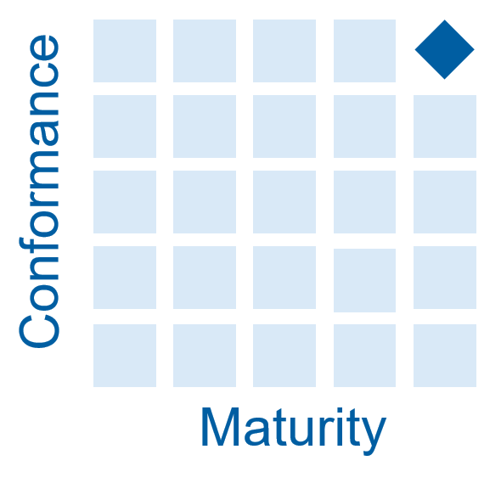
Strategic Agency Outreach
Assessment-Driven Insight: The 2023 Government-wide Section 508 Assessment revealed significant performance gaps, with only 7% of entities scoring high for both maturity and conformance.
Purpose: To understand what characterized these high achievers, GSA conducted a focused study, exploring the strategies and practices of top-performing agencies. In other words:
Key Question: How do you get to the top spot?
Methods: In-depth interviews with federal employees across five departments, maintaining respondent anonymity.
Outcome: Identified key foundational practices that distinguish top-performing Section 508 programs and established the groundwork for a "model 508 program."

Slide 25
Foundations for a Model 508 Program: In Three Parts
Situational Awareness and Goal Setting
Leadership and Coordination
Setting the Location of 508 Operations
Document your current situation.
Leadership must assert to the organization that accessibility is the right thing to do (and v.v.)
The 508 Program Office must be established and funded as a service to applicable organizational elements.
Set your goals.
Leadership must steer and ensure coordination of the Section 508 work for the organization
Establish that 100% of any division’s budget covers 100% of the target population.
Leadership must ensure that Section 508 compliance is included in ICT-related leadership and management performance plans.
Establish that applicable organizational elements include Section 508 in their policies.
Focus on Foundational Shifts: One-time foundational changes have a greater impact on building strong Section 508 programs than incremental improvements.
Improve the Foundations: Just like fixing a cracked house foundation, investing in foundational program improvements is critical for long-term success, even if it requires upfront resources.
Hold division leadership accountable for providing the appropriate skills for Section 508 work.
Hold division leadership accountable for including Section 508 work in development, testing, and reporting.

Slide 26
Technology Accessibility Playbook

Slide 27
Technology Accessibility Playbook: How to Build an Effective Section 508 Program
Foundations vs. Playbook: While the foundations define what elements are needed for a successful Section 508 program, the Playbook provides the how with 12 strategic plays that guide agencies through building, assessing, and enhancing their programs.
Play 1: Establish a Technology Accessibility Program Manager
Play 7: Integrate Accessibility Needs Into Market Requirements Design
Play 2: Assess your Technology Accessibility Program Maturity
Play 8: Integrate Accessibility Needs Into Market Research and Acquisition
Play 3: Develop a Technology Accessibility Roadmap
Play 9: Integrate Accessibility Needs Into Development
Play 4: Establish a Technology Accessibility Policy
Play 10: Conduct ICT Standards Testing
Play 5: Develop a Technology Accessibility Program Team
Play 11: Track and Resolve Accessibility Issues
Play 6: Collaborate with the Federal Accessibility Community
Play 12: Educate the Workforce

Slide 28
Tools for Improving Acquisition of Accessible ICT

Slide 29
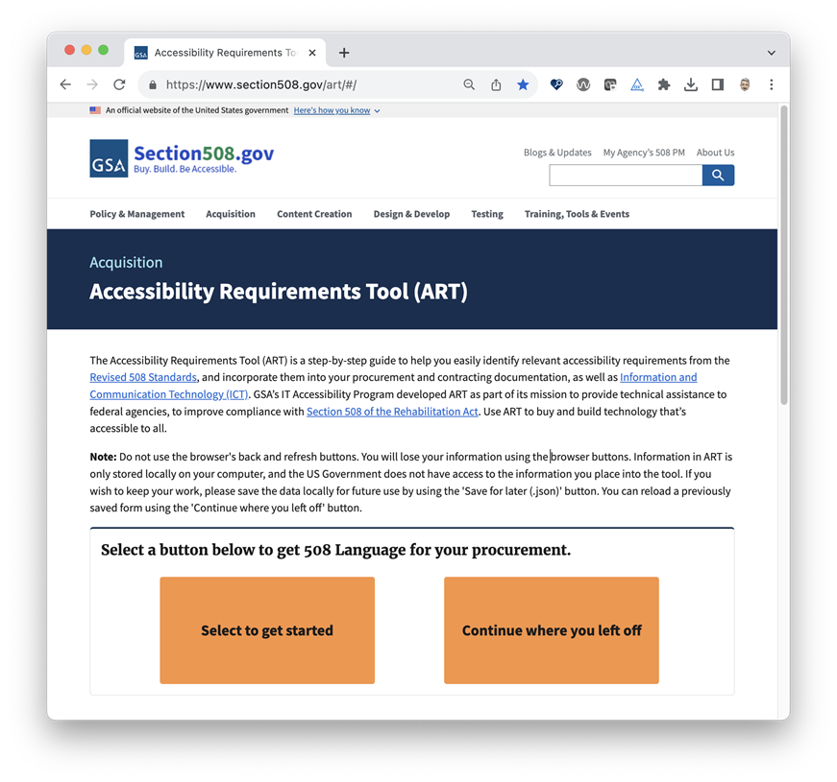
The Accessibility Requirements Tool (ART)
ART is a step-by-step guide to help you easily identify relevant accessibility requirements from the Revised 508 Standards and incorporate them into your procurement.
Selected recent ART updates:
Reduced time to create a procurement flow by 50%
Ability to save completed form in multiple formats
Upgraded from Drupal7 to most recent framework, Angular 15
Opportunity to continue from where user left off using saveable JSON file
Ability to be integrated with other platforms and software
Brand new Application Programming Interface (API) to facilitate integration with other systems

Slide 30
The OpenACR portfolio
The OpenACR data schema for a machine-readable ACR:
Buyers can more easily compare accessibility of different solutions
Managers gain insights into potential interface limitations
Executives more easily assess risks associated with accessibility issues in portfolio of ICT products
The OpenACR Editor is a user-friendly interface to:
Create machine-readable Accessibility Conformance Reports (ACRs) in the OpenACR format
Validate and edit previously created ACRs
Export and share machine-readable data
View ACR reports in HTML
Try Now: acreditor.section508.gov
The OpenACR repository will be a platform for users to store, compare and update information for ACRs. This repository will:
Provide the ability to see all products and ACRs in a comprehensive repository
Allow users the ability to compare ACR reports between products
Provide search functionality

Slide 31
Resources
Section 508 of the Rehabilitation Act (29 USC 794d), as amended
ICT Standards and Guidelines (36 CFR 1193 and 1194)
FY 23 Government-wide Section 508 Assessment
Technology Accessibility Playbook

Slide 32
How to Contact the GSA Gov-wide IT Accessibility Team
Visit our Contact Us page at section508.gov/contact-us/
Contact us via email at section.508@gsa.gov

Slide 33
Questions?

Slide 34
End

