Slide 1
The Art of Crafting Meaningful ALT+Text
© 2024
Accessiblü
Notes:
The Art of Crafting Meaningful ALT+Text. Title Slide. Copyright 2024. Accessiblü.

Slide 2


Crafting Meaningful ALT+Text
Jeff Rodgers, MS Ed
Director, Digital Accessibility, Accessibility Strategy Leader
Notes:
The Art of Crafting Meaningful ALT+Text.
My name is Jeff Rodgers, and I am the manager of digital accessibility for Accessiblü. Before joining Accessiblü. I am a former tenured professor, department chair, instructional designer, and accessibility specialist with twenty years of higher education experience. I’m happy to be able to be a part of the ASU accessibility day once again!

Slide 3
Session Overview
You may share ALT+Text descriptions.
  Please share in the chat if you are comfortable.
There will be a Q and A session at the end.
Notes:
A quick overview of today’s session. I will be asking you to share some thoughts on different ALT+Text descriptions, and if you are comfortable, please share them in the chat.
Also, I am planning few minutes for a Q and A session at the end. Let’s get started!

Slide 4
First, Some Assumptions
You know what ALT+Text is.
Why it is important.
Why incorrect or missing ALT+Text is bad!
How ALT+Text works with assistive technology.
Screen readers can have character limits.
  ⪅180 Characters
Notes:
First, To allow us to focus more on examples of ALT+Text, I want to set some assumptions. Things I am assuming we all know about ALT+Text descriptions. If you are not sure about any of these topics, please just type the number in the chat and I will be happy to review it.
So, number one, I am assuming that all of us are familiar with what ALT+Text is and what we mean when we refer to the term ALT+Text.
Two, why ALT+Text is important for accessibility.
Three, why incorrect or missing ALT+Text is bad and how it is a barrier for screen reader users.
Number four, how ALT+Text works with assistive technology when a screen reader comes across an image with ALT+Text.
Finally, number five, that screen readers have character limits and alt descriptions should be kept to 180 characters or less.

Slide 5

Let’s Craft Meaningful ALT+Text!
Notes:
Let’s dive in and start exploring how to craft some meaningful ALT+Text descriptions!

Slide 6
Step One:
Decide on What Needs ALT+Text
The first step is to decide on which images need a description, and which ones don’t.
Notes:
The first step in crafting some fantastic ALT+Text is deciding on which images NEED an alternative description, and which ones don’t.

Slide 7
Meaningful or Decorative?
Meaningful Images
Important for sighted readers = Needs an ALT!
Decorative Images
If removed, does it detract from the message.
Require a description.
Do not require a description.
Notes:
To help determine what images need ALT+Text, I suggest a fun game: Meaningful or Decorative?
You can play this fun game with your colleagues or by yourself as a way to stay awake during meetings with PowerPoints, that should have been an e-mail!
Meaningful images: These are images that are important. If they have some significance to sighted readers, then they require a description of some kind.
Decorative images: These are images, that if removed from the page, do not detract from the message or remove some important information. Decorative images do not require a description. Let’s play! Those of you who are screen reader users – you get to play too, but you get to be judges, and just like the TV show Who’s Line Is It Anyway? You award the points!

Slide 8

ASU Seal
Notes:
First up, Sighted people in the audience, Is this a meaningful or decorative image? Please enter your thoughts in the chat. I’ll describe it a minute and we can decide. Description: the ASU Seal: Arizona State University. 1885. Great Seal of the State of Arizona. 1912 in red on a white background. Choice: Meaningful! Points awarded?

Slide 9
Pentagon
Notes:
Next, let’s explore this image. Meaningful or decorative? Please enter your thoughts in the chat.
Description: A blue pentagon. Answer: This would most likely be decorative image, depending on how it is used on the page. And we will talk about that in a few minutes. Any points awarded?

Slide 10
Meaningful Images
Images with a purpose to sighted readers.
Logos, official seals, banners, and nameplates.
Photos, illustrations, maps, graphs, and charts.
Signatures and drawings.
Images of text.
Clickable graphics (buttons)
Groups of images.
Notes:
Here are some examples of Meaningful Images. The following are types of images that require ALT+Text:
Images with a purpose.
Logos, official seals, banners, nameplates.
Any branding that is trademarked.
Anything that needs to authenticate the owner of the information.
Photos, illustrations, maps, signatures, and drawings.
Graphics and charts.
Images of text.
“Clickable” graphics like buttons.
Groups of images.

Slide 11
Decorative Images
Have no purpose.
Removing them will keep info and the mood of the page the same.
Marking as decorative means it will be skipped by a screen reader.
Examples:
  Colored boxes and shapes.
  Separation lines.
  Where the ALT+Text would duplicate text already on the page.
  Complex images explained within the text or described in additional detail.
Notes:
Decorative Images
Decorative images have no relevant purpose and therefore are purely decorative. Removing these types of pictures or graphics will not impact the information and mood of the page.
Decorative images do not require a description. These images provide no context or additional information to users. When an image can be removed from the page without altering the information or content, it may be decorative.
Care should be taken when deciding if an image is decorative or not. Marking an image as “decorative” will cause screen readers to skip these images.
In Word or Adobe, images can be marked as decorative by checking a box wherever the ALT+Text is entered or in HTML using the alt=”” attribute.
Decorative images are sometimes called background, artifact, or null images.
Decorative images examples:
Colored boxes in headers and footers.
Colored boxes or shapes with no text.
Separation lines.
Images whose ALT+Text would duplicate text that is already on the page.
Complex images which are explained within the text on the page or described in detail via an additional document.

Slide 12
What About Reused Images?
If the image is used in the same context.
  Keep the same description.
If the image is used in a different context.
  Craft a different description.
Notes:
ALT+Text for Reused Images
It's common for images to be used more than once on a page, document, or website. However, it's important to note that the description used for one image may not work for the same image if it's used in a different context or for a different purpose. This means that ALT+Text may not always be sufficient when reusing the same image. If an image is used to introduce a topic and later used to demonstrate a point, it may require two different descriptions. Or, in an academic setting, where it is used within a lesson then used again within a test question. Certain aspects of the description can change when they are used for different purposes.

Slide 13
Step Two:
Context and Purpose!
Notes:
Step two of crafting meaningful ALT+Text: Context and Purpose!

Slide 14
The Keys to Meaningful ALT+Text
The CONTEXT the image is used in.
The PURPOSE it serves to all readers.
Notes:
The answer to life, the universe, and crafting meaningful ALT+Text is….Context and Purpose! The are the two keys to unlocking the mystery of crafting meaningful alt descriptions! When writing an alt description you want to focus on describing the CONTEXT the image is used in and the PURPOSE it serves to all readers.

Slide 15

Context & Purpose
Describe dominant visuals.
Capture the action.
Tell the story.
Repeat image text.
Describe who and what is happening.
Note genders, race, ages, etc.
Set the mood.
Notes:
When thinking about the CONTEXT and PURPOSE all readers need to obtain, focus on these aspects.
Describe the critical information your readers need: You’ll need to balance information and details, considering that screen readers can have a character limit.
Here are some tips about deciding what to say. You could do any combination of the following:
You could describe the dominant visual details.
Capture the action.
Tell the story.
Repeat any relevant text in the image.
State what is noteworthy for users.
Note what is unusual.
Describe who is in the picture and what they are doing.
Note the genders, races, ages, and appearances.
Note the location if necessary.
Describe the environment, time of day, etc.
Set the mood or ambiance.
If you use images from a source or publisher, do not assume that all provided ALT+Text will meet accessibility standards or align with the context and purpose of the image as you are using it!

Slide 16
ALT +Text Tips
180 characters or less.
Avoid: “An image or Picture of…”
Be concise.
Avoid editorial content.
Don’t duplicate the caption.
Use sentence structure.
Use correct punctuation and grammar.
Notes:
Tips for writing great ALT+Text:
When preparing to write ALT+Text, here are a few things you should keep in mind:
Aim for 180 characters or less.
Avoid starting with “a picture of…” or “an image of….”
Remember to focus on conveying the context and purpose.
Be concise. Describe only what the user needs to obtain or know.
Avoid editorial content. Save that for the caption. (e.g., photo by Tia Ivy via Getty Images)
Avoid duplicating captions or information that is already present on the page when using ALT+Text.
Always use standard sentence structure. It should sound natural when read aloud.
ALT+Text does require correct punctuation, including periods.

Slide 17
The 7 Different Types of Images
Notes:
The W3C uses the following seven categories or types of images regarding ALT+Text.

Slide 18
The W3C’s Different Image Types
Eye Candy = Often confused with decorative.
Functional Images = Shopping Cart.
Informational Images (most) = Pictures.
Complex Images = Charts and Maps
Images of Text = Pics of sign.
Groups of Images.
Decorative
Notes:
The W3C classifies images into 7 different types.
Eye Candy. These are images that serve a purpose but are not necessarily informative. They can help make a point or set a mood. They are often mistakenly marked as decorative.
2. Functional Images. Images like shopping cart icons, buttons, or links. Images that have or perform a function.
Informational Images. These are most images or pictures. The typical images that we think need descriptions.
Complex Images. These are charts or graphs and images that have a lot of data or information that can’t be described in 180 characters or less.
Images of text. These are images with text or numbers which need to be included in a description.
Maps. These are well, maps. They can be images of maps or dynamic map types like Google Maps.
Groups of images. These would be collages or images that have multiple images or types grouped together in a carousel, grid, etc
Let’s explore some examples and see how far we can get.

Slide 19

Eye Candy
Notes:
Eye Candy (Window dressing, mood-setters)
These types of images are often mistakenly marked as decorative. However, they may require ALT+Text if they serve a purpose for sighted users. For example, images that help set the mood of an article or lesson. They should provide the same context to non-sighted users as they do for sighted users.
Images require ALT+Text if they:
Are eye-catching or provide a visual improvement for sighted users.
Are also not purely decorative; they have a purpose.
Set the mood.
Reinforce a message.
Entice readers.

Slide 20

Functional Images
Submit
Notes:
#2 Functional Images. Here is an example of a functional image. These can be shapes used for buttons or text used for hyperlinks. Examples include icons representing a save, print, or search function. These do require a description that should describe the function, destination, or event that will happen because of activating the function.
Remember: If you are assessing a publisher or third-party website, you will want to make sure any functional images learners need to use have appropriate ALT+Text!

Slide 21

Informative Images
ALT+Text:
Screenshot of the ASU Online web page. An image of an ASU graduated cheering. Same degree as campus students. 100,000 online graduates.
Notes:
Informative Images
Typically, pictures, photos, and illustrations, these images represent concepts and information. Therefore, the descriptions for these images should convey the essential information, mood, or impression that all users should get.

Slide 22
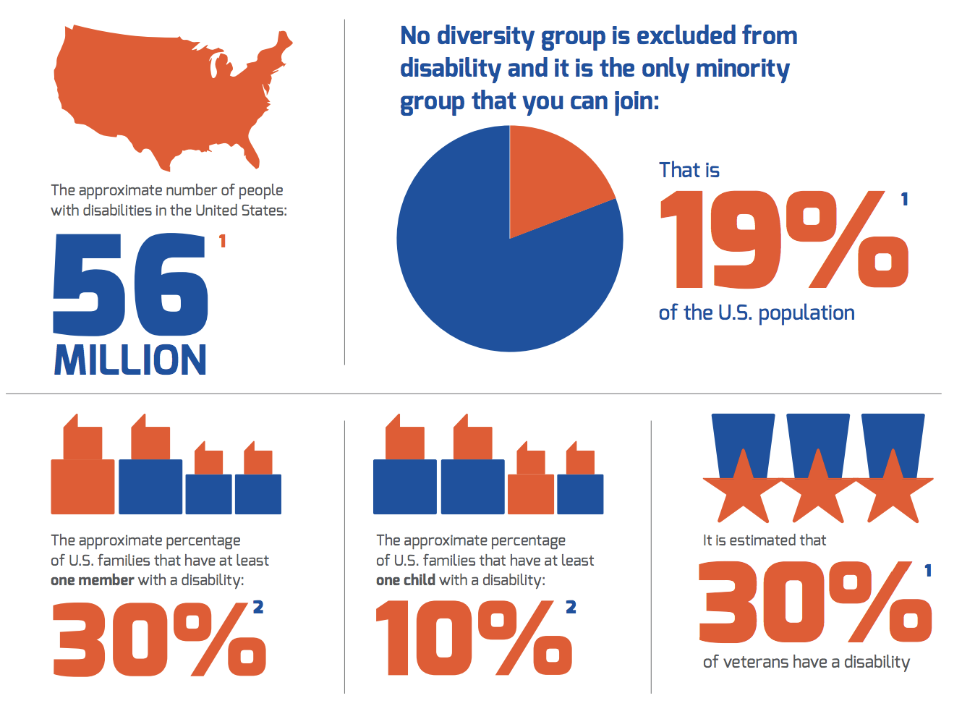
#5 Complex Images
ALT+text:
Infographic about percentages of people with disabilities in the U.S.. Essential text: Disability is the only minority group you can join. That is 19% of the U.S. population.
Notes:
Complex Images
Complex images such as charts, diagrams, and illustrations require ALT+Text. While it may seem impossible to describe all the details within 160 characters, this can be accomplished by utilizing the ALT+Text description in conjunction with other methods.
Here are some strategies for dealing with complex images:
Focus on the purpose of the chart or graphic.
Use the surrounding text to deliver details and additional information.
Describe the significant data points or trends the user needs to know.
Provide essential information.
Avoid duplicating information already on the page.
For web pages, utilize a long description attribute.
Providing a text-only version for charts or graphics with large amounts of data points is appropriate.
Images with layers should be combined into a single image.

Slide 23
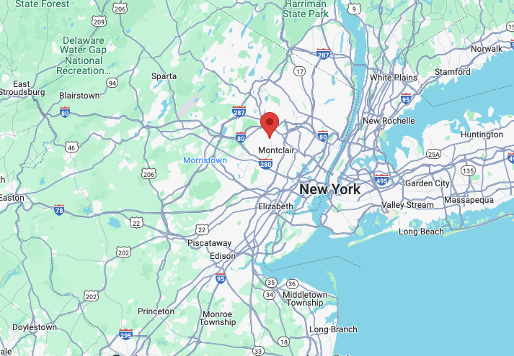
Maps
ALT+Text:
A Google map of the greater New York Area. Accessiblü's home office is indicated with a red point to the left of New York City, just above Newark, near Montclair New Jersey.
Notes:
Image Maps
Alternative text used for maps or images of maps that contain clickable points (Google Maps) should describe the overall context of the links or map. In addition, each clickable area of the map/image should have alternative text that identifies the purpose of that link. Be sure to describe the purpose or destination of the link. You can also follow tips for complex images such as explaining essential information in the surrounding paragraphs or using a caption. Remember that captions are readable by everyone, so follow that best practice and leverage both a caption and ALT+Text for your map.
Describe the overall context of the map.
Note essential points.
Clickable areas should each have their own ALT+Text.
Describe purpose or destination of the link.
Follow tips for complex images.

Slide 24
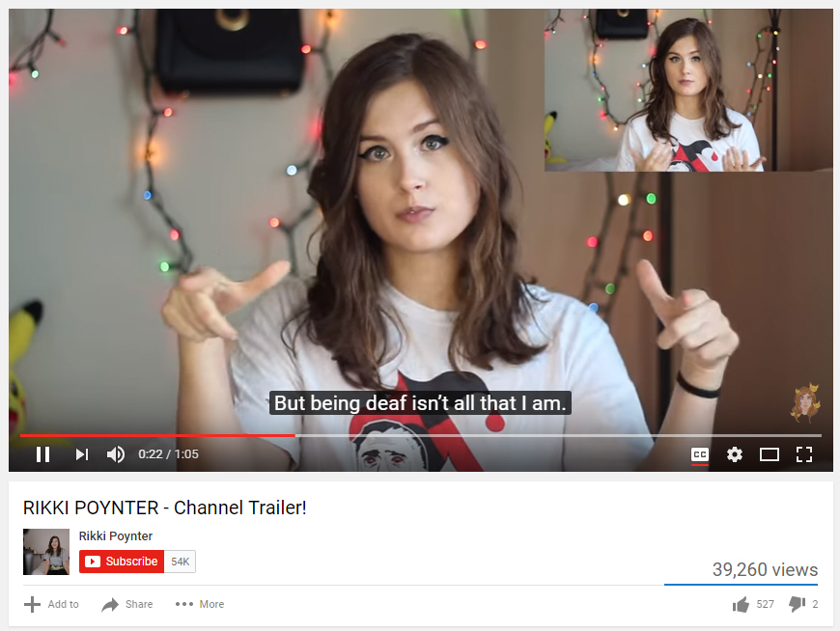
Images of Text
ALT+Text:
Screenshot of a Youtube video player. A woman with long brown hair and a white t-shirt performs sign language with her hands. Captions on the screen read, "But being deaf isn't all that I am."
Notes:
Images of Text
Whenever possible, images of text should be avoided. If an image of text must be included, the description should contain the exact words as in the picture.
Logos containing text images are permissible and should be identified as such in the description, as these can be required for trademark protection.
Word art in MS Word should include the correct ALT+Text description by default. However, this should always be checked. Watermarks should be described to convey their existence to all readers. For example, in MS Word, watermarks are read as part of the header.

Slide 25
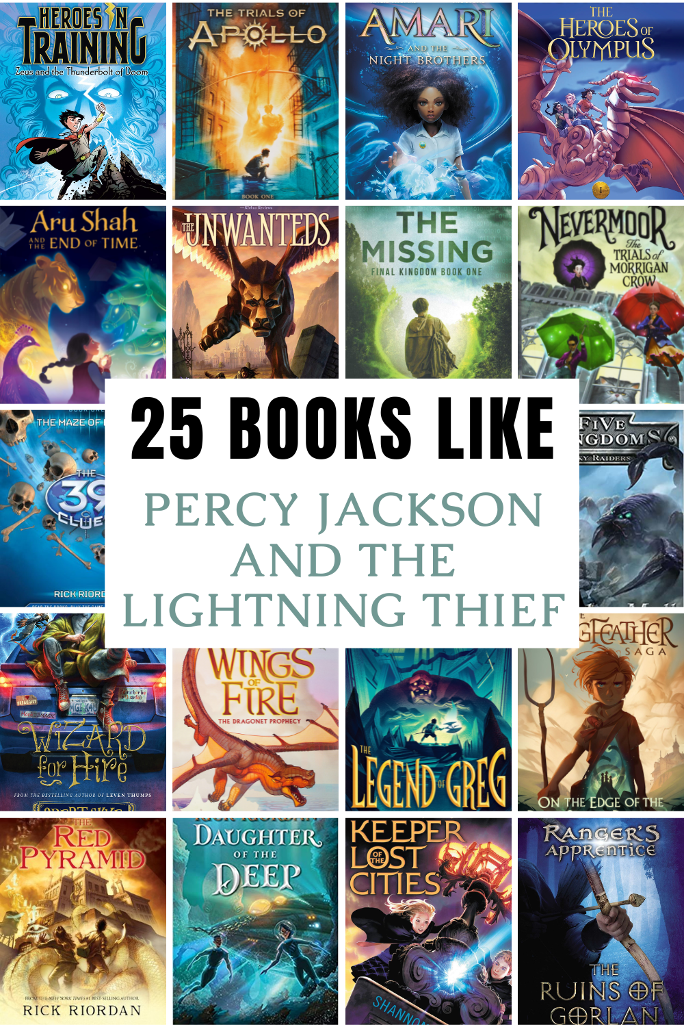
#7 Groups of Images
ALT+Text:
25 Series to Try if You Loved Percy Jackson and the Lightning Thief. Text over top of various book covers indicating fantasy fictional images. Many include dragons. Examples include Heros in Training and the Trials of Apollo.
Notes:
Groups of Images
If multiple images convey the same point or piece of information, the first image should be given the description, and the rest should be marked as decorative. The ALT+Text description should identify that it is serving multiple images. Finally, Always include essential text within the image.

Slide 26
What to Avoid with ALT+Text?
Notes:
What are some things to avoid when writing alt text?

Slide 27
When Writing ALT+Text:
Never use the image file name.
Avoid clipped or harsh language.
Avoid abbreviations.
Only use ALL CAPS for acronyms.
Use correct spelling, grammar, and punctuation.
Avoid including editorial information (Use a caption).
Avoid Information about the copyright of an image.
Do not include a hyperlink within ALT+Text.
Notes:
What to Avoid with ALT+Text:
Well-written ALT+Text should sound natural when read aloud since that is what a screen reader will replicate. However, some AT readers sound more realistic than others, so care should be taken to ensure the text-to-speech process can accurately convey the ALT+Text.
When writing ALT+Text:
Never use the image file name (e.g., 12345.jpg).
Avoid clipped or harsh language.
Avoid abbreviations.
Only use ALL CAPS for acronyms.
Use correct spelling, grammar, and punctuation.
Failing to end with a period or punctuation may cause the reader to run on to the next readable item.
Avoid including editorial information (Use a caption).
Avoid Information about the copyright of an image.
Do not include a hyperlink within ALT+Text.

Slide 28
Go Forth & Craft Meaningful ALT+Text!
Notes:
Go forth and craft meaningful ALT+Text!

Slide 29
Time for Questions!
Notes:
Time for questions!

