Slide 1
Enhancing Python & Data Science Education for B/VI Students
Bridging the Accessibility Gap

Slide 2
Agenda
Introduction
Introduction & Overview of Challenges in Data Science
Accessible Curriculum Design for Data Science
Data Accessibility with MAIDR
  MAIDR’s Role in Data Science Education
  Case Study – Data Vision Summer Course
Partnerships and Collaborative Success
Call to Action: Promoting Accessible Learning in Data Science
  Invest in Accessible Data Science R&D
  Integrate MAIDR in Curricula
Q&A
Notes:
Agenda
* Introduction
* The Data Science Accessibility Gap
* Accessible Tools for Coding and Data Analysis
* Data Accessibility with MAIDR
* MAIDR’s Role in Data Science Education
* Case Study – Data Vision Summer Course
* Collaborative Support
* Call to Action: Promoting Accessible Learning in Data Science
* Invest in Accessible Data Science R&D
* Integrate MAIDR in Curricula
* Q&A

Slide 3

Introduction
Presentation Duration
  25-minute presentation
  5-minute Q&A session
Presenters
  Jeff Bishop
    IT Accessibility Consultant
    The University of Arizona
  Ken Perry
    Senior Software Developer
    The American Printing House
Notes:
This 30-minute session includes a 25-minute presentation followed by a 5-minute Q&A. Presenters are Jeff Bishop from The University of Arizona and Ken Perry from The American Printing House.
Original Content:
30 Minutes
• 25-minute Presentation
• 5-minute Q&A
Presenters:
• Jeff Bishop – IT Accessibility Consultant, The University of Arizona
• Ken Perry – Senior Software Developer, The American Printing House

Slide 4
Challenges and Accessibility

Slide 5

Introduction & Overview of Challenges in Data Science
Challenges Faced by BLV Students in Data Science
  Visual nature of tools and resources
  Lack of accessible options
  Underrepresentation in the field
Need for Accessible Learning Tools
  Importance of inclusivity
  Potential solutions and innovations
Notes:
Blind and visually impaired students face challenges in data science due to the visual nature of tools. This leads to underrepresentation, highlighting the need for accessible learning tools.
Original Content:
• The Data Science Accessibility Gap:
Blind and visually impaired (BLV) students face critical challenges in data science due to the visual nature of tools and resources. The lack of accessible options in these areas leads to underrepresentation in the field, underscoring the need for accessible learning tools​:contentReference[oaicite:0]{index=0}​:contentReference[oaicite:1]{index=1}.
1. Introduction & Overview of Challenges in Data Science (5 minutes)

Slide 6
The Data Science Accessibility Gap
Challenges for BLV Students in Data Science
Visual nature of tools and resources
Lack of accessible options
Impact of Accessibility Issues
Underrepresentation in the field
Need for accessible learning tools
Notes:
Blind and visually impaired students face challenges in data science due to the visual nature of tools. This leads to underrepresentation and highlights the need for accessible learning tools.
Original Content:
• The Data Science Accessibility Gap:
Blind and visually impaired (BLV) students face critical challenges in data science due to the visual nature of tools and resources. The lack of accessible options in these areas leads to underrepresentation in the field, underscoring the need for accessible learning tools​:contentReference[oaicite:0]{index=0}​:contentReference[oaicite:1]{index=1}.

Slide 7
Accessible Tools and Curriculum Design

Slide 8
Accessible Curriculum Design for Data Science
Accessible Tools for Coding and Data Analysis
  GitHub & Visual Studio Code
    Accessible keyboard shortcuts
    Screen reader compatibility
    Enhances collaborative coding skills for BLV students
  Python Command-Line Tools
    Terminal interfaces for code management and analysis
    Provides tactile feedback
    Complements screen readers and braille displays
Notes:
Let's discuss accessible curriculum design for data science. We'll cover tools like GitHub and Visual Studio Code, which offer accessible keyboard shortcuts and screen reader compatibility. Additionally, Python command-line tools provide tactile feedback, enhancing code management and analysis for BLV students.
Original Content:
2. Accessible Curriculum Design for Data Science (10 minutes)
• Accessible Tools for Coding and Data Analysis:
– GitHub & Visual Studio Code: Accessible keyboard shortcuts and screen reader compatibility allow BLV students to work on code repositories, enhancing their skills in collaborative coding.
– Python Command-Line Tools: Terminal interfaces provide BLV students with accessible ways to manage and analyze code, offering tactile feedback that complements screen readers and braille displays​:contentReference[oaicite:2]{index=2}​:contentReference[oaicite:3]{index=3}.

Slide 9

Accessible Tools for Coding and Data Analysis
GitHub & Visual Studio Code
  Accessible keyboard shortcuts
  Screen reader compatibility
  Enhances collaborative coding skills for BLV students
Python Command-Line Tools
  Terminal interfaces for code management and analysis
  Provides tactile feedback
  Complements screen readers and braille displays
Notes:
Accessible tools like GitHub and Visual Studio Code offer keyboard shortcuts and screen reader compatibility. Python command-line tools provide tactile feedback, aiding BLV students in coding and data analysis.
Original Content:
• Accessible Tools for Coding and Data Analysis:
– GitHub & Visual Studio Code: Accessible keyboard shortcuts and screen reader compatibility allow BLV students to work on code repositories, enhancing their skills in collaborative coding.
– Python Command-Line Tools: Terminal interfaces provide BLV students with accessible ways to manage and analyze code, offering tactile feedback that complements screen readers and braille displays​:contentReference[oaicite:2]{index=2}​:contentReference[oaicite:3]{index=3}.

Slide 10
MAIDR and Case Studies

Slide 11
Data Accessibility with MAIDR
MAIDR’s Role in Data Science Education
  Braille Displays and Sonification
    Facilitates tactile and auditory data exploration
    Makes complex datasets more accessible
  AI-Generated Text Summaries
    Provides AI-driven textual summaries
    Helps BLV students interpret data visualizations as narrative descriptions
    Levels the playing field in data science
Case Study – Data Vision Summer Course
  MAIDR provided hands-on data science experiences for BLV students
  Helped students explore data meaningfully
  Showcased the transformative potential of accessible tools in data science education
Notes:
MAIDR enhances data science education for BLV students through Braille displays, sonification, and AI-generated text summaries. A case study from the Data Vision Summer Course highlights its transformative potential.
Original Content:
3. Data Accessibility with MAIDR (8 minutes)
• MAIDR’s Role in Data Science Education:
– Braille Displays and Sonification: MAIDR facilitates tactile and auditory data exploration, making complex datasets more accessible.
– AI-Generated Text Summaries: With MAIDR’s AI-driven textual summaries, BLV students can interpret data visualizations as narrative descriptions, leveling the playing field in data science​:contentReference[oaicite:4]{index=4}​:contentReference[oaicite:5]{index=5}.
• Case Study – Data Vision Summer Course:
MAIDR was essential in providing BLV students with hands-on data science experiences, helping them explore data meaningfully. This case study shows the transformative potential of accessible tools in data science education​:contentReference[oaicite:6]{index=6}.

Slide 12

MAIDR’s Role in Data Science Education
Braille Displays and Sonification
  MAIDR facilitates tactile and auditory data exploration
  Makes complex datasets more accessible
AI-Generated Text Summaries
  AI-driven textual summaries by MAIDR
  BLV students can interpret data visualizations as narrative descriptions
  Levels the playing field in data science
Notes:
MAIDR enhances data science education through braille displays and sonification, making data exploration tactile and auditory. It also provides AI-generated text summaries, allowing BLV students to interpret visual data as narratives, thus leveling the playing field.
Original Content:
• MAIDR’s Role in Data Science Education:
– Braille Displays and Sonification: MAIDR facilitates tactile and auditory data exploration, making complex datasets more accessible.
– AI-Generated Text Summaries: With MAIDR’s AI-driven textual summaries, BLV students can interpret data visualizations as narrative descriptions, leveling the playing field in data science​:contentReference[oaicite:4]{index=4}​:contentReference[oaicite:5]{index=5}.

Slide 13
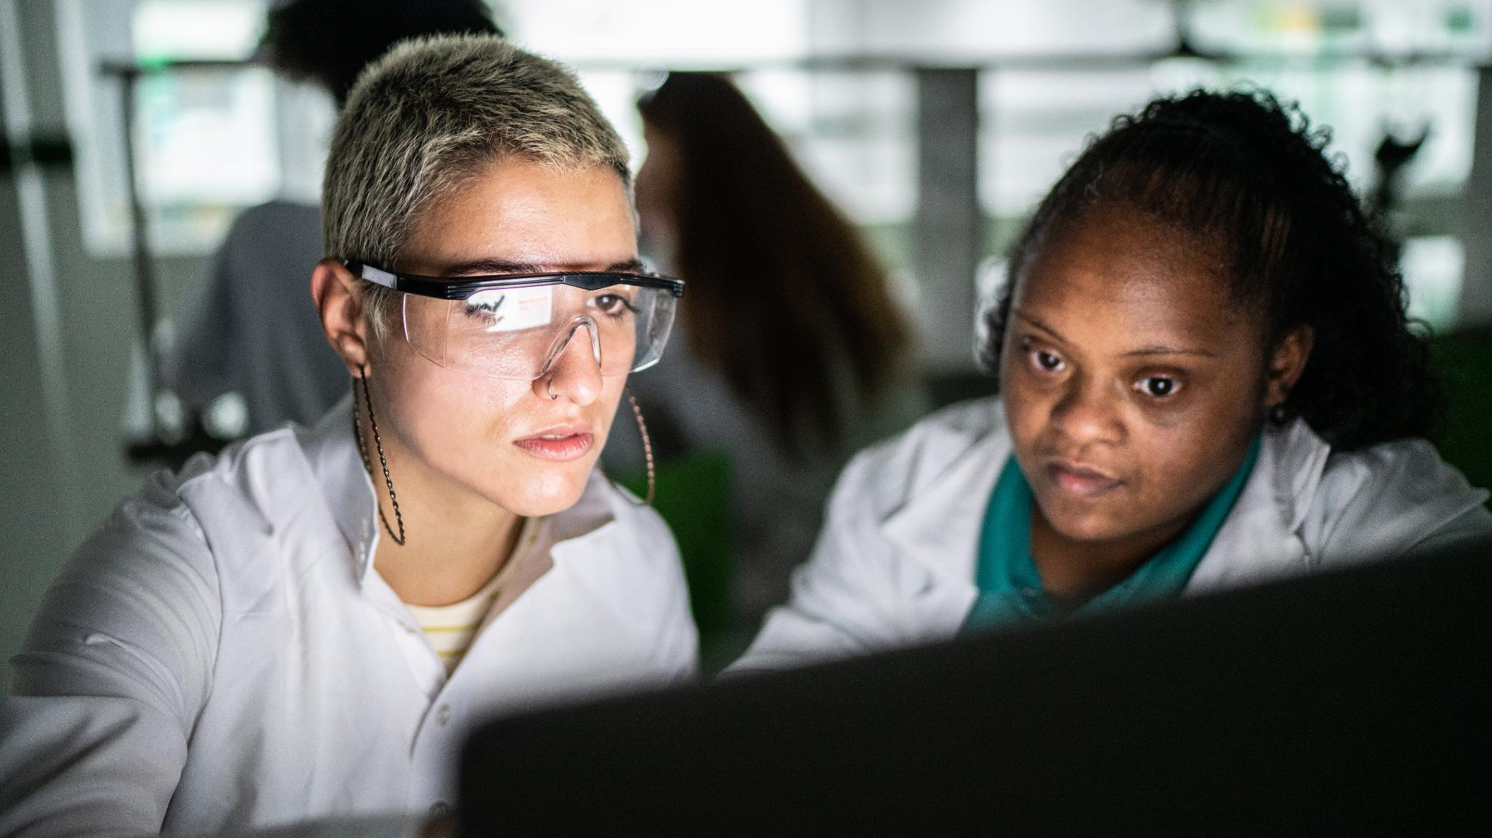
Case Study – Data Vision Summer Course
MAIDR's Role in Data Science Education
  Provided BLV students with hands-on data science experiences
  Helped students explore data meaningfully
Transformative Potential of Accessible Tools
  Showcased in the case study
  Highlighted the importance of accessible tools in education
Notes:
This case study highlights how MAIDR provided BLV students with hands-on data science experiences, showcasing the transformative potential of accessible tools in education.
Original Content:
• Case Study – Data Vision Summer Course:
MAIDR was essential in providing BLV students with hands-on data science experiences, helping them explore data meaningfully. This case study shows the transformative potential of accessible tools in data science education​:contentReference[oaicite:6]{index=6}.

Slide 14
Collaborative Efforts and Call to Action

Slide 15

Partnerships and Collaborative Success
Collaborative Support
  Partners like the National Library Service, Perkins, and Bookshare
  Adapt data science resources for BLV students
  Enrich academic and professional experiences
Notes:
Partners such as the National Library Service, Perkins, and Bookshare are essential in adapting data science resources for BLV students, enhancing their academic and professional experiences.
Original Content:
4. Partnerships and Collaborative Success (2 minutes)
• Collaborative Support:
Partners like the National Library Service, Perkins, and Bookshare play a crucial role in adapting data science resources to support BLV students, enriching academic and professional experiences.

Slide 16

Collaborative Support
Collaborative Support from Key Partners
  National Library Service
  Perkins
  Bookshare
Adapting Data Science Resources
  Tailored for BLV students
  Enhancing academic experiences
  Enriching professional opportunities
Notes:
Partners like the National Library Service, Perkins, and Bookshare adapt data science resources to support BLV students, enhancing their academic and professional experiences.
Original Content:
• Collaborative Support:
Partners like the National Library Service, Perkins, and Bookshare play a crucial role in adapting data science resources to support BLV students, enriching academic and professional experiences.

Slide 17
Call to Action: Promoting Accessible Learning in Data Science
Integrate MAIDR in Curricula
  Adopt MAIDR and similar tools in data science courses
  Support BLV students' skills development
Faculty Training
  Include accessible teaching and MAIDR training in faculty development programs
  Create inclusive classrooms
Industry Partnerships
  Collaborate with organizations dedicated to accessibility
  Integrate real-world accessible data science practices into academic settings
Invest in Accessible Data Science R&D
  Fund research in accessible technology
  Drive innovation and sustainability in accessible data science education
Notes:
We must integrate MAIDR in curricula, train faculty, form industry partnerships, and invest in accessible data science R&D to promote inclusive learning in data science.
Original Content:
5. Call to Action: Promoting Accessible Learning in Data Science (5 minutes)
• Integrate MAIDR in Curricula:
Academic departments should adopt MAIDR and similar tools in data science courses to support BLV students’ skills development.
• Faculty Training:
Faculty development programs should include accessible teaching and MAIDR training to create inclusive classrooms.
• Industry Partnerships:
Collaborating with organizations dedicated to accessibility helps integrate real-world accessible data science practices into academic settings.
• Invest in Accessible Data Science R&D:
Funding for research in accessible technology will drive innovation and sustainability in accessible data science education.
By embedding MAIDR and accessibility-driven practices in academic curricula, we can create a more inclusive landscape, ensuring all students can thrive in STEM.

Slide 18
Invest in Accessible Data Science R&D
Funding for Accessible Technology Research
  Drives innovation in data science education
  Promotes sustainability in accessible practices
Embedding MAIDR and Accessibility Practices
  Incorporates accessibility in academic curricula
  Creates an inclusive STEM landscape
  Ensures all students can thrive in STEM fields
Notes:
Investing in accessible data science R&D drives innovation and sustainability. By embedding MAIDR and accessibility practices in curricula, we create an inclusive STEM landscape where all students can thrive.
Original Content:
• Invest in Accessible Data Science R&D:
Funding for research in accessible technology will drive innovation and sustainability in accessible data science education.
By embedding MAIDR and accessibility-driven practices in academic curricula, we can create a more inclusive landscape, ensuring all students can thrive in STEM.

Slide 19
Integrate MAIDR in Curricula
Integrate MAIDR in Curricula
  Adopt MAIDR and similar tools in data science courses
  Support skills development for BLV students
Faculty Training
  Include accessible teaching in faculty development programs
  Provide MAIDR training to create inclusive classrooms
Industry Partnerships
  Collaborate with organizations dedicated to accessibility
  Integrate real-world accessible data science practices into academic settings
Notes:
We should integrate MAIDR in data science curricula to support BLV students. Faculty training programs must include accessible teaching and MAIDR training. Partnering with accessibility-focused organizations can bring real-world practices into academia.
Original Content:
• Integrate MAIDR in Curricula:
Academic departments should adopt MAIDR and similar tools in data science courses to support BLV students’ skills development.
• Faculty Training:
Faculty development programs should include accessible teaching and MAIDR training to create inclusive classrooms.
• Industry Partnerships:
Collaborating with organizations dedicated to accessibility helps integrate real-world accessible data science practices into academic settings.

Slide 20

Q&A
Notes:
We aim to discuss strategies to enhance accessible data science education and create inclusive academic environments for all students.
Original Content:
We look forward to discussing ways to advance accessible data science education and foster inclusive academic environments for all students.

