Slide 1
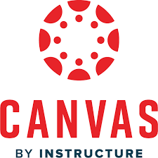
November 7^{th,} 2024
Universal Design for Learning (UDL) Principles
Presented by:
Michael Erwin
Manager of Instructional Support
College of Health Solutions
merwin8@asu.edu
Ideas on How to Implement UDL Principles in Canvas

Slide 2
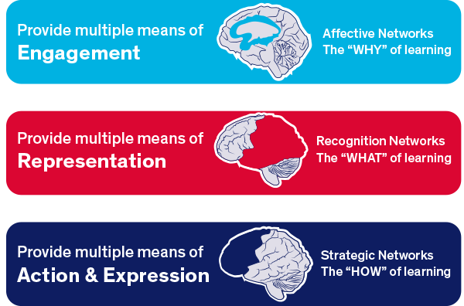
What is it?
Introduction to UDL
What is Universal Design for Learning (UDL)?
Definition Universal Design for Learning (UDL) is an educational framework that promotes inclusive teaching practices. It emphasizes the need for flexible approaches that can accommodate the diverse needs of all learners. Focuses on three primary principles: Engagement, Representation, Action & Expression.
Cognitive Neuroscience Research UDL draws from research on how the brain learns, emphasizing the need for diverse methods of engagement, representation, and action/expression. “Learning Styles”
Goal Create inclusive learning environments that provide equal opportunities for all students.

Slide 3
Why UDL Matters
Benefits of UDL
Improved Student Engagement Statistic: Students in UDL-based classrooms showed a 40% increase in engagement compared to traditional classrooms. (Meyer, 2019).
Enhanced Academic Performance Statistic: UDL implementations have led to a 20-30% increase in overall academic performance among diverse learners. (Rose, 2020). Reduction in Achievement Gaps Statistic: Schools using UDL principles saw a 25% reduction in achievement gaps between high and low-performing students.(Hall, 2020). Increased Retention Rates Statistic: UDL practices have been linked to a 15% increase in retention rates for at-risk students. (Gruba, 2021).
Positive Student Perceptions Statistic: Over 80% of students reported feeling more motivated and supported in UDL-based courses. (McGuire & Scott, 2021).
Inclusivity for Diverse Learners Ensures that all students, regardless of ability, background, or learning style, can access and engage with the curriculum.
Enhanced Student Motivation Engaging students in ways that resonate with them can increase their interest in learning and lead to higher retention rates.
Improved Learning Outcomes Studies indicate that classrooms implementing UDL principles often see better performance and reduced achievement gaps among students.
Notes:
Learner Variability
Understanding Individual Differences Every student comes to the classroom with a distinct set of experiences, backgrounds, skills, and challenges. This variability can include differences in learning styles (visual, auditory, kinesthetic), cognitive abilities, interests, cultural backgrounds, and prior knowledge.
Tailoring Instruction By recognizing these differences, educators can tailor instruction to meet the diverse needs of all students. This might involve differentiating content, processes, and products to ensure that every learner can engage meaningfully with the material.
Promoting Inclusion Embracing learner variability helps create a more inclusive environment where all students feel valued and supported. This approach encourages collaboration among students, allowing them to learn from one another’s unique perspectives.
Data-Driven Decision Making Utilizing assessments and feedback to understand each student’s strengths and areas for growth enables educators to make informed decisions about instructional strategies and interventions.

Slide 4
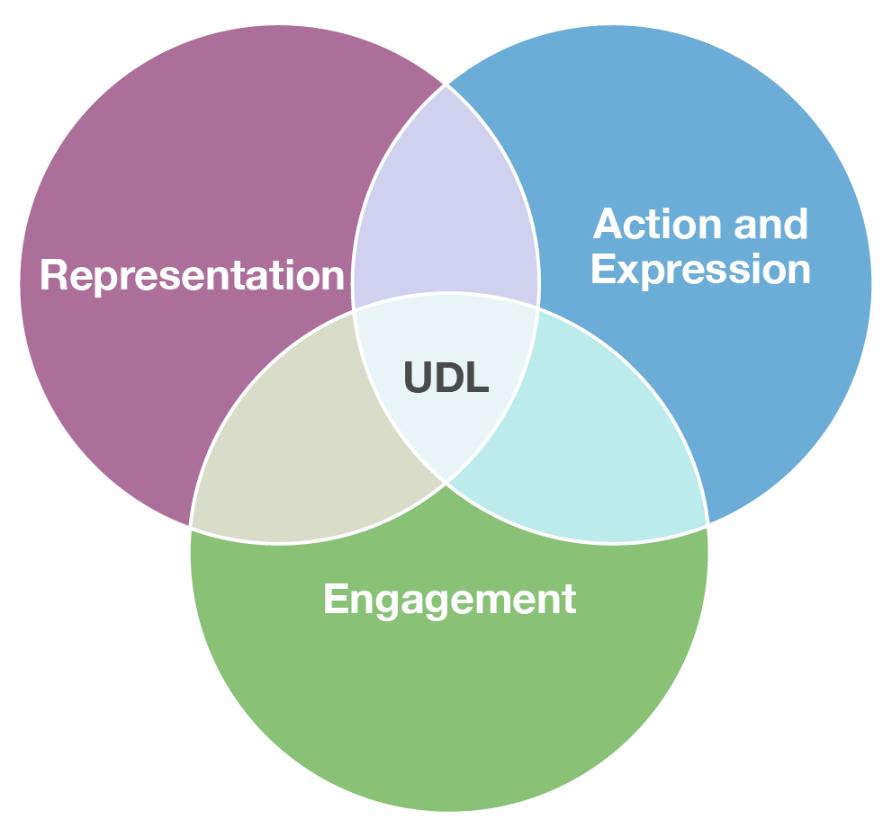
Three UDL Principles Overview
Engagement
This principle involves offering diverse methods for students to engage with content. Present information in multiple formats to accommodate different learning styles and needs. Focuses on creating an engaging learning environment that motivates all students.
Representation
Offer diverse presentation methods (text, audio, visuals).
Ensure content accessibility through various formats.
Action & Expression
Provide multiple ways for students to demonstrate knowledge.
Encourage creativity and individual expression in assignments.
Engagement addresses how learners interact with the content.
Representation deals with the delivery of content.
Action & Expression is concerned with how learners demonstrate their understanding.

Slide 5
Principle 1# What Does Engagement in Canvas Look Like?
This principle is about tapping into students’ interests, offering appropriate challenges, and increasing motivation.
1. Gamification Elements Badges and Points Use tools like Badgr to award badges for achievements, which can motivate students to complete tasks. Leaderboards Incorporate leaderboards for friendly competition, encouraging students to participate actively in discussions and assignments.
2. Real-World Connections Project-Based Learning / Case Studies Create assignments that relate to real-world issues or local community projects. For instance, students might analyze a community problem and propose solutions. Guest Speakers Use Canvas to schedule virtual guest lectures from professionals in relevant fields, allowing students to connect course content with real-world applications.
3. Collaborative Activities Group Assignments Leverage the Group feature in Canvas to facilitate collaborative projects. Students can work together to research topics, share resources, and create presentations. Discussion Boards Create discussion forums where students can share ideas, ask questions, and provide feedback on each other’s work. This promotes a sense of community and engagement.
Notes:
Additional:
Motivation and Interest
Engaging students is crucial for fostering a love of learning. By connecting tasks to students’ lives and interests, educators can make learning relevant and meaningful. This connection helps to ignite curiosity and encourages persistence through challenges.
Real-World Relevance Incorporating real-world scenarios allows students to see the practical applications of their learning, making the material more engaging and relatable. For example, using local community issues as project topics can increase investment in learning.
Strategies
Gamification: Implement game elements such as points, badges, and leaderboards in lessons to create a fun, competitive atmosphere. This approach can enhance motivation and encourage participation.
Collaborative Projects Facilitate group work where students can collaborate on projects, promoting social interaction and deeper engagement. This method also teaches important teamwork and communication skills.
Choice Boards Provide students with a variety of task options (e.g., research projects, presentations, or creative works) that they can choose from based on their interests, boosting their investment in the learning process.

Slide 6
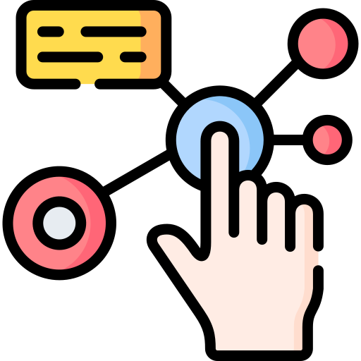
Principle 1# What Does Engagement in Canvas Look Like?
This principle is about tapping into students’ interests, offering appropriate challenges, and increasing motivation.
4. Choice and Autonomy
Choice Boards Offer a variety of assignment options (e.g., essays, videos, presentations) within modules. Allowing students to choose how they demonstrate their understanding increases ownership of their learning.
Flexible Pathways Use Modules to provide pathways for students to select activities that align with their interests and learning preferences.
5. Interactive Content Canvas Studio: Utilize Canvas Studio to create and share interactive video content, including embedded quizzes to engage students during the viewing process.
Interactive Activities: Integrate interactive elements like quizzes, games, and branching scenarios that foster active engagement. Storyline, H5P etc.
6. Timely Feedback Rubrics Use clear rubrics for assignments that outline expectations and provide structured feedback. This helps students understand how to improve and fosters continuous engagement. Peer Reviews Incorporate peer review assignments, where students can give and receive constructive feedback, encouraging collaboration and engagement with course materials.

Slide 7
Principle 1# What Does Engagement in Canvas Look Like?
7. Regular Check-Ins
Surveys and Polls: Use Canvas’s survey feature to gauge student understanding and interest throughout the course. Regular check-ins can help you adapt your teaching strategies.
Office Hours: Schedule virtual office hours through Canvas for students to discuss course content, ask questions, and receive additional support.

Slide 8
Principle 2# What Does Representation in Canvas Look Like?
This principle focuses on providing various ways for students to acquire information and knowledge.
Key Aspects of Representation in UDL:
Multiple Formats: Use various formats like text, audio, video, images, infographics, graphics organizers to present content.
Clarity and Comprehensibility: Ensure that information is clear and easy to understand, using language and symbols appropriate for the learners.
Customization Options: Allow learners to adjust the way they receive information (e.g., changing text size, background color).
Use of Supports: Incorporate tools like glossaries, visual aids, and captions to assist comprehension. Links to expand or explain.
Implementing Representation in Canvas:
Diverse Content Types: Upload and integrate different types of media (videos, podcasts, interactive simulations) in course materials.
Accessible Documents: Ensure that all documents are formatted for accessibility, such as using headings, alt text for images, and screen reader compatibility.
Multimedia Assignments: Encourage students to demonstrate their understanding through varied formats (e.g., presentations, videos, written assignments).
Use of Canvas Features: Utilize built-in tools like quizzes with varied question types, and discussions that allow for text, audio, and video contributions.
Supplementary Resources: Provide links to additional resources (e.g., articles, tutorials) that cater to different learning preferences.
Notes:
Definition: Representation in UDL focuses on providing information in multiple ways to cater to the diverse learning needs of students. It recognizes that learners process and understand information differently due to factors like prior knowledge, cultural backgrounds, and sensory abilities.
Key Differences
Focus:
Representation is about how information is delivered (the content).
Engagement is about how students connect with and interact with the content (the learner's experience).
Purpose:
Representation aims to make content accessible and comprehensible for all learners.
Engagement aims to foster motivation, interest, and active participation in the learning process.
Strategies:
In representation, strategies include using various media, providing visual aids, and ensuring accessibility.
In engagement, strategies include offering choices, encouraging collaboration, and relating material to students' lives.

Slide 9
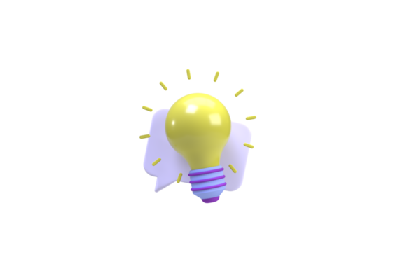
Principle 3# What Does Action and Expression look like in Canvas Look Like?
This principle emphasizes offering students different ways to demonstrate what they know.
1. Diverse Assessment Options
Varied Formats: Allow students to choose how they express their understanding. Options can include:
Traditional essays or reports
Multimedia presentations (videos, podcasts)
Creative projects (art, digital storytelling)
Infographics or posters
Alternative Assessments: Use assessments that go beyond traditional testing, such as:
Portfolios showcasing a collection of work over time.
Project-based assessments where students tackle real-world problems.
2. Digital Tools For Expression
Canvas Assignments: Use the assignment feature to create tasks that allow for multiple formats. Specify different options in the assignment prompt, allowing students to select how they will complete the task.
Discussion Boards: Encourage students to share their understanding through discussion posts. They can express ideas via text, video responses, or audio clips.
Peer Review: Utilize Canvas's peer review feature to foster collaborative feedback. This encourages students to articulate their thoughts and critique their peers’ work.
3. Self-Regulation and Goal Setting
Learning Objectives: Provide clear learning objectives for each assignment, helping students understand what they need to achieve.
Checklists and Rubrics: Offer checklists and detailed rubrics for assignments to guide students in self-assessment. This clarity helps them monitor their own progress.
Reflection Prompts: Incorporate reflection assignments where students can assess their learning processes and outcomes. Encourage them to set goals for future work.
Notes:
Definition: Implementing the Action & Expression principles of Universal Design for Learning (UDL) in Canvas involves providing students with various ways to demonstrate their understanding and encouraging self-regulation in their learning.

Slide 10
Principle 3# What Does Action and Expression look like in Canvas Look Like?
This principle emphasizes offering students different ways to demonstrate what they know.
4. Feedback Mechanisms
Timely Feedback: Use Canvas’s speed grader to provide prompt, constructive feedback on assignments. Timely feedback supports learners in adjusting their approaches.
Peer Feedback: Encourage students to give and receive feedback through peer review activities. This not only promotes self-reflection but also helps them learn from others.
5. Use of Multimedia and Interactive Tools
Interactive Quizzes: Design quizzes that allow for various response formats (e.g., multiple-choice, short answer, or reflective prompts).
Engaging Resources: Incorporate multimedia resources (videos, simulations) that allow students to explore concepts in different ways before expressing their understanding.
6. Scaffolded Learning Opportunities
Gradual Release: Start with structured assignments and gradually shift to more open-ended projects that require greater independence in expression.
Mini-Assignments: Use smaller assignments to build skills before larger projects. For instance, a series of drafts or practice presentations leading to a final project.
Notes:
Key Differences
Nature of Focus:
Representation deals with the delivery of content.
Engagement addresses how learners interact with the content.
Action & Expression is concerned with how learners demonstrate their understanding.
Purpose:
Representation aims to ensure access to information.
Engagement seeks to motivate and involve learners.
Action & Expression focuses on enabling learners to articulate their knowledge and skills.
Strategies:
Representation might include using varied media and ensuring accessibility.
Engagement may involve providing choices and fostering collaborative activities.
Action & Expression could include offering multiple assessment formats and encouraging self-reflection.
Conclusion
While all three principles of UDL—Representation, Engagement, and Action & Expression—work together to create an inclusive learning environment, they each have distinct focuses and goals. Understanding these differences allows educators to design more effective and supportive learning experiences that cater to the diverse needs of all learners.

Slide 11
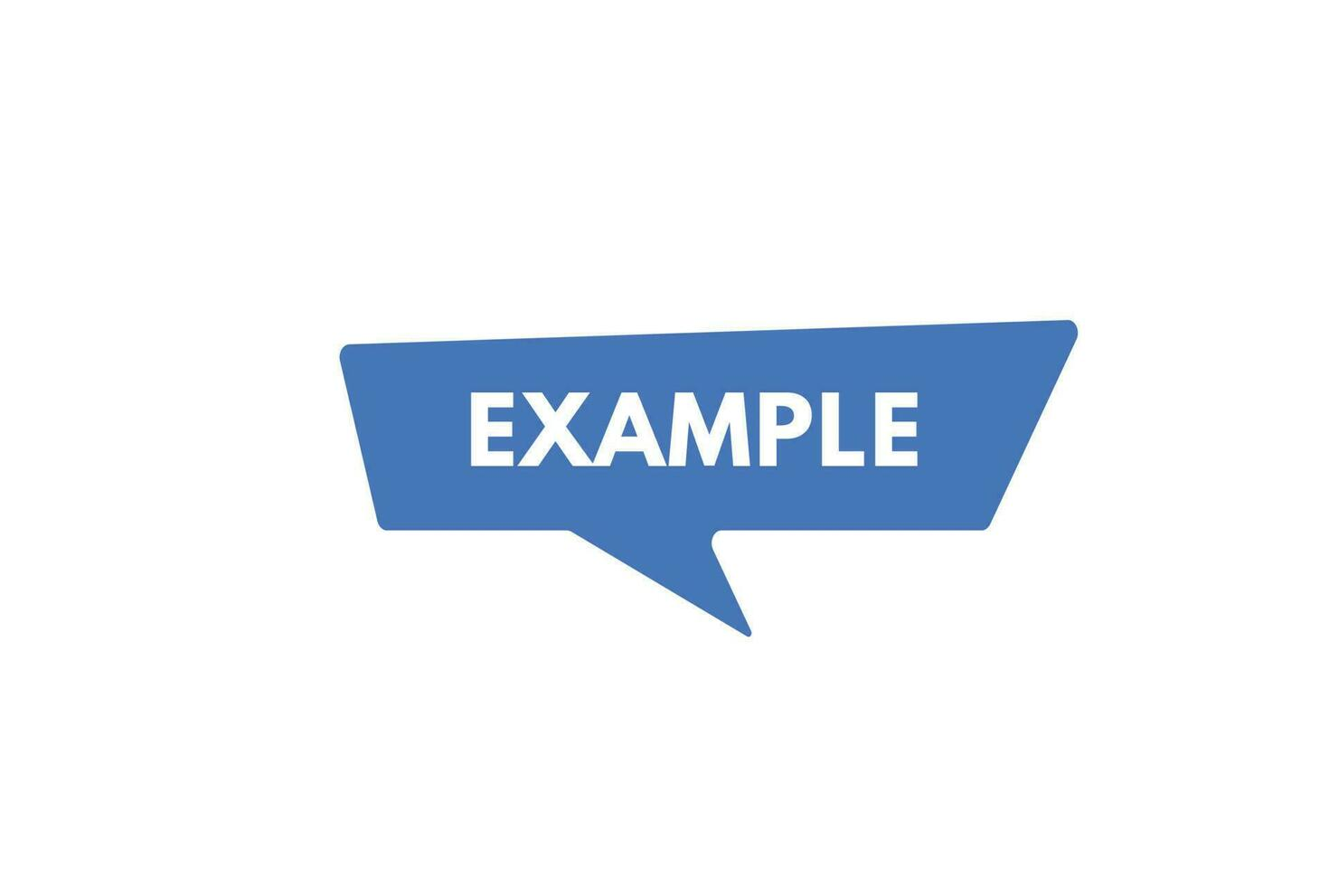
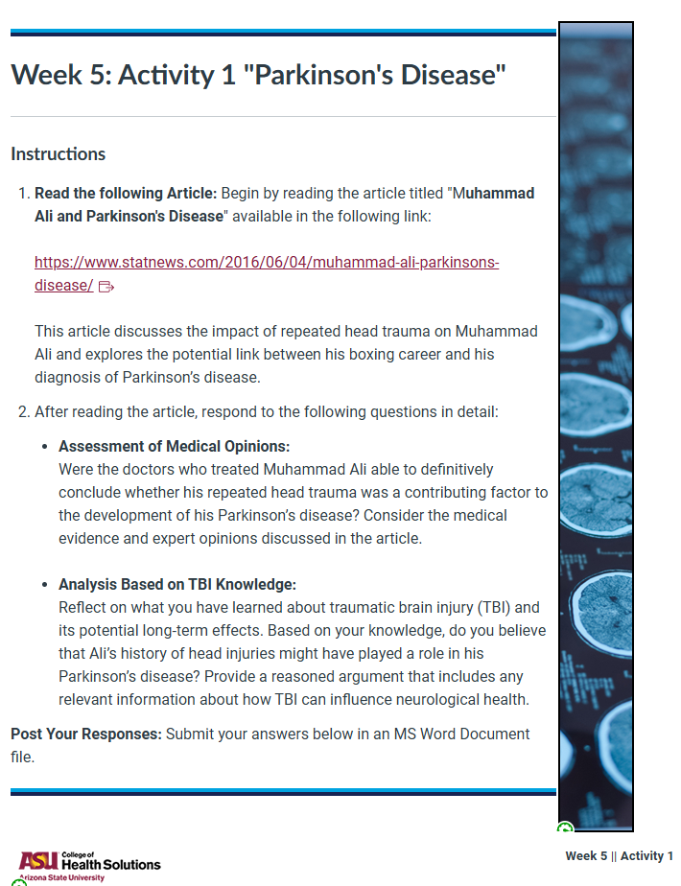
Example of Assignment Choice
Original Assignment Format

Slide 12
Week 5: Activity 1 “Parkinson's Disease” Instructions Choose one of the assignment options below that best taps into your preferred learning style. Article Reading Option Begin by reading the article titled "Muhammad Ali and Parkinson's Disease," available at the following link: https://www.statnews.com/2016/06/04/muhammad-ali-parkinsons-disease/ This article discusses the impact of repeated head trauma on Muhammad Ali and examines the potential link between his boxing career and his diagnosis of Parkinson’s disease. Assignment Options After reading the article, choose one of the following options that aligns with your preferred learning style to respond to the questions: Visual Learners: Create a visual presentation (e.g., infographic or PowerPoint) summarizing the medical opinions regarding Muhammad Ali's condition. Include key points about the link between his boxing career and Parkinson's disease, as well as relevant data on traumatic brain injury (TBI) and its effects. Auditory Learners: Record a podcast or audio commentary where you discuss your thoughts on the article. Address the following questions: Were the doctors able to definitively conclude whether repeated head trauma contributed to Ali's Parkinson’s disease? Based on your understanding of TBI, do you believe Ali’s injuries played a role in his diagnosis? Support your argument with relevant information. Kinesthetic Learners: Write a reflective journal entry or create a creative piece (like a poem or short story) that expresses your insights about the article. Include a personal reflection on how traumatic brain injuries can impact neurological health and relate it to Muhammad Ali's experiences. Reading/Writing Learners: Write a detailed essay responding to the following questions: Were the doctors who treated Muhammad Ali able to definitively conclude whether his repeated head trauma was a contributing factor to the development of his Parkinson’s disease? Analyze the medical evidence and expert opinions discussed in the article. Reflect on what you have learned about TBI and its potential long-term effects. Do you believe Ali’s history of head injuries might have played a role in his Parkinson’s disease? Provide a reasoned argument that includes relevant information about TBI’s influence on neurological health. Submission Once you’ve completed your chosen assignment, submit your work in the specified format. If you choose the visual presentation or audio format, ensure it is accessible and clearly presented.
Reformatted for Choice

Slide 13
Potential Challenges TO UDL
Implementing Universal Design for Learning (UDL) in Canvas, a popular Learning Management System (LMS), presents several challenges.
Here are some potential issues:
Technical Limitations: Canvas may not support all the interactive and multimedia elements required for UDL, limiting the ability to provide multiple means of representation, engagement, and expression (Instructure Community, 2017).
Instructor Preparedness: Many educators lack training in UDL principles and how to effectively integrate them into Canvas. This can lead to inconsistent application and reduced effectiveness of UDL strategies (Greene, 2024).
Resource Constraints: Developing UDL-compliant materials can be time-consuming and resource-intensive. Instructors may struggle with the additional workload required to create accessible and flexible content (Instructure Community, 2017).
Assessment Challenges: Designing assessments that align with UDL principles in Canvas can be difficult. Ensuring that assessments are flexible and accessible to all students requires careful planning and often, additional tools or plugins (Greene, 2024).
Lack of Institutional Support: Successful UDL implementation often requires institutional support, including professional development and technical assistance. Without this support, instructors may find it challenging to sustain UDL practices (Instructure Community, 2017).
Note: Reach out to your Instructional Support Team for questions and ideas.

Slide 14
Recap of Universal Design for Learning (UDL)
Universal Design for Learning (UDL) is an educational framework designed to give all students an equal opportunity to succeed. It emphasizes flexibility in how students access material, engage with it, and demonstrate their knowledge.
Key Principles of UDL:
Multiple Means of Engagement: This principle focuses on motivating students by offering choices and making learning relevant to their interests and needs.
Multiple Means of Representation: This involves presenting information in various ways to cater to different learning styles and preferences.
Multiple Means of Action and Expression: This allows students to demonstrate what they know in different ways, such as through writing, speaking, or creating projects.
Why UDL is Important:
Inclusivity: UDL helps remove barriers to learning, making education more accessible to all students, including those with disabilities and English language learners¹.
Flexibility: By offering various ways to learn and show understanding, UDL accommodates diverse learning styles and needs².
Engagement: UDL strategies help keep students motivated and engaged by making learning relevant and providing choices².
Overall, UDL aims to create a more inclusive and effective learning environment for all students. If you have any specific questions about UDL or how it can be implemented, feel free to ask! merwin8@asu.edu

Slide 15
Q&A

Slide 16
(UDL) Simple List to Get Started
Communicate with students: Make it clear how students can contact you, and provide multiple communication options. For example, you can include your contact information on the homepage and syllabus, and use Canvas announcements.
Create a welcoming homepage: Include relevant buttons, media, and contact information on the homepage.
Use discussions: Before each topic, use discussions to help students reflect on the topic's relevance and what they hope to achieve from it.
Use mastery paths: Give students the option to choose which relevant work to complete in a module.
Provide multiple means of representation: Use Canvas Pages to include audiovisual resources, and make students aware of alternative document formats.
Organize content: Use a consistent module format, and organize modules by weeks or units.
Number assignments: Number assignments to improve navigation, and use keywords to indicate the topic.
Provide feedback: Leave personalized comments for each student using recorded audio or video.
Establish clear outcomes: Start with clear learning objectives, and anticipate learner variability.
Name modules consistently: Use consistent naming for modules, such as Module 1, Module 2, and so on.
You can also check out the Course Evaluation Checklist for more examples of Canvas tools that align with UDL principles.

Slide 17
Sources/Citations
CAST. (2024). Universal Design for Learning Guidelines. Retrieved from https://udlguidelines.cast.org/
Greene, J. A. (2024). Unraveling Challenges with the Implementation of Universal Design for Learning: A Systematic Literature Review. Educational Psychology Review, 36(35). Retrieved from https://link.springer.com/article/10.1007/s10648-024-09860-7
Gruba, P., & Hinkelman, J. (2021). UDL and Student Retention: The Impact of Learning Design on At-Risk Students. International Journal of Learning, Teaching and Educational Research, 19(5), 22-38.
Hall, T. E., Vue, G., & Meyer, A. (2020). The Impact of UDL on Student Outcomes. Journal of Educational Psychology, 112(1), 125-138.
Instructure Community. (2017). Implementing Universal Design for Learning on Canvas. Retrieved from https://community.canvaslms.com/t5/Canvas-LMS-Blog/Implementing-Universal-Design-for-Learning-on-Canvas/ba-p/271887
Meyer, A., & Rose, D. H. (2019). Universal Design for Learning: Theory and Practice. CAST Professional Publishing.
McGuire, J. M., & Scott, S. S. (2021). Universal Design and its Impact on Student Engagement. International Journal of Teaching and Learning in Higher Education, 33(1), 45-55.
Rose, D. H., Meyer, A., & Gordon, D. (2020). Universal Design for Learning: Theory and Practice. CAST Professional Publishing.

