Slide 1
Empowering Accessibility: The Developers Guide to Visually Hidden Text
Notes:
Opening Hook: Start with a compelling statement or question about the importance of web accessibility.
Purpose of the Talk: Briefly explain what visually hidden text is and why it matters.
Agenda Overview: Outline what you will cover in the session.

Slide 2
Introduction
Jon Farrell
Senior Digital Accessibility Consultant
Perkins Access
Notes:
Introduce yourself and your credentials (2 minutes)

Slide 3
Today’s Agenda
The Role of Developers in Accessibility
The Purpose of Visually Hidden Text
Techniques for Implementing Visually Hidden Text
Q&A And Discussion
Notes:
Purpose of the talk and what attendees will gain (3 minutes)

Slide 4
The Role of Developers
in Accessibility
Notes:
Team Effort: Discuss how accessibility is a team sport and the specific role developers play.
Challenges: Highlight common challenges developers face in making websites accessible.

Slide 5
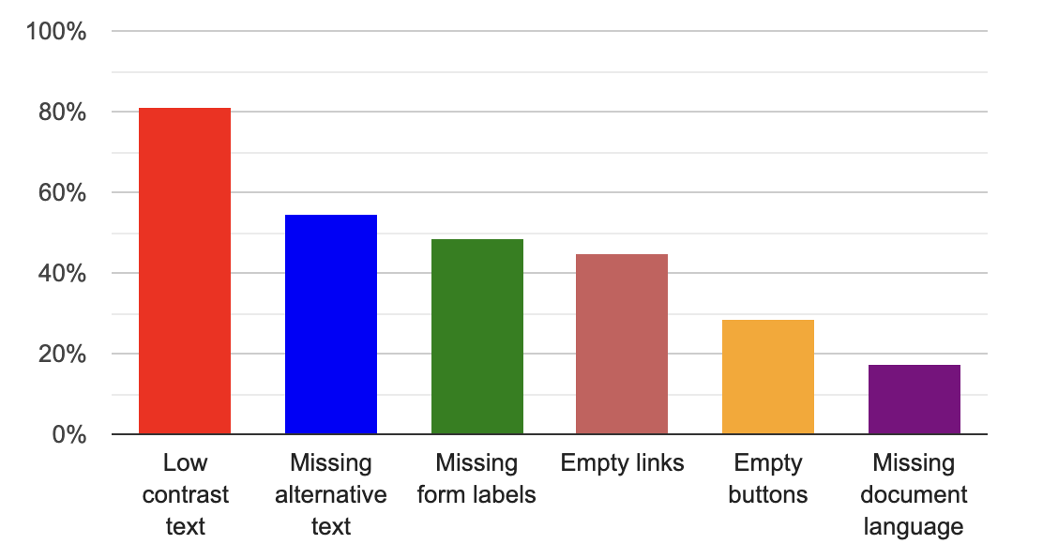
Most common WCAG failures
Notes:
Challenges developers face and how to overcome them (3 minutes)

Slide 6
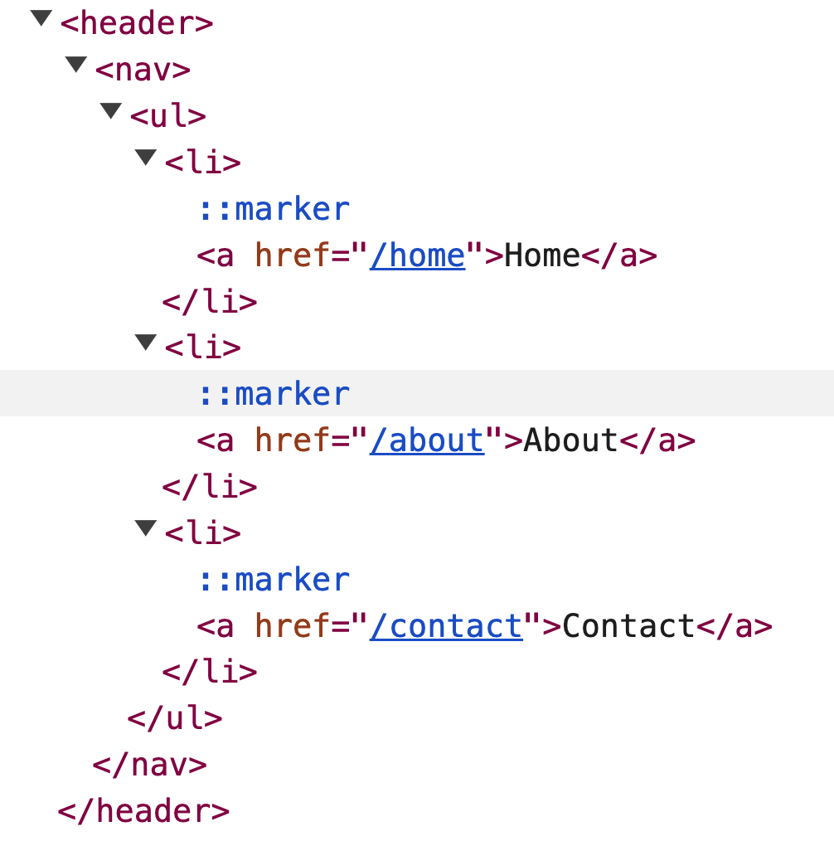
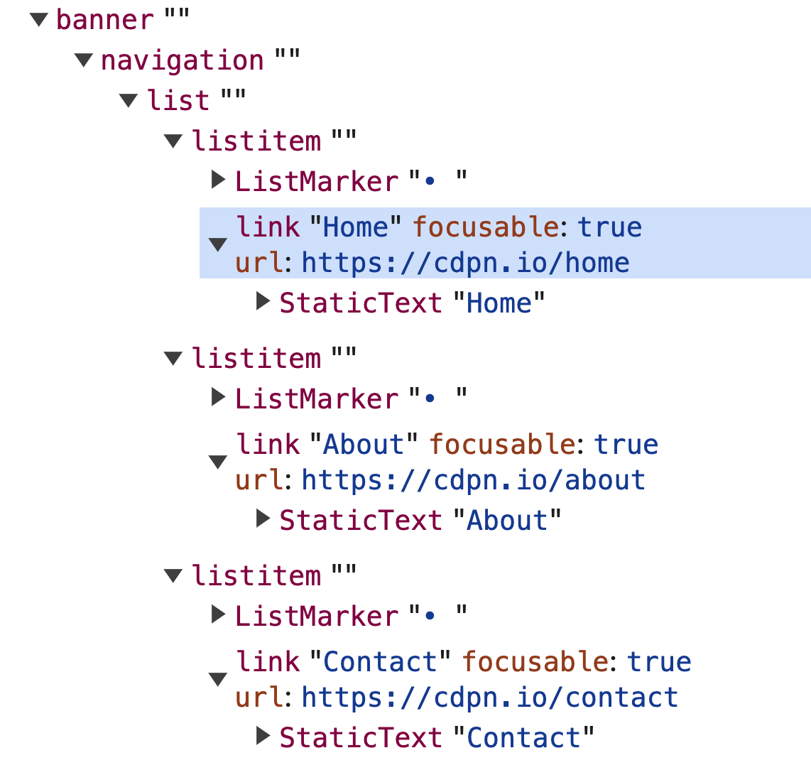
What we have the most control over
The Document Object Model | The Accessibility Tree

Slide 7
How Visually Hidden Text
Can Improve Accessibility

Slide 8
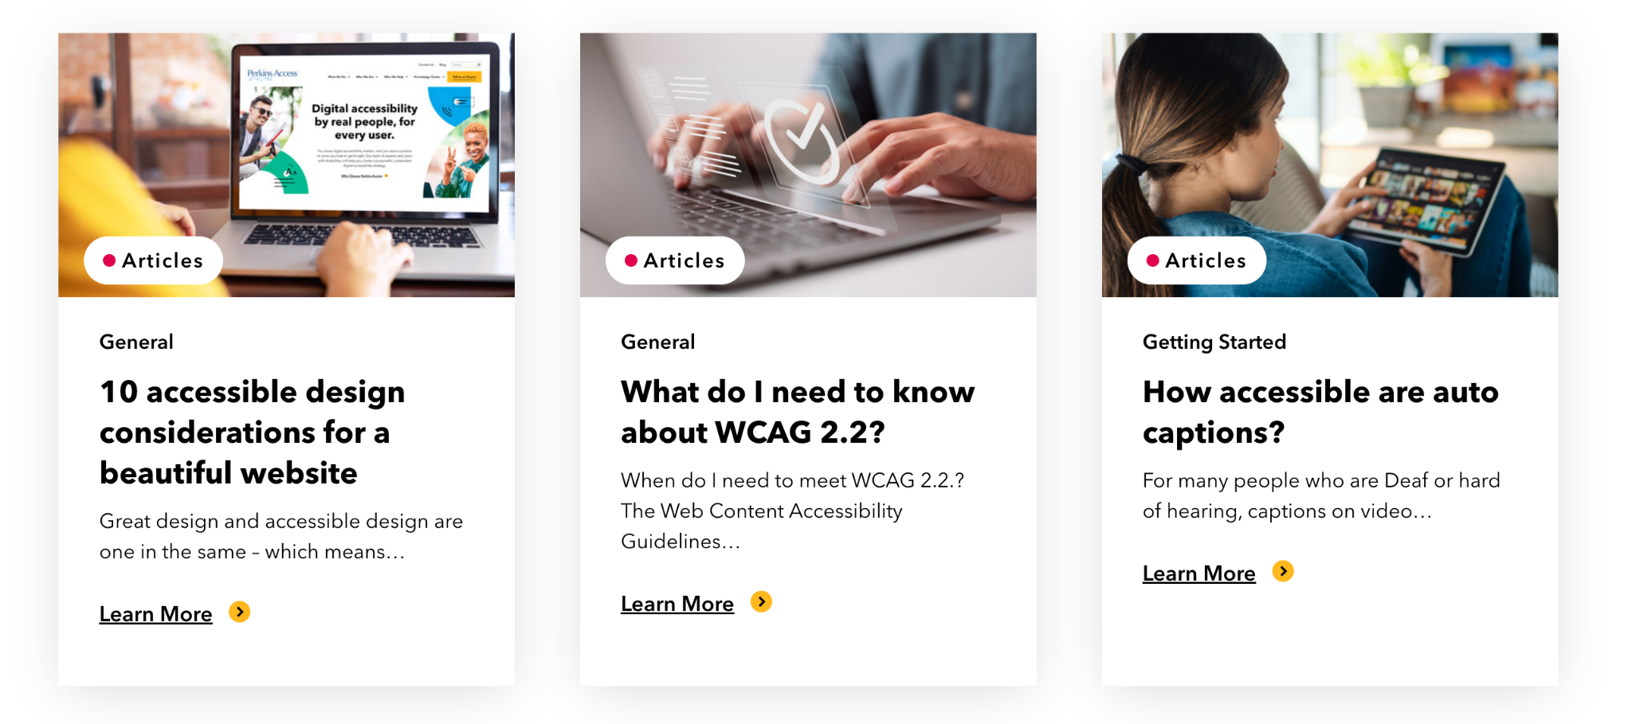
Links for Sighted Users
Notes:
Differences in navigation for sighted and non-sighted users (2 minutes)

Slide 9
Links for Screen Reader Users
Notes:
Differences in navigation for sighted and non-sighted users (2 minutes)

Slide 10
Better links for screen reader users
Notes:
Differences in navigation for sighted and non-sighted users (2 minutes)

Slide 11
Techniques for Implementing Visually Hidden Text with CSS Alone
Notes:
CSS Techniques: Text hidden with CSS (3 minutes)

Slide 12
Ways of hiding content with CSS
Method | Impact
CSS display: none | Hides content visually as well as from assistive technology
CSS visibility: hidden | Hides content visually as well as from assistive technology
CSS opacity: 0 | Hides content visually but exposes it to assistive technology

Slide 13
Comprehensive solution for visually hidden text
Using CSS Only
.sr-only:not(:focus):not(:active) { clip: rect(0 0 0 0); clip-path: inset(50%); height: 1px; overflow: hidden; position: absolute; white-space: nowrap; width: 1px; }

Slide 14
Example before using visually hidden text
The Markup | The Result
<li> <img .../> <p>General</p> <h3>The inclusive research checklist</h3> <p>Do you care about creating products and services that work for all users?</p> <a>Learn More</a> </li>
Notes:
aria-label and aria-labelledby (4 minutes)

Slide 15
Example after using visually hidden text
The Markup | The Result
<li> <img .../> <p>General</p> <h3>The inclusive research checklist</h3> <p>Do you care about creating products and services that work for all users?</p> <a> <span>Learn More</span> <span class=”sr-only”> about the inclusive research checklist</span> </a> </li>
Notes:
aria-label and aria-labelledby (4 minutes)

Slide 16
Techniques for Implementing Visually Hidden Text with ARIA
Notes:
aria-label and aria-labelledby (4 minutes)

Slide 17
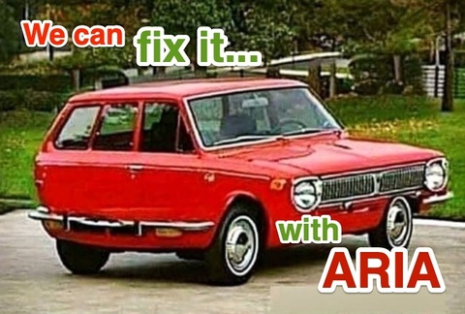
A word of caution: Be careful when using ARIA

Slide 18
Aria-label common example
The aria-label attribute defines a string value that can be used to name an element, as long as the element's role does not prohibit naming.
Learn more about aria-label
The Markup | The Result
<svg role=”img” aria-label=”Perkins Access Logo” ... >
Notes:
aria-label and aria-labelledby (4 minutes)

Slide 19
Example before using aria-label
The Markup | The Result
<li> <img .../> <p>General</p> <h3>The inclusive research checklist</h3> <p>Do you care about creating products and services that work for all users?</p> <a>Learn More</a> </li>
Notes:
aria-label and aria-labelledby (4 minutes)

Slide 20
Example after using aria-label
The Markup | The Result
<li> <img .../> <p>General</p> <h3>The inclusive research checklist</h3> <p>Do you care about creating products and services that work for all users?</p> <a aria-label=”Learn More about the inclusive research checklist”>Learn More</a> </li>
Notes:
aria-label and aria-labelledby (4 minutes)

Slide 21
Aria-labelledby common example
The aria-labelledby attribute identifies the element (or elements) that labels the element it is applied to.
Learn more about aria-labelledby
The Markup | The Result
<button aria-labelledby=”my-cart” >...</button> <span id=”my-cart”>My Cart</span>
Notes:
aria-label and aria-labelledby (4 minutes)

Slide 22
Example before using aria-labelledby
The Markup | The Result
<li> <img .../> <p>General</p> <h3>The inclusive research checklist</h3> <p>Do you care about creating products and services that work for all users?</p> <a>Learn More</a> </li>
Notes:
aria-label and aria-labelledby (4 minutes)

Slide 23
Example after using aria-labelledby
The Markup | The Result
<li> <img .../> <p>General</p> <h3 id=”card-title”>The inclusive research checklist</h3> <p>Do you care about creating products and services that work for all users?</p> <a id=”card-link” aria-labelledby=”card-title card-link”>Learn More</a> </li>
Notes:
aria-label and aria-labelledby (4 minutes)

Slide 24
Aria-describedby common example
The global aria-describedby attribute identifies the element (or elements) that describes the element on which the attribute is set.
Learn more about aria-describedby
The Markup | The Result
<input aria-describedby=”pw-help .../> <span id=”pw-help”>Password must be at least 6 characters long</span>
Notes:
aria-label and aria-labelledby (4 minutes)

Slide 25
Aria-live regions
The global aria-live attribute indicates that an element will be updated, and describes the types of updates the user agents, assistive technologies, and user can expect from the live region.
Learn more about aria-live
Notes:
aria-label and aria-labelledby (4 minutes)

Slide 26
Aria-live region common example
Before | After
Notes:
aria-label and aria-labelledby (4 minutes)

Slide 27
Differences in these ARIA approaches
Technique | Use Case
aria-label | To set the accessible name of an element to a specific string.
aria-labelledby | To set the accessible name of an element to the text of an element already on the page.
aria-describedby | To give additional context or information about an element.
aria-live | To make an announcement without moving the users user moving focus.
Notes:
aria-label and aria-labelledby (4 minutes)

Slide 28
Conclusion
Notes:
Open Floor: Allow time for audience questions and discussion.
Resources: Provide additional resources for further learning.

Slide 29
Thank you for joining!
Share your feedback
Post Session Survey (5 minutes)
Contact Me
Email: jon.farrell@perkins.org
Linkedin: https://www.linkedin.com/in/jonmfarrell/
Contact Perkins Access
Access@Perkins.org
https://PerkinsAccess.org

