Slide 1

Creating a Pathway for Accessible Course Design
A certified experience using Canvas Badges

Slide 2
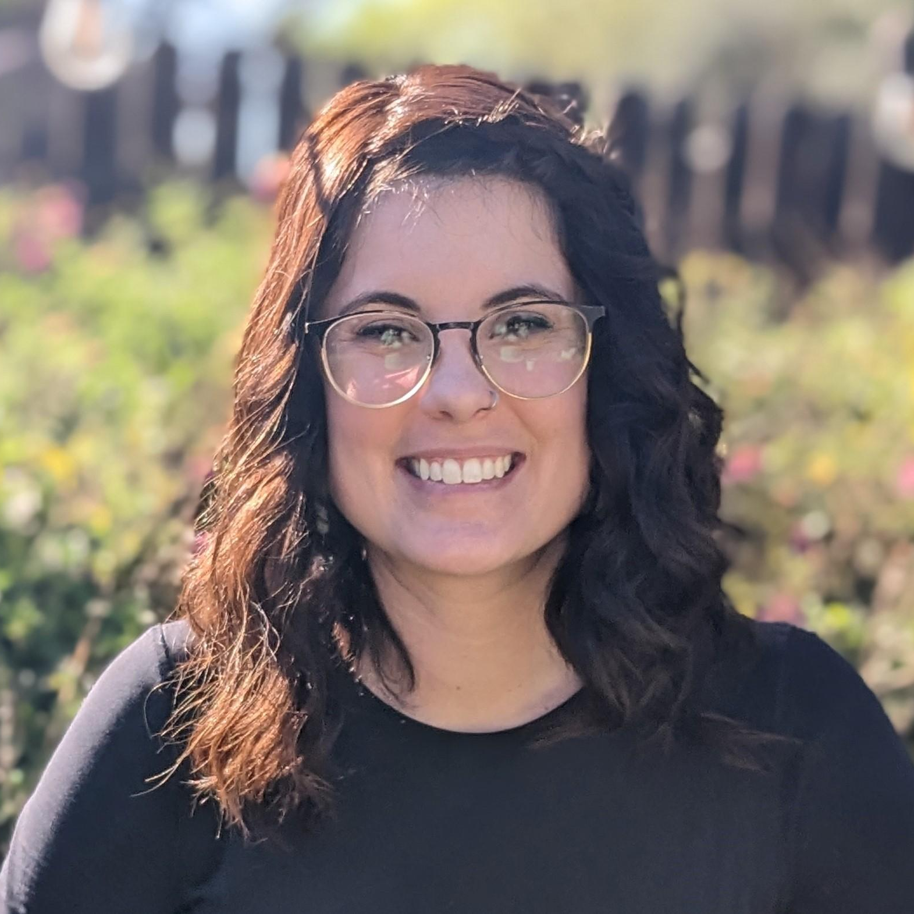
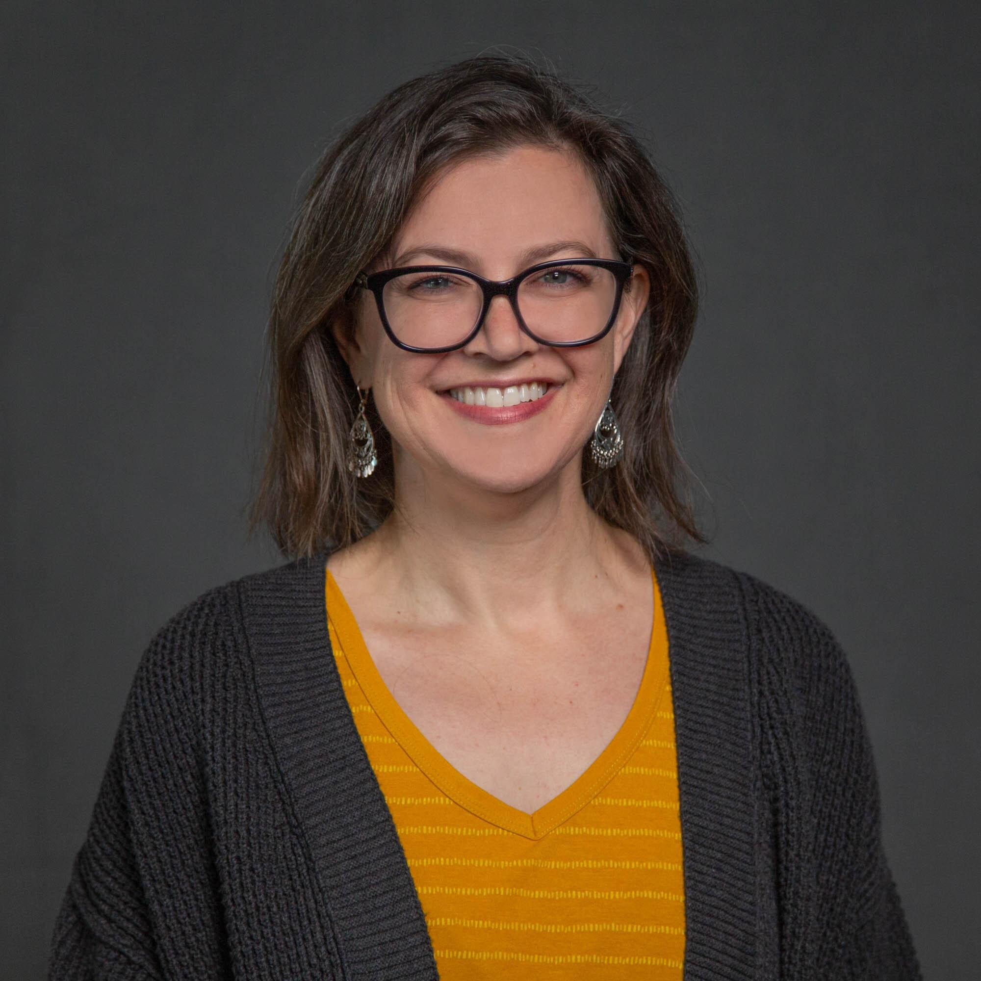
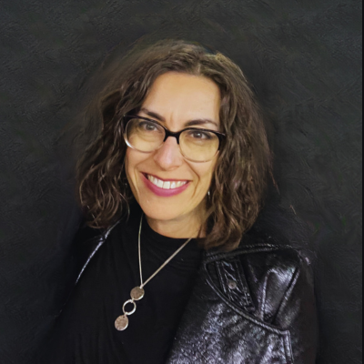
Presenters for Today
Mackenzie Ramirez Instructional Designer College of Health Solutions
Mary Loder Manager of Professional Development and Training EdPlus
Alejandra Dashe Sr. Instructional Designer Learning Enterprise

Slide 3

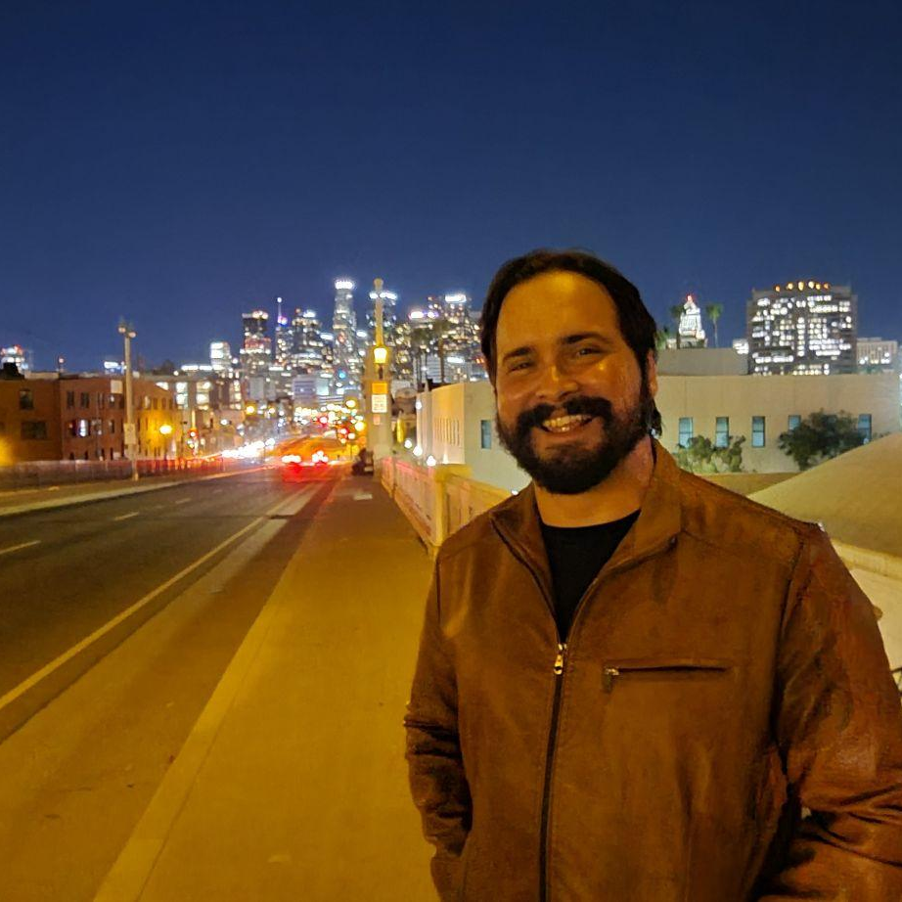
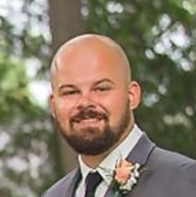
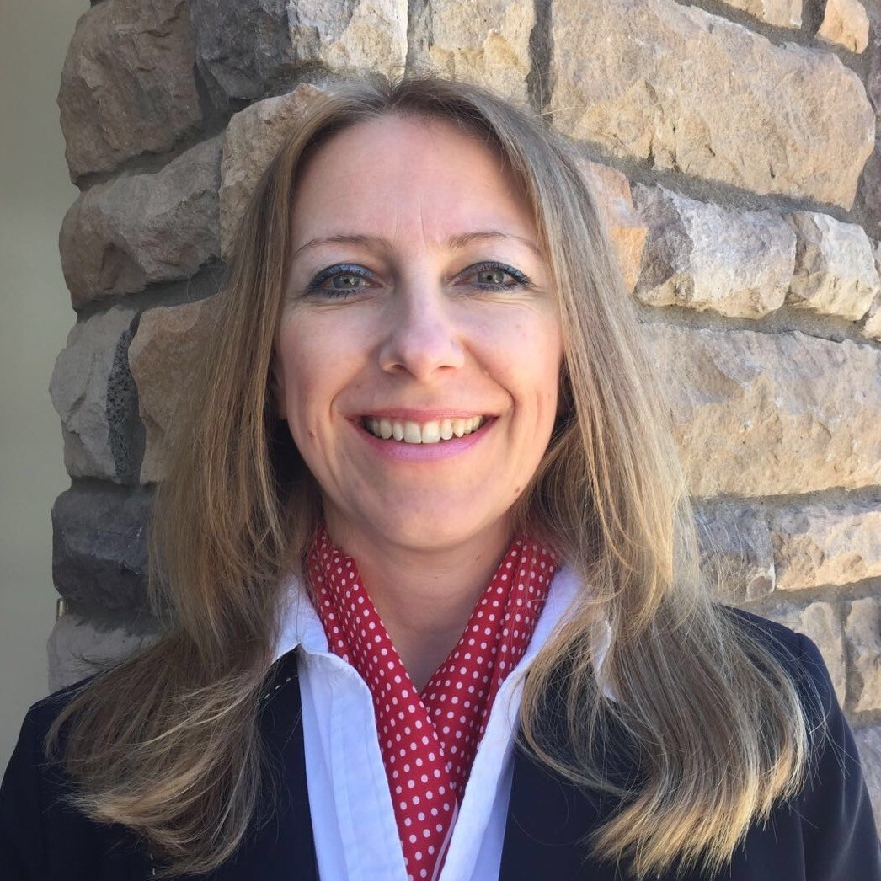
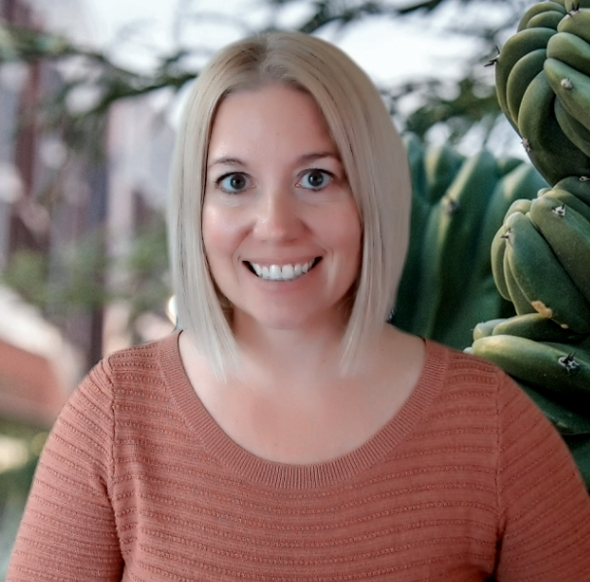
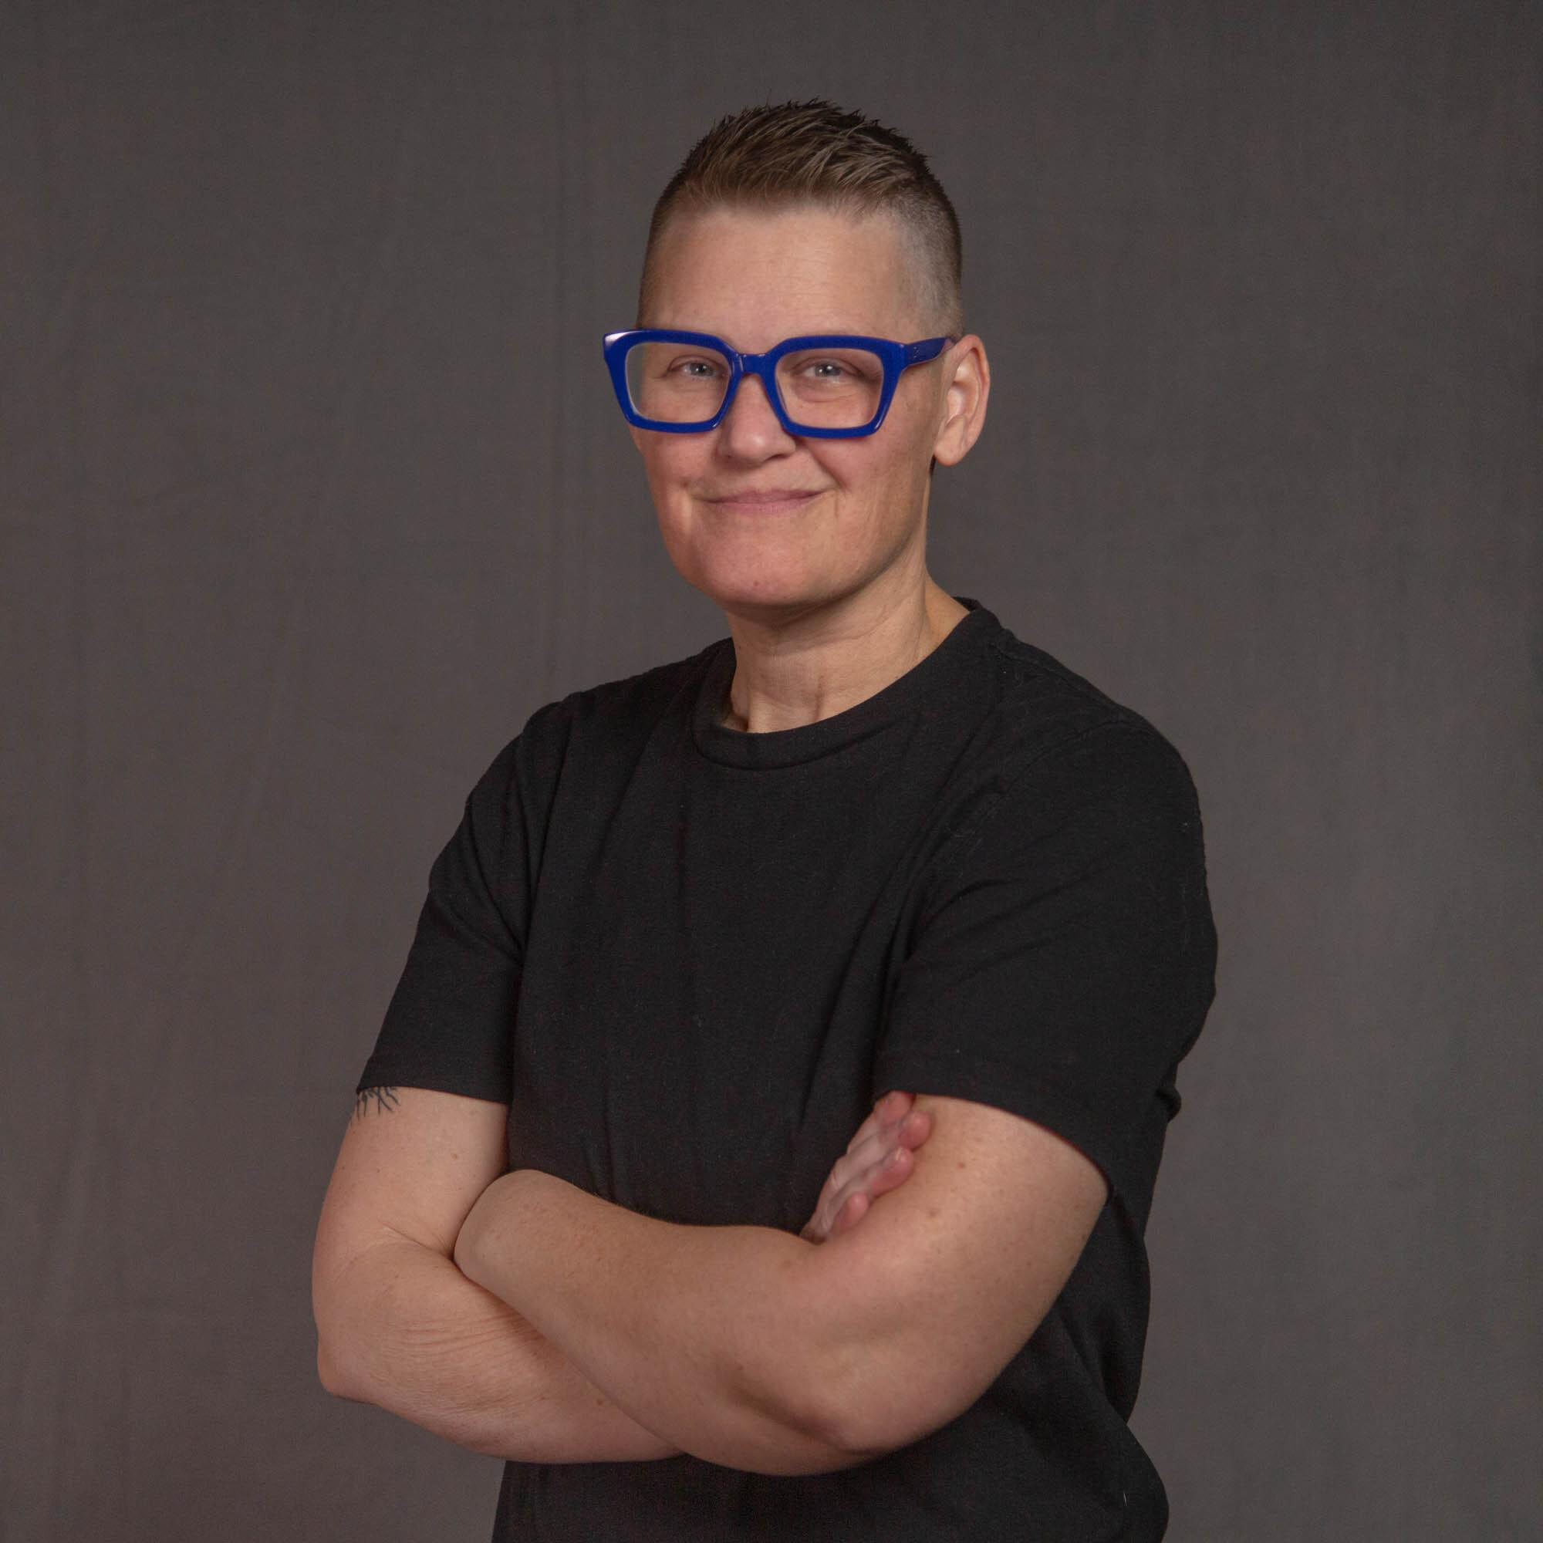
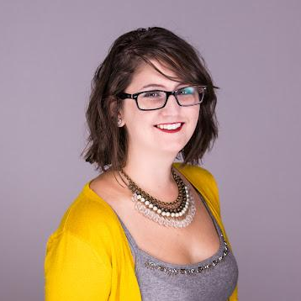
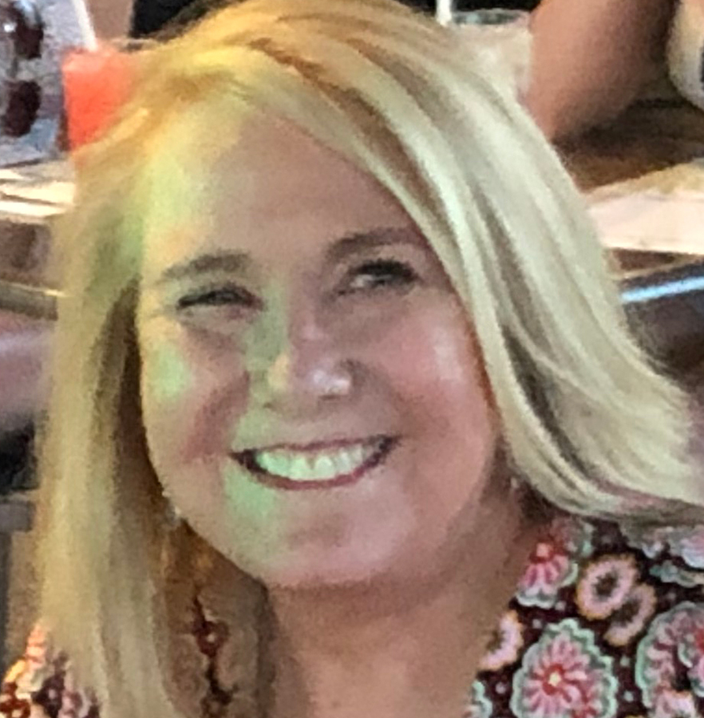
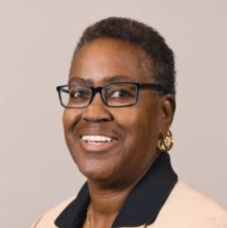
Creators of the Accessible Course Creator experience at Arizona State University
Notes:
This project came from the Universal Design and Access Technology (UDAT) working group. From there, the project became an ASU Enterprise wide, grassroots project spanning Academic Enterprise, EdPlus, Educational Outreach and Student Services (EOSS) - specifically Student Accessibility Inclusive Learning Services (SAILS), Enterprise Technology, and Learning Enterprise. We created a community of practice that shared knowledge, skills, and abilities in a respectful, kind, and inclusive way. We exhibited all of the characteristics that align with the ASU mission, vision, and values, as well as the belief that accessibility is everyone’s responsibility. We presented this at InstructureCon, so that we can be the model example for all institutions of higher education.

Slide 4

Agenda
Accessible Course Design, what is it?
How to create accessible Canvas courses.
Motivating faculty and staff to create accessible courses.
Tips and Tricks for success.

Slide 5

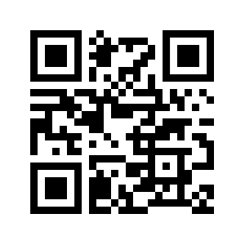
Accessible Course Design
What is it?
Notes:
Type in the chat: in one word, what is accessible course design?
Born from the desire to be accessible, in addition to our requirement. This course was made in response to many asking for training, asking for guidance. We created this course as a tool to help increase knowledge and to grow our army of accessibility experts. Creating accessible courses is a team approach, no one person is responsible for all of the accessibility needs of our University.
WCAG 2.2 https://www.w3.org/TR/WCAG22/
Guidelines at ASU are clearly defined on our accessibility.asu.edu site

Slide 6



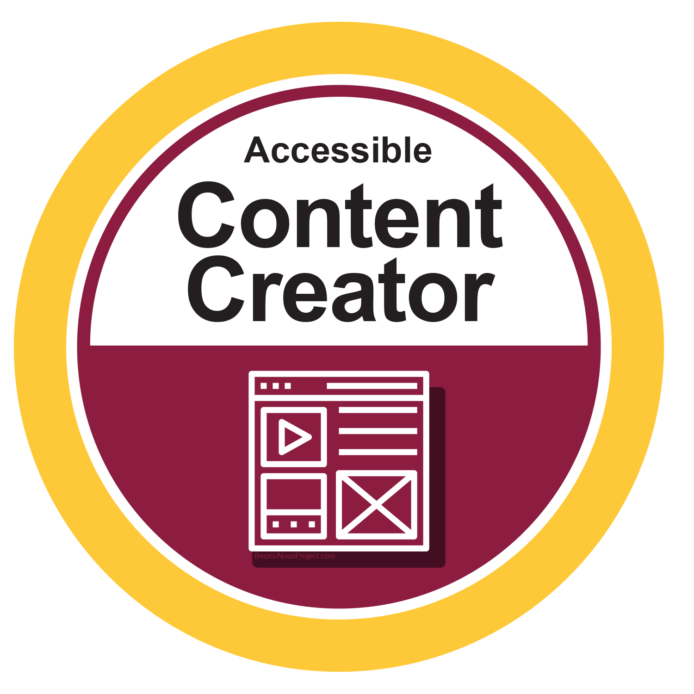

What we think matters!
Notes:
Each module in the course leads you through lessons to teach you how to be all of these things - all steeped in learning objectives:
Remediator Rockstar = able to use remediation tools
Media Manager = able to include captions and transcripts and the reasoning for it
Image Influencer = able to create and add alt-text, and the reasoning for it
Content Creator = able to write accessible content for webpages convert documents to accessible PDFs
Content Curator = abe to create and curate accessible content, and the reasoning for it

Slide 7
Remediation Objectives
Use remediation tools in one of your courses.
Identify inaccessible content using accessibility checker tools.
Identify accessibility resources.
Identify when to double-check accuracy of the remediation.

Slide 8
Media Manager Objectives
Discuss the preparation of creating a video for your courses.
Type of video
Video preparation tips
Describe the impact of captions on all learners.
Identify the importance of accurate captions and transcripts.
Identify your captioning resource page at ASU IT Accessibility
Use technologies and support systems to generate captions in your own course.

Slide 9
Image Objectives
Identify the ways to use and create various types of accessible images.
Revise ambiguous alt text so that it describes the image.
Describe the impact of alt text on all learners.
Create an alternative to graphical text.

Slide 10
Content Creator Objectives
Observe the needs within a provided student profile.
Identify elements of writing accessible content for learning experiences.
Apply the elements of accessible content creation to educational materials.
Reflect on how writing accessible content impacts student success.
Identify elements of meaningful link text.
Identify how to properly convert a document into a PDF.

Slide 11
Content Curator Objectives
Review the requirements for video and audio content.
Review the impact of proper formatting on all learners.
Describe the importance of ensuring that external resources are accessible.
Use descriptive links to associate external resources.
Articulate the benefit of using the ASU Library Resource Organizer to curate content for your course.

Slide 12
Creating Accessible Courses
The Canvas Accessibility Checker and more…
Notes:
As you know, we have Student Accessibility and Inclusive Learning Services (SAILS) under Educational Outreach and Student Services (EOSS) to ensure our students feel included when they need services related to their self-selected learning needs based on a disability and the diversity of the neurotypes that exist within our ecosystem.
Canvas supports many of these efforts through the Canvas Accessibility Checker. Where that does not provide, ie captions and training on what a meaningful alt text is or how to write a descriptive link, our course helps with the process and considerations through self directed learning.

Slide 13
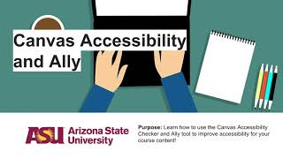
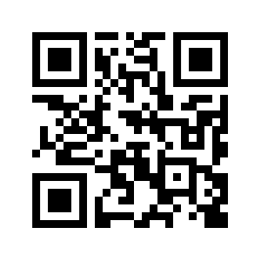
Orientation via Video
This video was created via the Learning Experience team at the Enterprise Technology Office with ASU; it shows how to use the Canvas Accessibility checker and the Ally checker installed in Canvas.
Notes:
In the course we make the best effort to model the change we want to see by being mindful of the language we want to use. We use content from all parts of the university to teach you how to use tools like the Canvas accessibility checker and Ally, for example.
Neurotype conversation, being mindful on the language we use, though some may be ok with some terms others are not, what works for some does not work for all. We are all different.
DSM is medical terminology by psychiatrists. Neurodiversity is psychology and historically is autism and then ADHD. Neurodivergent is a radical inclusive term that expands the neurodiversity umbrella beyond autism and ADHD.
Disorder vs neurotype
Neurodiversity affirming practices and language

Slide 14
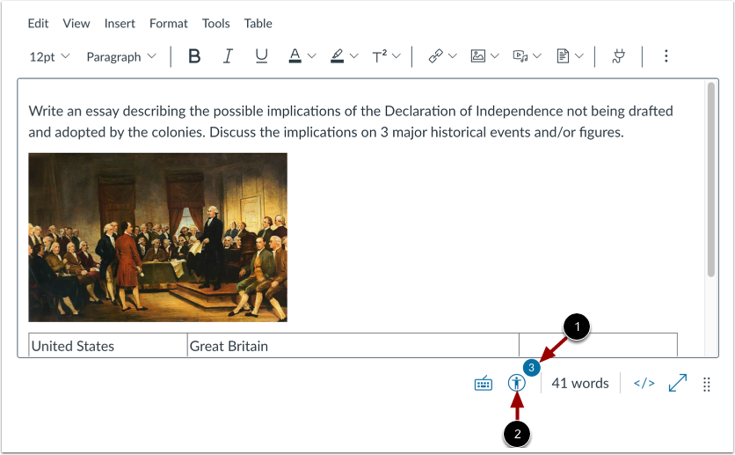
Accessibility Checker in Canvas
Instructor Guide
Student Guide
Notes:
Using the Canvas accessibility checker, our resources at the accessibility.asu.edu site help our faculty and staff determine what to do when an issue is found using our checker tools.

Slide 15
Motivation to do the thing…
How to engage and empower your faculty and staff.
Notes:
What is our motivation to do this? Why are we doing it? Because it’s the right thing to do. It follows the university mission. It’s also required as part of the law since we receive federal funding.

Slide 16
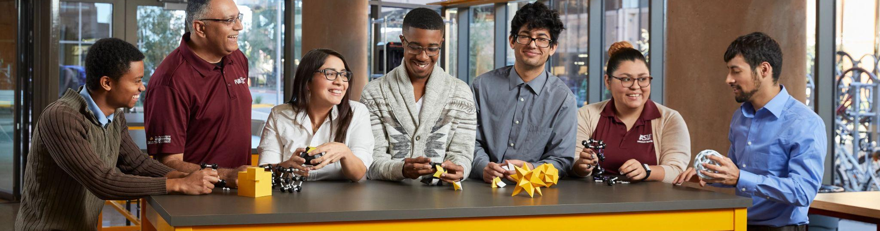
The desire to promote full access to online spaces for the diverse learners who are our ASU students.
We challenged ourselves to identify who has been left out of our design
Designing from the Margins
Trickle Up Social Justice
Notes:
Designing from the margins is a method of designing with the most marginalized in mind, by engaging them in the process of designing and redesigning, and putting their feedback front and center
Trickle Up Social Justice is a similar concept of standing with marginalized people and putting an end to the marginalization

Slide 17
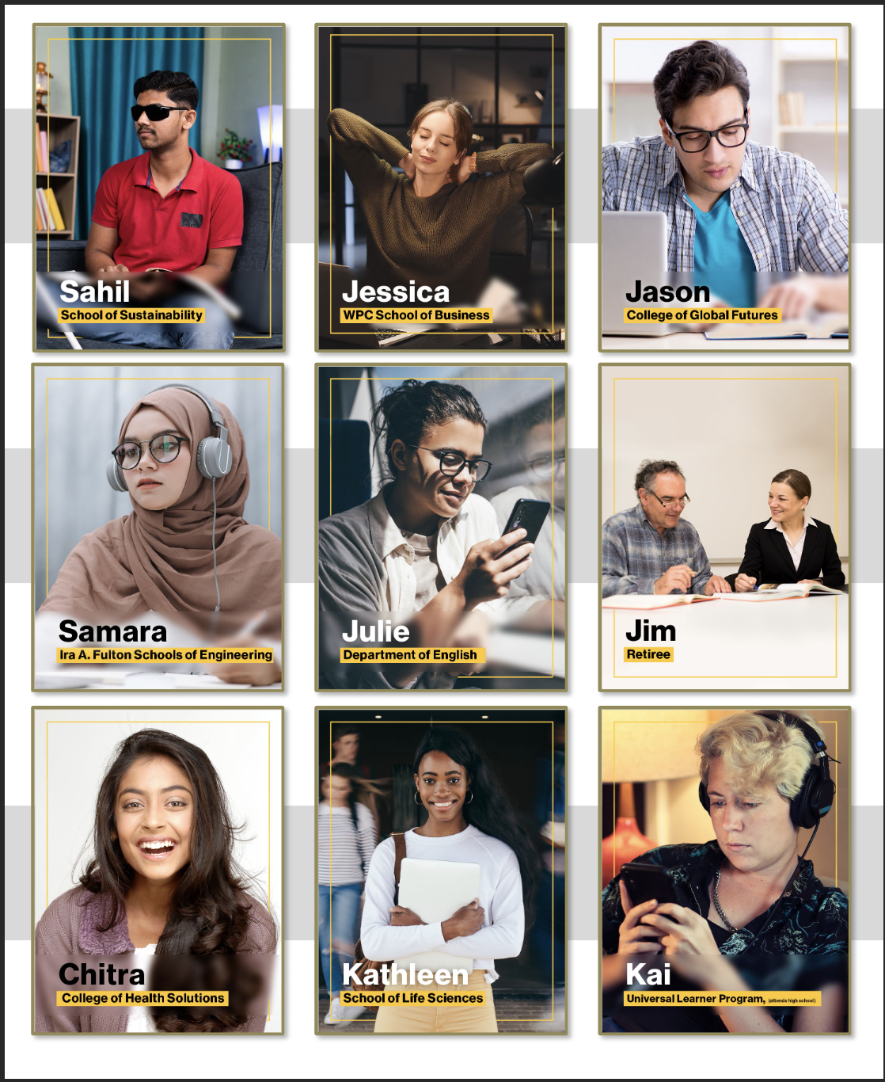
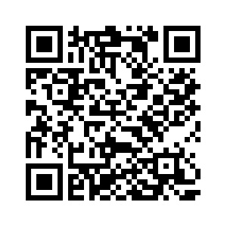
ASU Student Profiles…who We serve and how They succeed!
Scan or visit the Student Profiles Page for a more accessible and interactive version.
Notes:
https://asuonline-dev.asu.edu/accessible-course-creator/story.html
Created the personas based on demographics and research about the students and learners from all areas of the university

Slide 18

A Message from ASU President Michael Crow

Slide 19
What we think matters!

Slide 20
Tips and Tricks
On accessibility and badging in Canvas.
Notes:
Michael

Slide 21
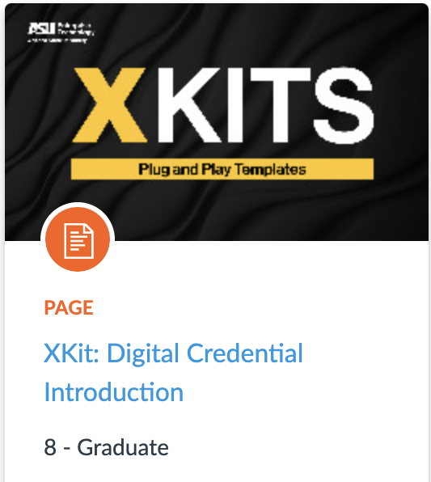
ASU Digital Credential XKit
In the Canvas Commons, available to all.
Explains digital credentials
Why they are valuable
How to get assistance

Slide 22
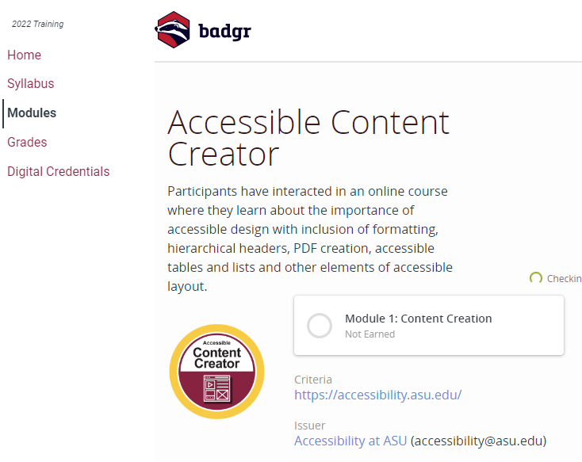
Badging Tips and Tricks
Auto-award badges:
Best for auto-graded assignments
Set a module requirement
Add “Canvas Credentials” external tool to the module
Manually award badges:
Best for manually-graded assignments
Push badges by “Export to CSV” within Canvas
Canvas Badges claim codes:
Best for completing a survey
Copy claim code from Canvas Badges website
Notes:
Add a claim code at the end of the module if you do not intend to use a requirement to indicate an auto award.
https://community.canvaslms.com/t5/Canvas-Badges/Managing-Canvas-Badges-Credentials-in-a-Canvas-course-as-a/ta-p/528733
Survey mechanism and feedback prompting additional formative learning.

Slide 23
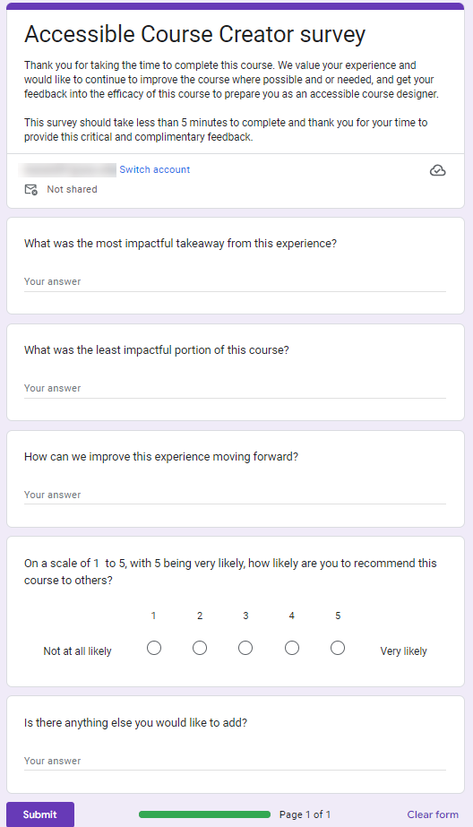
Feedback
Based on feedback received, we have made the following changes:
Adding student profiles to assessments
Reducing amount of text on pages
Reorganization of content, so that information is not repetitive.
We will continue to update this course based on future feedback.
Notes:
We ask for feedback from the people taking the course to improve it. We have used the feedback to make these changes:

Slide 24
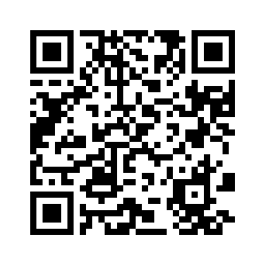
Accessible Course Creator Pathway
Scan to read more @ Canvas Badges site

